Slide 1
Periods of American Art

Slide 2
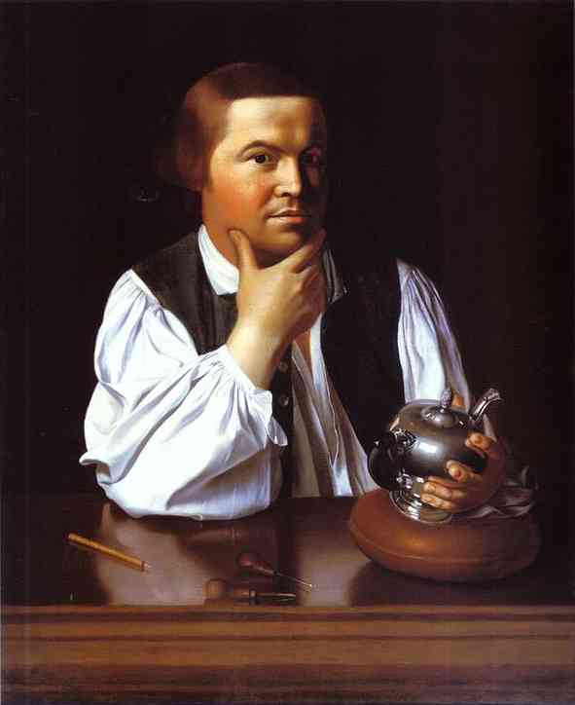
Paul Revere John Singleton Copley, 1768
Notes:
Paul Revere is Copley’s only finished portrait of an artisan dressed in shirtsleeves and shown at work. Revere is shown half-length, seated behind a highly polished table, and casually attired. He cradles his chin in his right hand and regards the viewer as if he has just looked up from the teapot in his left hand; the pot is finished but remains undecorated, and the engraving tools at Revere’s elbow attest to the work yet to come. When Copley painted Revere’s portrait, his sitter was an accomplished, well-established silversmith and master of the rococo style, both in engraving and in three-dimensional hollowware such as teapots [35.1775]. He completed the Sons of Liberty Bowl [49.45], now considered one of the United States’ most cherished historical treasures, the same year Copley captured his likeness.

Slide 3
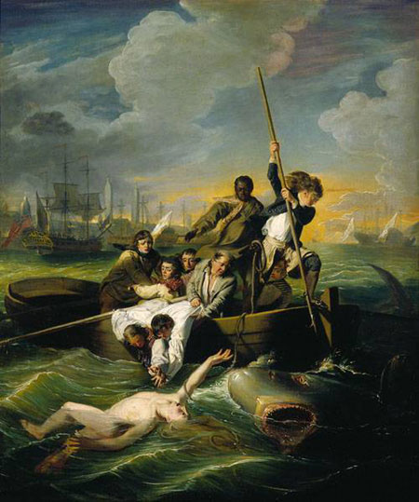
Brooke Watson Rescued from a Shark John Singleton Copley, 1778
Notes:
John Singleton Copley’s dramatic rendering of a shark attacking 14-year-old Brook Watson caused a sensation when it was exhibited at London’s Royal Academy in 1778. The pictured attack had occurred some 30 years earlier. Watson, an orphan, had unwisely decided to take a dip from a skiff while the ship on which he was crewing docked in Havana Harbor. A shark attacked him, biting his right leg and pulling him under. The boy surfaced briefly before the shark dragged him under a second time, severing his right foot. By the time Watson surfaced again, his mates had nearly reached him. Copley depicts the boy’s climactic rescue: just as the shark zeroed in for its third strike, a determined crewmate armed with a boat hook drove it away.
Copley, an American artist who moved to London amid the tensions of the Revolutionary War, here takes the pictorial representation of terror to new heights. The injured Watson’s deathly pale body rises from the depths, naked and vulnerable, with blood swirling around his leg. As the huge shark’s gaping jaws close in, Watson looks back in shock and grasps futilely for the lifeline cast by a West African crewman, whose prominent position in the picture and sympathetic rendering were extraordinary for the time. Two shipmates stretch desperately to reach the boy flailing in the turbulent waters. The faces of the wind-whipped crewmen—derived from models of emotional expression developed by 18th-century French artist Charles LeBrun—convincingly register a range of responses: contempt (the harpooner); dread (the sailor at far left); compassion (the West African); and astonishment (the older sailor).

Slide 4
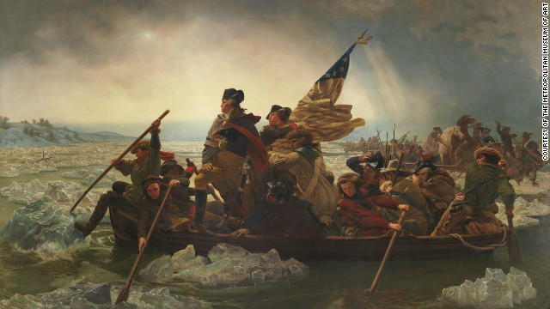
Washington Crossing the Delaware Emanuel Gottlieb Leutze, 1851
Notes:
First a Germanartist painted it in response to German politics. Emanuel Leutze, born in Germany in 1816, moved to America as a child, but returned to Germany to study art in 1840. With a strong belief in liberal democracy, he painted this American Revolution scene to inspire German reformers. When his first painting of Washington’s crossing became popular in Europe, he shipped this second huge version to the United States in 1851. It became an instant success with more than fifty thousand people coming to see it. Today it is owned by the Metropolitan Museum of Art.
But is it accurate? Is this really how it happened? Yes, and no. Leutze got the spirit of ’76 right and that was his main purpose. He created an inspirational vision of brave and upright men from a variety of backgrounds standing up and fighting together against incredible odds for the common cause of liberty. However, the details of the scene are more symbolic than accurate. Leutze exercised his artistic license to create a powerful composition.
The Boat
The boat in the painting is much smaller than the Durham boats that Washington had requested to ferry his army back and forth across the Delaware. If he had stood in a boat this small, he probably would have tipped it over. Leutze made it small to emphasize the almost life-size figures. The boat represents the revolutionary cause, carrying and uniting the men towards a common goal of liberty.
The Hero
George Washington, the commanding general, seems much older in this painting than others of him that were painted from life not too long after the Revolution. (See Charles Wilson Peale’s portrait of Washington at Princeton.) Wearing his Continental army uniform, tricorne hat, boots, and a red-lined cape, he holds a brass telescope symbolizing his visionary leadership. His prominent saber suggests that he is a powerful warrior. Standing on one leg, he is one of the few objects in the painting that is not moving. He looks forward to the New Jersey shore and the upcoming battle. (There is a useful discussion of his strategy on the eve of the battle in section three “George Washington as Military Leader” from the PBS website Rediscovering George Washington.)
The Men
Twelve diverse, determined soldiers, including Washington, crowd the main boat. They wear clothing distinctive to their region. In addition to Washington, another Virginian and future president, who may represent Lieutenant James Monroe holds the flag. Western frontiersmen guide the boat, a man wearing a Scotch hat rows. Is he a recent immigrant? An African American man rows on the far side. He could represent one of the Massachusetts seamen who played an important role in ferrying the army back and forth across the river. Leutze was an ardent abolitionist. See the EDSITEment lesson plan African-American Communities in the North Before the Civil War.
A hatless figure in a man’s red shirt is rowing. There were women on Washington’s ration list and some historians guess that this figure could be a woman. Farmers huddle in blankets and broad-brimmed hats. One holds a double-barreled rifle. By this time in the war, many of Washington’s army no longer had shoes and wrapped their bleeding, freezing feet in rags. Leutze dressed models in colonial clothing to pose for his painting. See the EDSITEment unit and lesson plans The American War for Independence.
The Flag
The flapping flag in the painting features a circle of stars on a blue field and red and white stripes. It represents the unity of the states, but was not designed until 1777, after this event. On the night of the crossing each unit carried their own distinctive flag or that of their state. See the EDSITEment lesson plan Stars and Stripes Forever: Flag Facts for Flag Day.
The River
As the temperature dropped on Christmas Day, ice was forming in the swollen Delaware River. Washington decided to cross the river in a blinding snow storm because he feared that once the river froze, the Hessians would easily move their heavy artillery, horses, and army over the ice to attack Philadelphia. Leutze modeled the river in the painting after Germany’s Rhine River. Ice on this section of the Delaware River usually forms in large flat sheets, not chunks pictured in the painting. Washington had divided his army into several groups with each to cross the river at a different place, but due to river and weather conditions only Washington’s contingent made it across the river that night. Although a few fell overboard, they all survived the crossing.

Slide 5
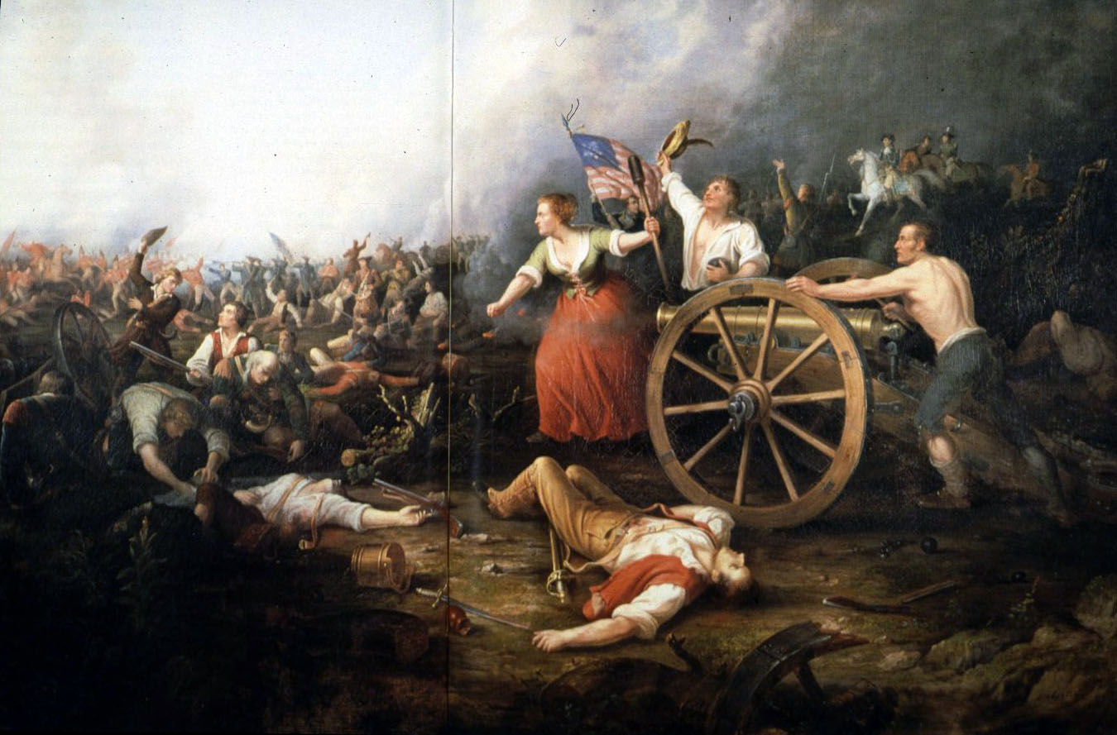
(Molly Ludwig)Molly Pitcher at the Battle of Monmouth c. 1875 - Dennis Malone Carter

Slide 6
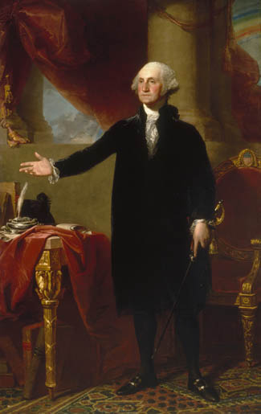
George Washington – The Lansdowne Portrait 1796 - Gilbert Stuart
Notes:
http://www.georgewashington.si.edu/portrait/

Slide 7
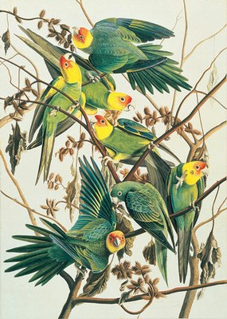
Carolina Parakeet John James Audubon, 1825
Notes:
A man of his times, he reflected the surging interest in moving science out of the realm of theological debate, as it endeavored to create taxonomic models for newly-discovered creatures in a rapidly-expanding natural world. With one foot in the arts and the other in the natural sciences, Audubon defies ready characterization. With his eye very much affixed to his future place in history, his gifts as poet, writer and documentarian, he strived to actively engage his audiences in the drama and inherent beauty to be found in the birds he so actively observed, researched and documented with his brilliant, dynamic images.
Those who follow Audubon’s work are fully aware of the fact that he was not principally a field artist, but shot and arranged his material in the studio; but the reality is brought home in dramatic ways was the exhibition illustrates the process in its nascent phase. The New York Historical Society’s show, by Roberta J. M. Olson, curator of drawings at the historical society, and main author of the comprehensive exhibition catalog, is to be presented in its entirety over the next two years. Through a careful interpretation of the wealth of material available from their permanent collection and a handful of materials on loan she reveals, in Audubon, a devoté of nature and art. Over the course of his career he evolves—together with his subject matter—as though the survivalist nature and combativeness of the birds were a reflection of Audubon’s own relentless determination and—by extension—that of the emerging, rough-hewn American character, itself.artes fine arts

Slide 8
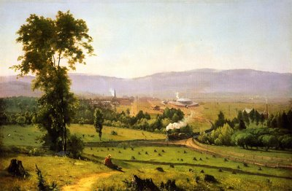
The Lackawanna Valley George Inness, 1855
Hudson River School
Notes:
Rather than celebrating nature in the tradition of the Hudson River School, George Inness' Lackawanna Valley seems to commemorate the onset of America's industrial age. While documenting the achievements of the Delaware, Lackawanna, and Western Railroad, Inness has also created a topographically convincing view of Scranton, Pennsylvania. The artist took relatively few liberties with his composition, but in compliance with the wishes of his corporate patron, he intentionally exaggerated the prominence of the railroad's yet-to-be-completed roundhouse. His inclusion of numerous tree stumps in the picture's foreground, although accurate, lends an important note of ambiguity to the work.
Whether it is read as an enthusiastic affirmation of technology or as a belated lament for a rapidly vanishing wilderness, this painting exemplifies a crucial philosophical dilemma that confronted many Americans in the 1850s; expansion inevitably necessitated the widespread destruction of unspoiled nature, itself a still-powerful symbol of the nation's greatness. Although it was initially commissioned as an homage to the machine, Inness' Lackawanna Valley nevertheless serves as a poignant pictorial reminder of the ephemeral nature of the American Dream.

Slide 9
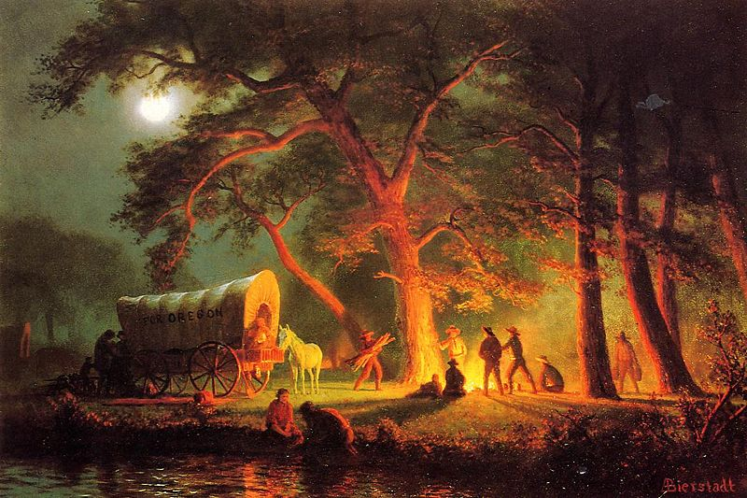
The Oregon Trail Albert Bierstadt, 1869
Notes:
Redefined by territorial expansion in the mid-1800s, the boundary of the American West shifted from the Mississippi River to the Pacific Ocean, fueled largely by exploration and emigration along the Oregon Trail, among others. Over the course of fifty years, almost 400,000 people traveled the 2,170-mile route, leaving their farms along the East Coast in hopes of securing fertile land in the Oregon Territory. American artist Albert Bierstadt documented his journey on the trail, capturing the dramatic panoramas and indomitable spirit of the emigrants on his oversized canvases. With their rich colors and pristine details, these romanticized images roused an already fascinated American public to begin their own westward adventure.

Slide 10
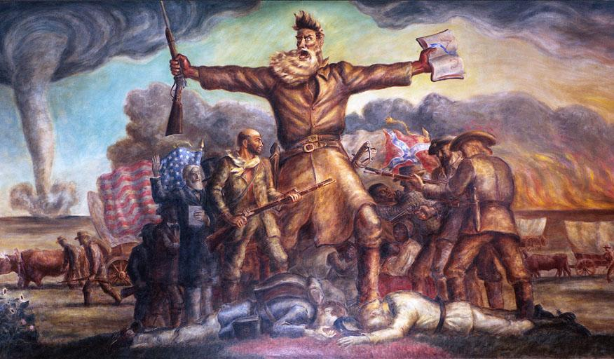
Tragic Prelude John Steuart Curry, 1937
Notes:
Curry’s interpretation of John Brown and the antislavery movement in Kansas Territory before the Civil War, is considered one of his best murals. Rich in symbolism, the painting depicts John Brown as an important, albeit fanatic man who would kill for his beliefs. In 1859 Brown was hanged for treason after leading a raid on the federal arsenal at Harpers Ferry, Virginia.
The tornado and prairie fires represent the storms of war that gathered and the fires of war that swept the land. The men on either side of Brown symbolize the brother against brother conflict of the Civil War. The two dead men at his feet represent the more than one million soldiers and civilians who were either killed or wounded during the war. Curry’s critics disliked his color scheme and the overall menacing effect of the mural.
In 1937, a group of prominent Kansas newspaper owners and businessmen began a campaign to bring nationally recognized artist John Steuart Curry back to his home state to paint murals that would cover the walls of the statehouse. The group included Jack Harris of the Hutchinson News as well as William Allen White from the Emporia Gazette. Curry accepted the invitation based on the terms that he could have full control of the creation of the murals, with no outside influence or attempts at changing the themes he presented. Curry believed he could fully represent the characterization of the state, as he grew up in a small town in northeast Kansas called Dunavant. Even before the controversy that ensued after he painted the murals for the statehouse, Curry had a large group of dissenting critics in his home state. Many citizens and officials from Kansas believed Curry’s previous works on the state focused on the negative aspects, namely the bad weather (tornadoes) and religious fanatics.
When Curry finished his first three murals for the statehouse, members of the Kansas legislature passed a measure to keep them from being hung on the walls. The controversy was all based on his depiction of Civil War Kansas and John Brown in “Tragic Prelude.” Critics of the mural were concerned about multiple things including: the blood on Brown’s hands could signify the murderous traitor some thought Brown to be, the tornado in the background and prairie fire showed Kansas to be a dangerous, inclement place and the Bible would add to the sentiment that Kansas was home to religious fanatics. Curry contended that the blood on Brown’s hands signified the violence of the Border War and the Civil War while the Bible signified Brown’s Calvinist, religious background. The tornado and prairie fire simply illustrated the damage that happened to Kansas during the Civil War battles. Curry left the murals unsigned and left Topeka in anger and the murals were not on the walls of the statehouse when he died in 1942. Today, “Tragic Prelude” hangs in the Kansas statehouse and is an important aspect of Kansas history as well as the most important piece John Steuart Curry completed in his artistic career. The mural of John Brown has been featured in multiple articles and documentaries on John Brown as well as Bleeding Kansas. University of Kansas fans definitely recognize the significance of “Tragic Prelude,” as poster recreations and t-shirts are made every year for the annual Border War with the University of Missouri.

Slide 11
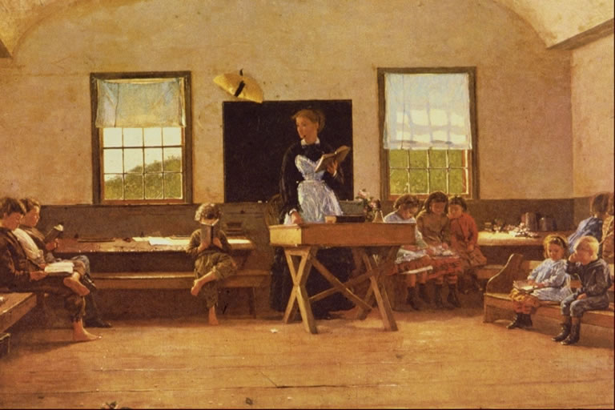
The Country School Winslow Homer, 1871
Notes:
Winslow Homer painted this scene of a country school in 1871, nearly two decades after Massachusetts became the first state to pass a compulsory education law in the United States. As was the custom, boys sat on one side of the room, girls on the other. The one exception is the boy and girl to the teacher's left, no doubt brother and sister. Siblings were allowed to sit together so they could share the same books -- probably McGuffey Readers.
Massachusetts had long demanded that parents educate their children before that first compulsory education law passed in 1852. The Puritans who ran the Massachusetts Bay Colony in 1642 required parents to educate their children in reading, writing and a trade, as well as an understanding of the principles of religion. Other New England colonies passed similar laws between then and 1671. Southern colonies didn’t adopt such requirements until 1705.

Slide 12
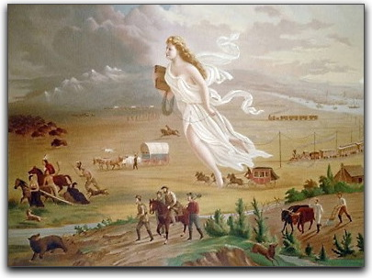
American Progress John Gast, 1872
Notes:
JOHN GAST'S "AMERICAN PROGRESS" (1872)
IN JOHN GAST'S "AMERICAN PROGRESS," (1872) A DIAPHANOUSLY AND
PRECARIOUS CLAD AMERICA FLOATS WESTWARD THRU THE AIR WITH THE
"STAR OF EMPIRE" ON HER FOREHEAD. SHE HAS LEFT THE CITIES OF THE
EAST BEHIND, AND THE WIDE MISSISSIPPI, AND STILL HER COURSE IS
WESTWARD. IN HER RIGHT HAND SHE CARRIES A SCHOOL BOOK--
TESTIMONIAL OF THE NATIONAL ENLIGHTENMENT, WHILE WITH HER LEFT
SHE TRAILS THE SLENDER WIRES OF THE TELEGRAPH THAT WILL BIND THE
NATION. FLEEING HER APPROACH ARE INDIANS, BUFFALO, WILD HORSES,
BEARS, AND OTHER GAME, DISAPPEARING INTO THE STORM AND WAVES OF
THE PACIFIC COAST. THEY FLEE THE WONDEROUS VISION--THE STAR "IS
TOO MUCH FOR THEM."--PRECIS OF A CONTEMPORARY DESCRIPTION OF THIS
PAINTING BY GEORGE CROFUTT WHO DISTRIBUTRED HIS ENGRAVING OF IT
WIDELY.

Slide 13
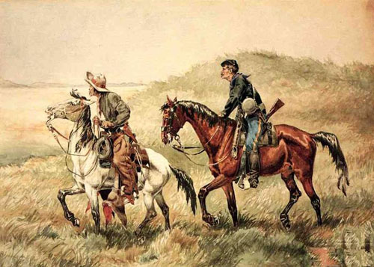
The Couriers Frederic Remington, 1886
Notes:
Frederic Remington (1861-1909) is best known for his art depicting the cowboys, soldiers and Native Americans of the Old West. A native of Canton, New York, Remington found inspiration in these subjects from an early age.
His career took off in the mid-1880s when he began making western illustrations for Harper's Weekly and many other widely read New York magazines. Remington's pictures brought visual information to the eastern public accompanying both factual accounts and fiction of the Old West. He was praised and trusted for the accuracy of detail in his work. Many people assumed, and still assume, that he was a westerner, if not, in fact, a soldier or a cowboy himself. In truth, he was an easterner who was as fascinated by the subjects he depicted as his audience was.
Frederic Remington traveled west repeatedly. He loved the idea of the frontier and greatly admired the rough and heroic cowboys and soldiers he met there. He enjoyed meeting them, hearing their stories and following their lives in his visits as a journalist/illustrator. Among other things, he admired them for seeming undaunted by the many elements of frontier life that Remington himself could barely tolerate - poor and scarce "grub," long rides in the saddle, and extended periods between baths.

Slide 14
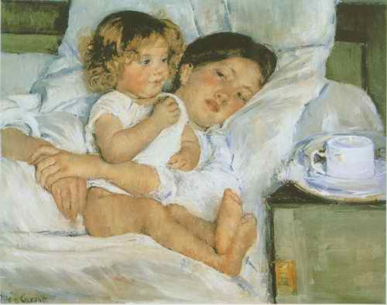
Breakfast in Bed Mary Cassatt, 1897
Notes:
Born in Pennsylvania, Mary Cassatt attended the Pennsylvania Academy of the Fine Arts before going to Europe for further study. In 1873, she settled in Paris where she was to remain the rest of her life.
A close friend of Edgar Degas, Cassatt became part of the French avant garde and embraced the tenets of Impressionism. With its broken brush strokes and bright colors, Breakfast in Bed reflects the artist's aesthetic ties.
The subject of a woman and child is a recurring theme in her work and this particular example is an especially telling treatment of the subject. With the child centrally placed in an upright pose, Cassatt depicts a quiet but charged moment in which a mother embraces her daughter, whose attention is elsewhere. Contrasting the mother's protective action and gaze with her offspring's curiosity with the world beyond her reach, Cassatt evokes the subtle tensions implicit in the relationship of parent to child.

Slide 15
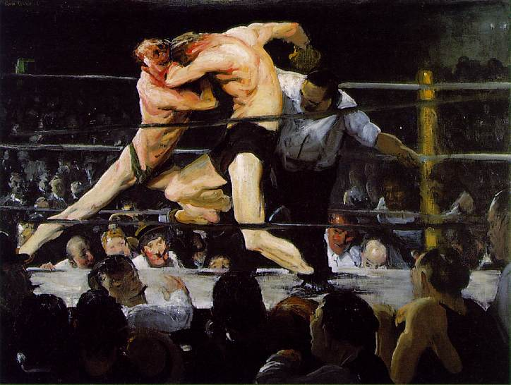
Stag at Sharkey’s George Wesley Bellows, 1909
Ash Can School
Notes:
The greatest period of activity and influence for the American artists known as the Ashcan School was prior to World War I. The name, taken from the ever-present urban image of the garbage can, wasn't actually coined until the 1930s. The Ashcan School first came to the public's attention as The Eight, but was soon after known by the more colorful moniker "Apostles of Ugliness."
George Bellows, the semipro baseball player-turned-artist responsible for the enduring Stag at Sharkey's, was a disciple of the Philadelphia-born artist Robert Henri (pronounced "hen-rye"). Henri, educated in art in Paris and America, led a movement that rejected French Impressionism and American painting that glorified the American West. Henri and The Eight, a group which included John Sloan and George Luks (Bellows joined the group later) sought realism in art, finding their muse and their home in New York City. At the turn of the century, the reality of urban slums became a more compelling subject for artists than the open prairie or grand Western landscape. Coming about 10 years after such writers as Mark Twain and William Dean Howells had embraced realism in literature, Henri's circle produced paintings that were dark, dirty, and reflective of life in a changing America.
Despite a short career -- he died at 43 -- Bellows was one of Ashcan's stars. Stag at Sharkey's embodies the grittiness, violence, and masculinity of the new city. In 1909, when Bellows completed this painting, prizefighting was illegal in New York. Athletic clubs such as Sharkey's were the equivalent of Prohibition's speakeasies -- illegal, but they did a booming business. In Bellows's boxing match, the spectators are vulgar; their expressions indicate that they are at least as violent as the match they are watching. But the boxers themselves are reminiscent of stags in nature, still graceful while locked in combat.
Stag at Sharkey's has been part of the Cleveland Museum of Art's permanent collection since 1922, three years before Bellows's death.

Slide 16
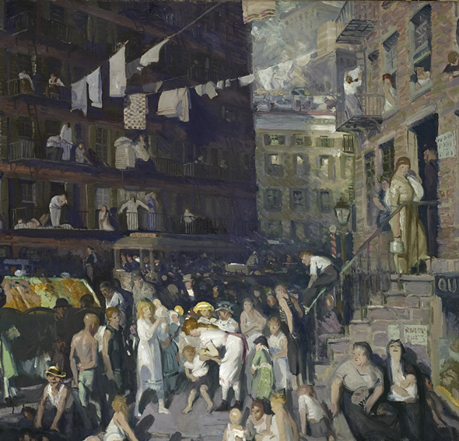
Cliff Dwellers George Wesley Bellows, 1913
Ash Can School
Notes:
A large part of the work’s attraction to students of American history has been the fact that it appears to stand out among Ash Can school paintings as a statement of strong social criticism. This interpretation has been derived not so much from the appearance of the canvas as from the fact that it is very similar to the drawing Why Don’t They Go to the Country for a Vacation? (1913, LACMA), executed by Bellows for the socialist journal The Masses and published as the frontispiece of its issue of August 1913.
Almost all the Ash Can school artists who contributed to The Masses stopped short of creating outright political statements. For the most part, they simply considered themselves to be realist artists, producing vignettes of urban life that fit with the journal’s alert, down-to-earth editorial tone. Their consciously artistic, realist drawings of indulgent social satire are distinctly different from the bald editorial cartooning that also appeared in The Masses. Their paintings were yet further removed from the editorial tone of the magazine. John Sloan, for instance, who occasionally contributed scathing editorial cartoons to The Masses, did not express any sense of social criticism in his paintings, which portray the energy and simple pleasures of the poor.

Slide 17
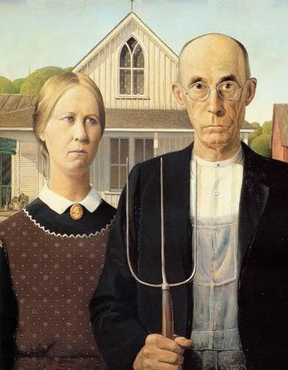
American Gothic Grant Wood, 1930
Notes:
This familiar image was exhibited publicly for the first time at the Art Institute of Chicago, winning a three-hundred-dollar prize and instant fame for Grant Wood. The impetus for the painting came while Wood was visiting the small town of Eldon in his native Iowa. There he spotted a little wood farmhouse, with a single oversized window, made in a style called Carpenter Gothic. “I imagined American Gothic people with their faces stretched out long to go with this American Gothic house,” he said. He used his sister and his dentist as models for a farmer and his daughter, dressing them as if they were “tintypes from my old family album.” The highly detailed, polished style and the rigid frontality of the two figures were inspired by Flemish Renaissance art, which Wood studied during his travels to Europe between 1920 and 1926. After returning to settle in Iowa, he became increasingly appreciative of midwestern traditions and culture, which he celebrated in works such as this. American Gothic, often understood as a satirical comment on the midwestern character, quickly became one of America’s most famous paintings and is now firmly entrenched in the nation’s popular culture. Yet Wood intended it to be a positive statement about rural American values, an image of reassurance at a time of great dislocation and disillusionment. The man and woman, in their solid and well-crafted world, with all their strengths and weaknesses, represent survivors.
— Entry, Essential Guide, 2013, p. 56.

Slide 18
Four Freedoms Norman Rockwell, 1943
Notes:
In his January 1941 address to Congress, President Franklin Delano Roosevelt articulated his vision for a postwar world founded on four basic human freedoms: freedom of speech, freedom of religion, freedom from want, and freedom from fear. While mulling it over, Rockwell, by chance, attended a town meeting where one man rose among his neighbors and voiced an unpopular view. That night Rockwell awoke with the realization that he could paint the freedoms best from the perspective of his own hometown experiences using everyday, simple scenes such as his own town meeting. Rockwell made some rough sketches and, accompanied by fellow Post cover artist Mead Schaeffer, went to Washington to propose his poster idea.The timing was wrong. The Ordnance Department didn’t have the resources for another commission. On his way back to Vermont, Rockwell stopped at Curtis Publishing Company, publisher of The Saturday Evening Post, and showed his sketches to editor Ben Hibbs. Hibbs immediately made plans to use the illustrations in the Post.

Slide 19
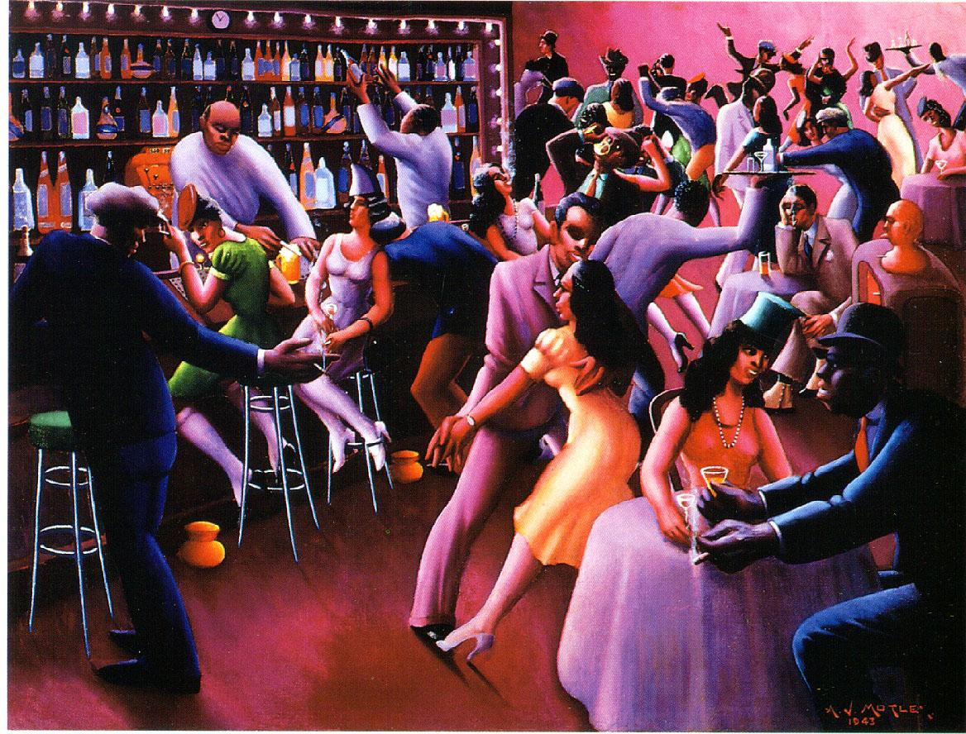
Nightlife Archibald J. Motley, Jr., 1943
Harlem Renaissance
Notes:
Archibald J. Motley Jr. often depicted contemporary black nightlife in the city. His focus was Chicago’s Bronzeville neighborhood. Also known as the Black Belt, this area became home to more than 90 percent of the city’s black population by the 1930s.
Nightlife, one of Motley’s most celebrated paintings, takes viewers inside one of Bronzeville’s many nightspots. Although the artist painted the picture during World War II (1939–45), his figures seem to have left the world’s troubles behind. Inside the club, there is nothing but exuberant, upbeat energy.
The dancers’ pulsing, jumping movements are suggestive of jazz. Motley conveyed the sound and motion of jazz through composition and color. He outlined the figures with simplified, geometric shapes and emphasized diagonal lines, creating a sense of lively motion. Fascinated with natural and artificial light, Motley chose glowing violet-red tones. The subject ofNightlife gave the artist the opportunity to present, in his own words, "an expression of the numerous shades and colors which exist in such great variety" among African Americans in Chicago.

Slide 20
Number One Jackson Pollock, 1948
Notes:
Jackson Pollock’s mural-size “drip” paintings met with mixed reactions when they debuted at the Betty Parsons Gallery in New York City in 1948. Sales were dismal, and critical reviews offered skepticism or mild appreciation. Yet only one year later, a Life magazine article featured Pollock, arms crossed and cigarette dangling from his lips, standing in front of one of his swirled, caffeinated images. The caption under the photograph asked, “Is he the greatest living painter in the United States?”
Pollock’s move from dark horse to darling of the art world came out of various concurrences: the powerful art critic Clement Greenberg’s insistence that Pollock’s work represented a new, authentic American art; a shift in the art world; and Pollock’s success, achieved over a period of years, at making gesture, line, texture, and composition the very subject of his canvases.
Pollock’s method was based on his earlier experiments with dripping and splattering paint on ceramic, glass, and canvas on an easel. Now, he laid a large canvas on the floor of his studio barn, nearly covering the space. Using house paint, he dripped, poured, and flung pigment from loaded brushes and sticks while walking around it. He said that this was his way of being “in” his work, acting as a medium in the creative process. For Pollock, who admired the sand painting of the American Indians, summoning webs of color to his canvases and making them balanced, complete, and lyrical, was almost an act of ritual. Like an ancient cave painter, he “signed” Lavender Mist in the upper left corner and at the top of the canvas with his handprints.

Slide 21
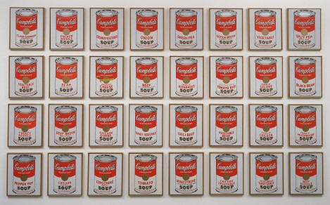
Campbell’s Soup Cans
Andy Warhol, 1962
Notes:
When Warhol first exhibited these Campbell’s Soup Cans in 1962, they were displayed together on shelves, like products in a grocery aisle. At the time, the Campbell’s Soup Company sold 32 soup varieties; each canvas corresponds to a different flavor. Warhol did not indicate how the canvases should be installed. At MoMA, they are arranged in rows that reflect the chronological order in which the soups were introduced. The first flavor introduced by the company was tomato, in 1897.
Though Campbell’s Soup Cans resembles the mass-produced, printed advertisements by which Warhol was inspired, it is hand-painted, while the fleur de lys pattern ringing each can’s bottom edge is hand-stamped. In this work, he mimicked the repetition and uniformity of advertising by carefully reproducing the same image across each individual canvas. He varied only the label on the front of each can, distinguishing them by their variety. Warhol said of Campbell’s Soup, “I used to drink it. I used to have the same lunch every day, for 20 years, I guess, the same thing over and over again.”
Towards the end of 1962, shortly after he completed Campbell’s Soup Cans, Warhol turned to the photo-silkscreen process. A printmaking technique originally invented for commercial use, it would become his signature medium and link his art making methods more closely to those of advertisements.

Slide 22
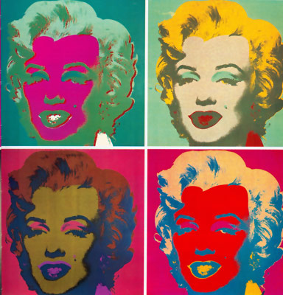
Marilyn Monroe Andy Warhol, 1962
Notes:
Multiplying Marilyn
Soon after her tragic death in 1962, Warhol made a series of paintings paying tribute to Marilyn Monroe, the film star and sex symbol who had captured America’s imagination in films like Gentlemen Prefer Blondes and How to Marry a Millionaire. Warhol based this portrait on a publicity still from the 1953 film Niagara. He painted the background gold before silkscreening the boldly colored face in the center, adding black to show her features. Even as Warhol canonizes Monroe, he reveals her public persona as a carefully structured illusion.
Warhol took Marilyn Monroe as his subject in different mediums, silkscreening the actress’s image multiple times in a grid in bright colors and in black and white. By repeating Monroe’s image (and that of other celebrities) over and over again, Warhol acknowledged his own fascination with a society in which personas could be manufactured, commodified, and consumed like products.

Slide 23
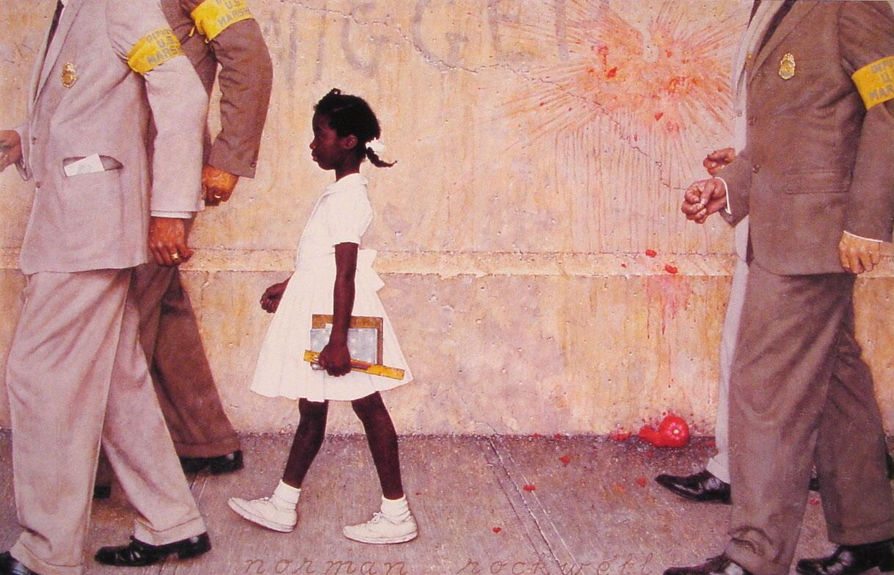
The Problem We All Live With [Ruby Bridges]
Norman Rockwell, 1963
Notes:
Ruby Bridges’ historic walk took place six years after the 1954 United States Supreme Court Brown v. Board of Education ruling declared that state laws establishing separate public schools for black and white students were unconstitutional, and represented a definite victory for the American Civil Rights Movement. Among those Americans to take note of the event was artist Norman Rockwell, a longtime supporter of the goals of equality and tolerance. In his early career, editorial policies governed the placement of minorities in his illustrations (restricting them to service industry positions only), however in 1963 Rockwell confronted the issue of prejudice head-on with one of his most powerful paintings–“The Problem We All Live With.” Inspired by the story of Ruby Bridges and school integration, the image featured a young African-American girl being escorted to school amidst signs of protest and fearful ignorance. The painting ushered in a new era in Rockwell’s career, and remains an important national symbol of the struggle for racial equality.

