Slide 1
Antebellum Reform
Second Great Awakening
Social Reform
Abolition
Women’s Rights

Slide 2
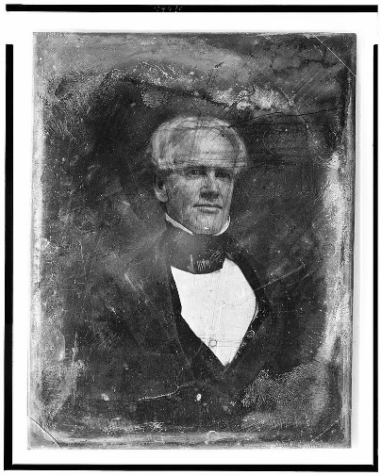
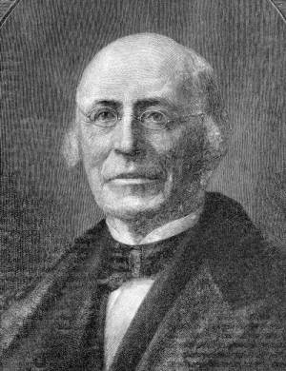
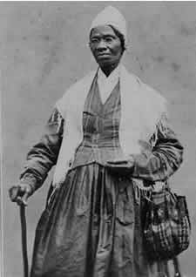
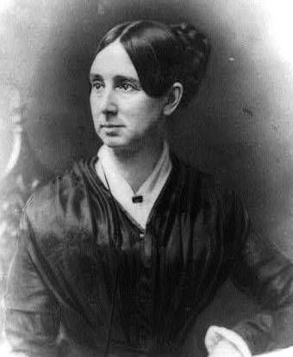
Key Concepts
Key Concept 4.1.III. Increasing numbers of Americans, many inspired by new religious and intellectual movements, worked primarily outside of government institutions to advance their ideals.
Horace Mann
Wm. Lloyd Garrison
Sojourner Truth
Dorothea Dix

Slide 3
Key Concepts
A) Americans formed new voluntary organizations that aimed to change individual behaviors and improve society through temperance and other reform efforts.
B) Abolitionist and antislavery movements gradually achieved emancipation in the North, contributing to the growth of the free African American population, even as many state governments restricted African Americans’ rights. Antislavery efforts in the South were largely limited to unsuccessful slave rebellions.
C) A women’s rights movement sought to create greater equality and opportunities for women, expressing its ideals at the Seneca Falls Convention.

Slide 4
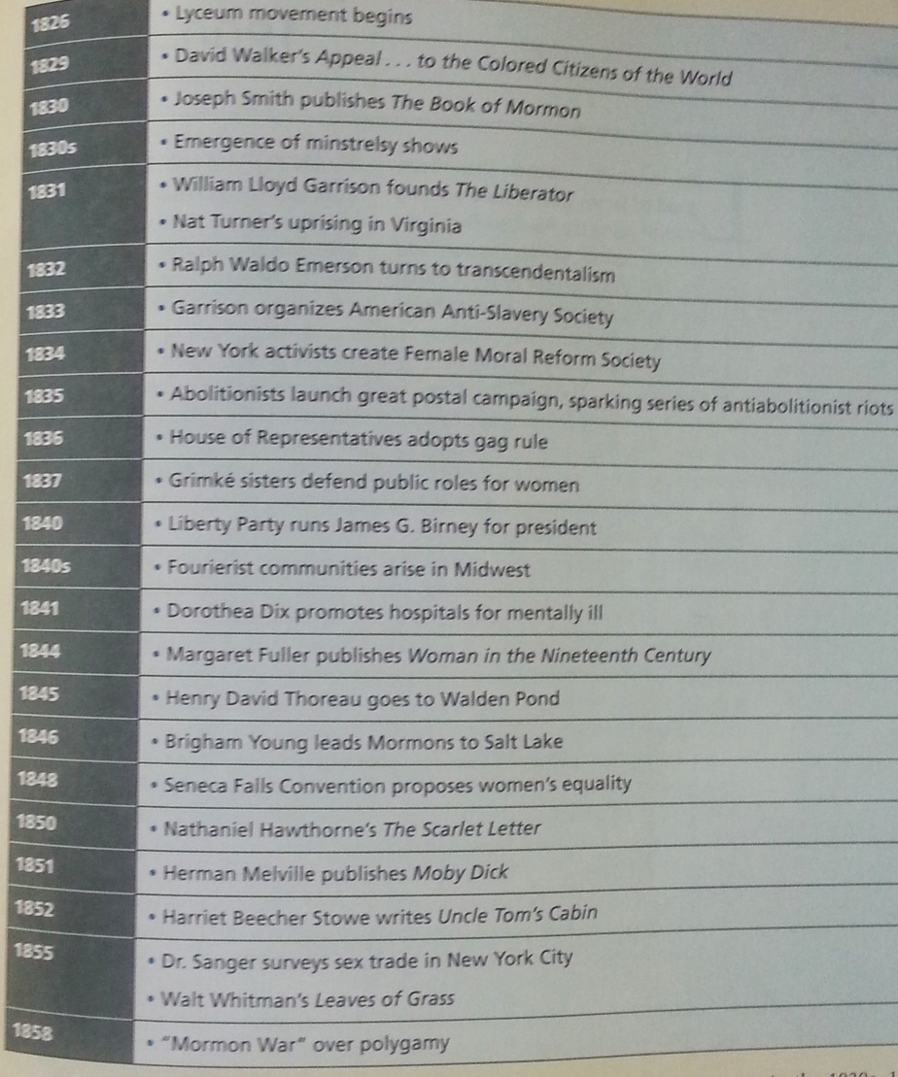
Antebellum Period
1815-1860
From end of War of 1812
Solidified independence from Britain
Increased sense of nationhood
To onset of Civil War

Slide 5
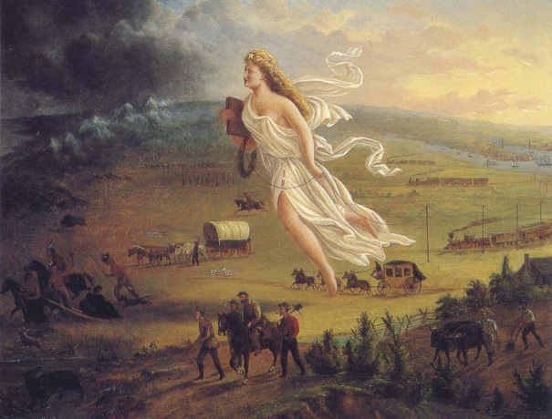
Antebellum Period Issues
Manifest Destiny—westward expansion
Indian Removal
Mexican-American War
Sectionalism
Democracy defined
Rise and fall of Political Parties
Universal white male suffrage
Federal-State balance of power
Tariffs
Nullification
Slavery

Slide 7
Antebellum Period Changes
Industrialism
Textile Technology—Samuel Slater, Francis Cabot Lowell
Tariffs to compete with British manufacturers
Lowell System—cheap female labor
Transportation Improvements
Canals
Railroads
National Road
American System
Economic Expansion
Panics of 1819, 1837, 1857
Emergence of distinct middle class

Slide 8
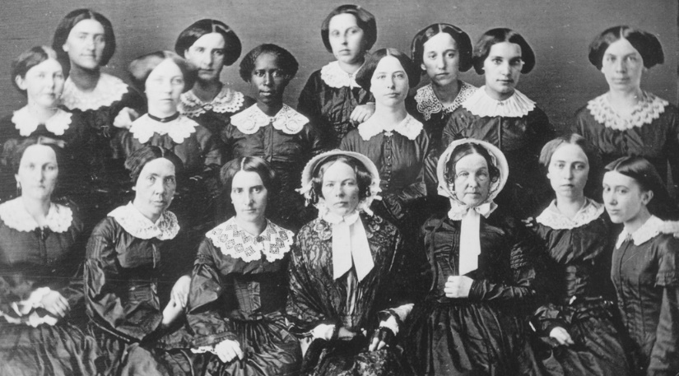
Antebellum Social and Cultural Changes
Immigration
Irish, German
Transcendentalism
R.W. Emerson, Thoreau
Walt Whitman
Second Great Awakening
Methodists, Baptists
African Methodist Episcopals (AME)
Burned-Over District (NY)
Mormons
Utopian Communities
Oneida, Fourier,
The Oberlin Female Reform Society, 1835-1857

Slide 9
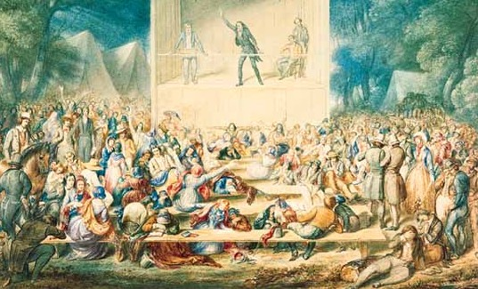
Second Great Awakening
Widespread religious change
Reduced authority of clergy
Revival meetings
Evangelism
Belief that individuals are responsible for their own morality and improving that of others in their communities
“Religion is the work of man. It is something for man to do.”—Charles Grandison Finney

Slide 10
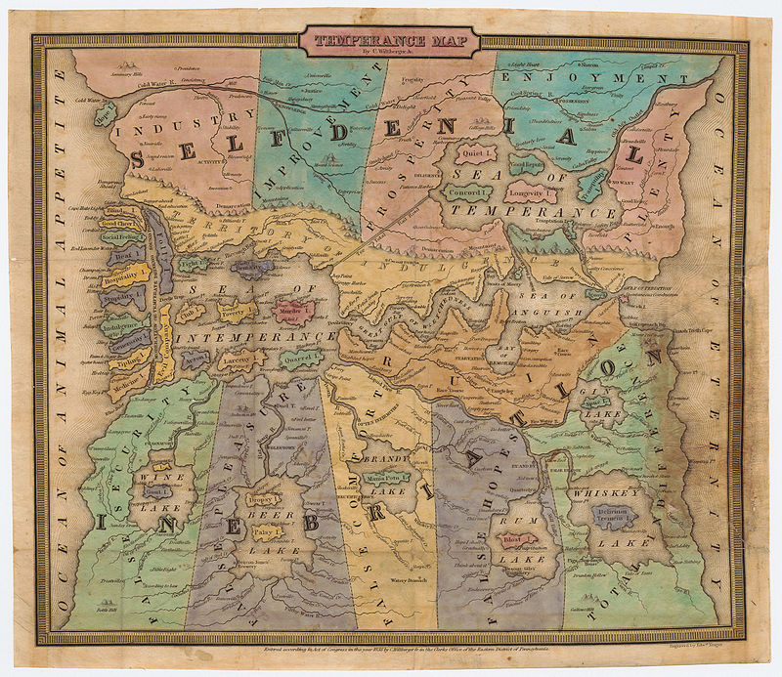
Reform Movements
Temperance
Lyman Beecher
Education
Horace Mann
Lyceum Movement
Women’s Health
Margaret Fuller
Prison/Asylum Reform
Dorothea Dix
An early allegorical map of temperance by John Jr Wiltberger, 1838.

