Slide 1
Jeopardy
Early America
Revolution/ New Nation
Expansion & Reform
Civil War/ Reconstruction
Gilded Age
Q $100
Q $100
Q $100
Q $100
Q $100
Q $200
Q $200
Q $200
Q $200
Q $200
Q $300
Q $300
Q $300
Q $300
Q $300
Q $400
Q $400
Q $400
Q $400
Q $400
Q $500
Q $500
Q $500
Q $500
Q $500
Double Jeopardy

Slide 2
$100 Question from Early America
What did Europeans bring to America that caused the most destruction for indigenous people?

Slide 3
$100 Answer from Early America
Disease

Slide 4
$200 Question from Early America
The offer of free land was a significant motivation for cavaliers who settled in which colony?

Slide 5
$200 Answer from Early America
Virginia

Slide 6
$300 Question from Early America
What Enlightenment thinker inspired American founders with the idea of natural rights?

Slide 7
$300 Answer from Early America
John Locke

Slide 8
$400 Question from Early America
The founders of Rhode Island had different views from the Massachusetts Puritans on the subject of---?

Slide 9
$400 Answer from Early America
Religious Tolerance

Slide 10
$500 Question from Early America
Which colony was established as a business venture?

Slide 11
$500 Answer from Early America
Virginia

Slide 12
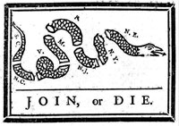
$100 Question from Revolution and New Nation
Who is the artist?

Slide 13
$100 Answer from Revolution and New Nation
Benjamin Franklin

Slide 14
$200 Question from Revolution and New Nation
During what conflict was this image created?

Slide 15
$200 Answer from Revolution and New Nation
French and Indian War

Slide 16
$300 Question from Revolution and New Nation
President can veto an act passed by Congress
Congress can override a veto by the President
Courts can declare a law unconstitutional
What idea is reflected in this list of powers?

Slide 17
$300 Answer from Revolution and New Nation
Checks and Balances

Slide 18
$400 Question from Revolution and New Nation
What document written by Thomas Jefferson directly influenced the First Amendment?

Slide 19
$400 Answer from Revolution and New Nation
Virginia Statute
for Religious Freedom

Slide 20
$500 Question from Revolution and New Nation
Opposed the Bank of the United States
Opposed the Jay Treaty with Great Britain
Favored an economy based on agriculture
Which early American political party agreed with the positions listed above?

Slide 21
$500 Answer from Revolution and New Nation
Democratic-Republicans

Slide 22
$100 Question from Expansion and Reform
Under the leadership of what Democratic president did suffrage expand for white men?

Slide 23
$100 Answer from Expansion and Reform
Andrew Jackson

Slide 24
$200 Question from Expansion and Reform
What conflict ended with the Treaty of Ghent?

Slide 25
$200 Answer from Expansion and Reform
War of 1812

Slide 26
$300 Question from Expansion and Reform
What was the US foreign policy statement that warned European powers to cease colonization efforts in the western hemisphere?

Slide 27
$300 Answer from Expansion and Reform
Monroe Doctrine

Slide 28
$400 Question from Expansion and Reform
What immigrant group was most significant in the construction of the Transcontinental Railroad?

Slide 29
$400 Answer from Expansion and Reform
Chinese

Slide 30
$500 Question from Expansion and Reform
What Native American was responsible for exploration of the Louisiana Territory with Lewis and Clark?

Slide 31
$500 Answer from Expansion and Reform
Sacagawea

Slide 32
$100 Question from Civil War and Reconstruction
“So you’re the little woman who wrote the book that made this great war!”
President Abraham Lincoln, 1862
To whom was President Lincoln speaking?

Slide 33
$100 Answer from Civil War and Reconstruction
Harriet Beecher Stowe

Slide 34
$200 Question from Civil War and Reconstruction
Why was the Battle of Fort Sumter was significant in Civil War history?

Slide 35
$200 Answer from Civil War and Reconstruction
It was the first military confrontation of the War.

Slide 36
$300 Question from Civil War and Reconstruction
What pre-Civil War document prohibited slavery in certain regions?

Slide 37
$300 Answer from Civil War and Reconstruction
Missouri Compromise

Slide 38
$400 Question from Civil War and Reconstruction
Urged southerners to reconcile and rejoin the United States
Served as President of Washington College
Who is described above?

Slide 39
$400 Answer from Civil War and Reconstruction
Robert E. Lee

Slide 40
$500 Question from Civil War and Reconstruction
1
2
3
4
Civil War Ends
Radical Republicans rise to power
Congress passes Civil Rights laws
In which section of this timeline does the assassination of President Lincoln belong?

Slide 41
$500 Answer from Civil War and Reconstruction
2

Slide 42
$100 Question from Gilded Age
Who was the Civil Rights leader who believed African Americans could earn equality by learning vocational skills?

Slide 43
$100 Answer from Gilded Age
Booker T. Washington

Slide 44
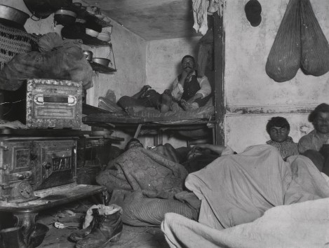
$200 Question from Gilded Age
This photograph demonstrates conditions exposed by a journalist advocating reform. What were such journalists called?

Slide 45
$200 Answer from Gilded Age
Muckrakers

Slide 46
$300 Question from Gilded Age
What 1890 law led to the 1911 breakup of the Standard Oil Company?

Slide 47
$300 Answer from Gilded Age
Sherman Antitrust Act

Slide 48
$400 Question from Gilded Age
What system was eliminated with passage of the Pendleton Civil Service Act?

Slide 49
$400 Answer from Gilded Age
Spoils System

Slide 50
$500 Question from Gilded Age
Following the Civil War, what party advocated a flexible supply of paper money to give more opportunity to the poor?

Slide 51
$500 Answer from Gilded Age
The Greenback Party

Slide 52
Double Jeopardy
Imperialism and WWI
Interwar Period
Civil Rights
Postwar Potluck
WWII
Q $200
Q $200
Q $200
Q $200
Q $200
Q $400
Q $400
Q $400
Q $400
Q $400
Q $600
Q $600
Q $600
Q $600
Q $600
Q $800
Q $800
Q $800
Q $800
Q $800
Q $1000
Q $1000
Q $1000
Q $1000
Q $1000
Final Jeopardy

Slide 53
$200 Question from Imperialism and WWI
Which president was characterized by a platform known as
“New Freedom”?
His greatest legacy was
the Fourteen Points.

Slide 54
$200 Answer from Imperialism and WWI
Woodrow Wilson

Slide 55
$400 Question from Imperialism and WWI
Which president was characterized by a foreign policy known as
“Dollar Diplomacy”?

Slide 56
$400 Answer from Imperialism and WWI
William Howard Taft

Slide 57
$600 Question from Imperialism and WWI
Besides the Zimmermann Telegram, what issue contributed most directly to the U.S. entry into World War I?

Slide 58
$600 Answer from Imperialism and WWI
Unrestricted Submarine Warfare

Slide 59
$800 Question from Imperialism and WWI
Why didn’t the United States join the League of Nations?

Slide 60
$800 Answer from Imperialism and WWI
The Senate voted against it.

Slide 61
$1000 Question from Imperialism and WWI
What 1920 amendment challenged the traditional role of women in American civic life?

Slide 62
$1000 Answer from Imperialism and WWI
19th Amendment

Slide 63
$200 Question from Interwar Period
What type of music was popularized in America in the 1920s?

Slide 64
$200 Answer from Interwar Period
Jazz

Slide 65
$400 Question from Interwar Period
Stock market crash
Excessive stock speculation
Increased availability of credit
Failure of the banking system
What is the correct order of these events?

Slide 66
$400 Answer from Interwar Period
3, 2, 1, 4
3. Increased availability of credit
2. Excessive stock speculation
1. Stock market crash
4. Failure of the banking system

Slide 67
$600 Question from Interwar Period
During the Great Migration of the early 20th century, who was migrating and where were they moving from and to?

Slide 68
$600 Answer from Interwar Period
African Americans,
from the South to Northern cities

Slide 69
$800 Question from Period
Which part of the national government controls the supply of money
in the economy?

Slide 70
$800 Answer from Interwar Period
Federal Reserve

Slide 71
$1000 Question from Interwar Period
William Jennings Bryan and
Clarence Darrow faced off
in what significant 1925 trial
focused on traditional American religious beliefs?

Slide 72
$1000 Answer from Interwar Period
Scopes trial

Slide 73
$200 Question from WWII
U.S. General who commanded the Allied Forces in the European Theater; he planned D-Day

Slide 74
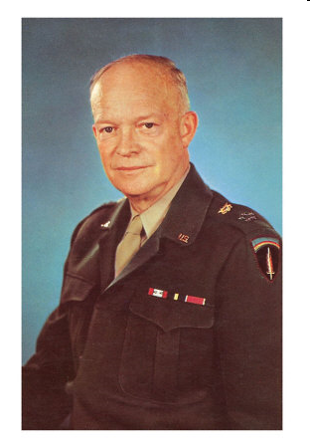
$200 Answer from WWII
Dwight D. Eisenhower

Slide 75
$400 Question from WWII
Country with whom the U.S. had the Lend-Lease Agreement; in 1940, this was the only country in Europe able to fight against Hitler

Slide 76
$400 Answer from WWII
Britain

Slide 77
$600 Question from WWII
This Pacific Battle, 6 months after Pearl Harbor, was a turning point in the war against Japan

Slide 78
$600 Answer from WWII
Battle of Midway

Slide 79
$800 Question from WWII
Aftermath of World War II
Country Occupied by the U.S. | Country Occupied by the U.S.S.R.
??? | Hungary
What country best completes the table?

Slide 80
$800 Answer from WWII
Japan

Slide 81
$1000 Question from WWII
What was the name of the regiment of the U.S. military composed of Japanese-American soldiers?

Slide 82
$1000 Answer from WWII
Nisei Regiment

Slide 83
$200 Question from Civil Rights
Registered Minority Voters
State | 1960 | 1970
Texas | 35.5% | 72.6%
Georgia | 29.3% | 57.2%
Arkansas | 38.0% | 82.3%
What president signed the legislation that made these changes possible?

Slide 84
$200 Answer from Civil Rights
Lyndon B. Johnson

Slide 85
$400 Question from Civil Rights
In what year did Martin Luther King, Jr. make his “I Have a Dream” speech?

Slide 86
$400 Answer from Civil Rights
1963

Slide 87
$600 Question from Civil Rights
Name the lawyer who represented Linda Brown in the Supreme Court case, Brown v. Board of Education.
The lawyer later became the first African-American justice on the Supreme Court.

Slide 88
$600 Answer from Civil Rights
Thurgood Marshall

Slide 89
$800 Question from Civil Rights
What was the response
in many places in Virginia,
such as Prince Edward County,
to the Supreme Court ruling that segregation of public schools was unconstitutional?

Slide 90
$800 Answer from Civil Rights
Massive Resistance

Slide 91
$1000 Question from Civil Rights
What issue was at stake in the case of Bakke v. University of California?

Slide 92
$1000 Answer from Civil Rights
Affirmative Action

Slide 93
$200 Question from Postwar Potluck
Name two of the four women who have served
on the U.S. Supreme Court.

Slide 94
$200 Answer from Postwar Potluck
Sandra Day O’Connor
Ruth Bader Ginsburg
Sonia Sotamayor
Elena Kagan

Slide 95
$400 Question from Postwar Potluck
NAFTA
Normalization of relations with Vietnam
NATO action in the former Yugoslavia
Lifted sanctions against South Africa when apartheid ended there.
Advocated universal health care (unsuccessfully)
Name the president.

Slide 96
$400 Answer from Postwar Potluck
Bill Clinton

Slide 97
$600 Question from Postwar Potluck
“Mr. Gorbachev, tear down this wall.”
“It’s morning again in America.”
Iran-Contra Scandal
Supply-side economics
Name the president.

Slide 98
$600 Answer from Postwar Potluck
Ronald Reagan

Slide 99
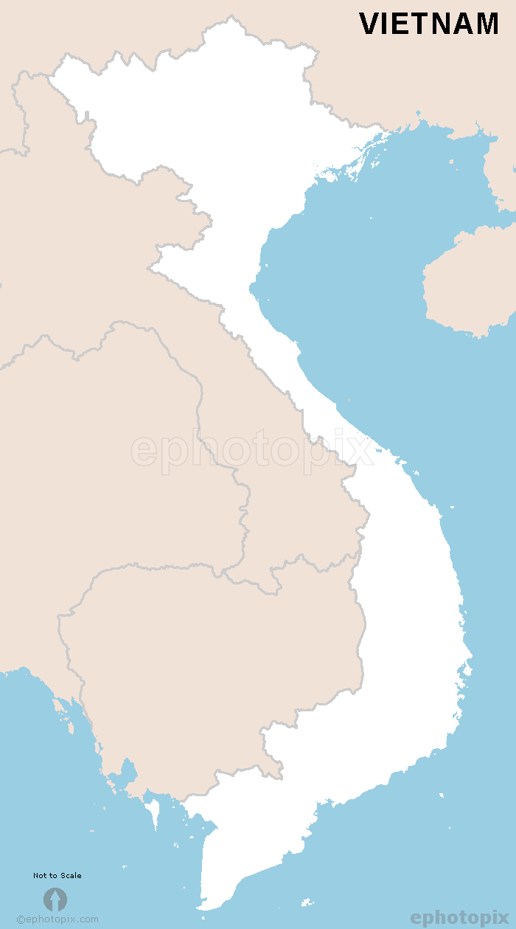
$800 Question from Postwar Potluck
What was the name of the place shown on this map from the time of the colonial era until 1954?

Slide 100
$800 Answer from Postwar Potluck
French Indochina

Slide 101
$1000 Question from Postwar Potluck
Alger Hiss is associated with what conflict following the end of WWII?

Slide 102
$1000 Answer from Postwar Potluck
Cold War

Slide 103
Final Jeopardy
Category: Presidents

Slide 104
Final Jeopardy
Civil Service Reform
Rough Riders
Panama Canal
Conservation
Bull-Moose Party

Slide 105
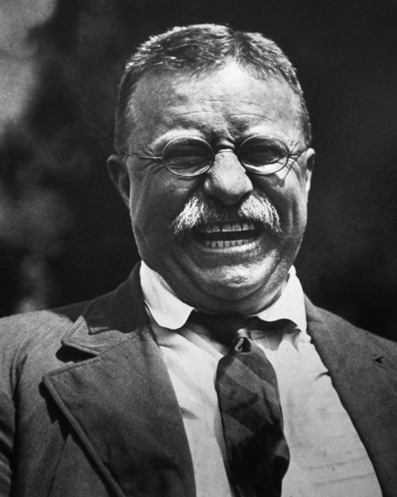
Final Jeopardy Answer
Theodore Roosevelt

