Slide 1
Jeopardy
World War
I & Great Depression
Cold War/ Later half of 20th Century
Social and Political Movements
WWII
Presidents
Q $100
Q $100
Q $100
Q $100
Q $100
Q $200
Q $200
Q $200
Q $200
Q $200
Q $300
Q $300
Q $300
Q $300
Q $300
Q $400
Q $400
Q $400
Q $400
Q $400
Q $500
Q $500
Q $500
Q $500
Q $500
Final Jeopardy

Slide 2
$100 Question from H1
This telegram was aimed at the United States’ neutral rights by Germany to convince Mexico to attack the United States. In return Mexico would have received all the land lost in the Mexican-American War.

Slide 3
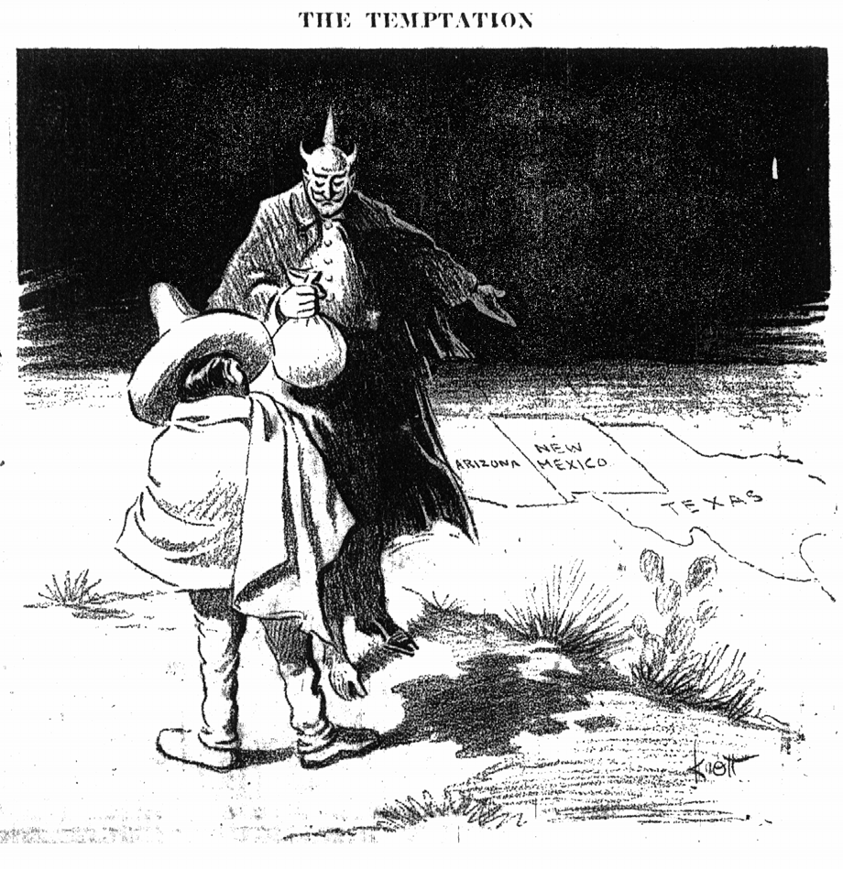
$100 Answer from H1
Zimmerman Telegram
Led to a nationalistic response to German products and culture.

Slide 4
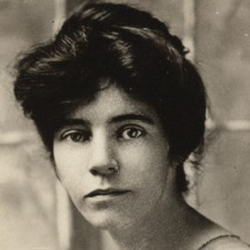
$200 Question from H1
This female suffragist was the leader of the National Woman’s Party and the Congressional Union. She led protest for women’s rights outside of the Capitol during WWI.

Slide 5
$200 Answer from H1
Answer: Alice Paul

Slide 6
$300 Question from H1
October 29, 1929, the day that the New York Stock Market crashed, was given this very “dark” name.

Slide 7
$300 Answer from H1
Black Tuesday
Many people lost assets and money within banks. It led to the end of the Republican Era and the rise of the era of Democratic presidents, such as FDR and Truman.

Slide 8
$400 Question from H1
This individual’s assassination led to the start of World War I.

Slide 9
$400 Answer from H1
Archduke Franz Ferdinand

Slide 10
$500 Question from H1
These unemployed WWI veterans came to Washington in 1932 protesting immediate payment that the bonus congress promised them in 1922. They were forcibly removed ☹

Slide 11
$500 Answer from H1
Bonus Army

Slide 12
$100 Question from H2
“The peace-loving nations must make a concerted effort in opposition to those violations of treaties and those ignorings of humane instincts which today are creating a state of international anarchy and instability from which there is no escape through mere isolation or neutrality. “Those who cherish their freedom and recognize and respect the equal right of their neighbors to be free and live in peace, must work together for the triumph of law and moral principles in order that peace, justice and confidence may prevail in the world. There must be a return to a belief in the pledged word, in the value of a signed treaty. There must be recognition of the fact that national morality is as vital as private morality.”
President Franklin Roosevelt, Quarantine Speech, 1937
How does FDR want America to move forward at this time in regards to foreign policy?

Slide 13
$100 Answer from H2
America must move pass the era of neutrality and play a bigger role around the world.
(Become more involved with WWII)

Slide 14
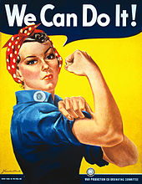
$200 Question from H2
Characters such as Rosie the Riveter and other Woman ordinance Worker posters were showing what importance during the war?

Slide 15
$200 Answer from H2
Women’s contribution to the war effort when their men were away fighting.

Slide 16
$300 Question from H2
These were designed for WWII veterans and their families after they returned from war

Slide 17
$300 Answer from H2
Veteran housing.
Remember that the growth of interstates made it possible for the developments of veteran neighborhoods

Slide 18
$400 Question from H2
The United States joined what international peacekeeping organization after WWII?

Slide 19
$400 Answer from H2
United Nations

Slide 20
$500 Question from H2
This important creation led to the rivalry between the Soviet Union and the United States which ushered in the Cold War.

Slide 21
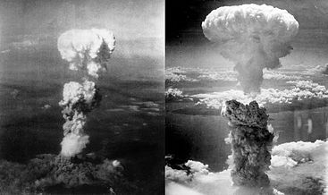
$500 Answer from H2
Creation of the Atomic Bombs.

Slide 22
$100 Question from H3
Expansion of programs such as Social Security, Medicare and Medicaid are examples of this which led to the rise of the Republican Party

Slide 23
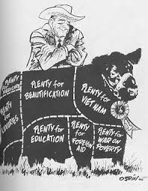
$100 Answer from H3
Big Government Policies

Slide 24
$200 Question from H3
This Supreme Court decision used physiological situations to make a change within society that was unheard of in the South.

Slide 25
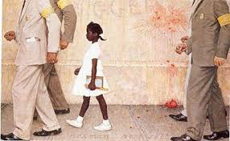
$200 Answer from H3
Brown v. Board of Education

Slide 26
$300 Question from H3
Rev. Dr. King, John Lewis and other prominent civil rights leaders participated in this famous event in Washington D.C.

Slide 27
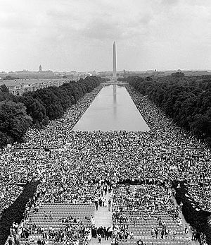
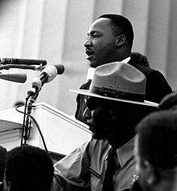
$300 Answer from H3
March on Washington for Jobs and Freedom

Slide 28
$400 Question from H3
I’m Not a Crook was the most famous words of this Cold War Era President.
HINT: HE WAS ☺ AHAHAHAHAHAH

Slide 29
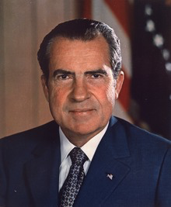
$400 Answer from H3
Richard “Tricky Dick” Nixon

Slide 30
$500 Question from H3
This resolution gave all necessary powers to the president to fight Communism.

Slide 31
$500 Answer from H3
Gulf of Tonkin Resolution

Slide 32
$100 Question from H4
Better working conditions during the 1910s were best align with this movement that put religion with labor and other social issues

Slide 33
$100 Answer from H4
Social Gospel: Remember that socialism in the 30s most align with this idea.

Slide 34
$200 Question from H4
This act was aimed at preventing individuals from Southern and Eastern Europe as well as Africans and Asian from entering the country. The end goal was to "to preserve the ideal of American homogeneity"

Slide 35
$200 Answer from H4
Immigration Act of 1924

Slide 36
$300 Question from H4
This era was an age of dancing, drinking, and fun in the 1920s. It included the flappers as well as the rise of big band leaders in areas such as Harlem NY

Slide 37
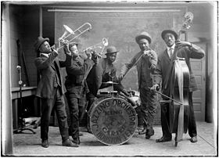
$300 Answer from H4
Jazz Age

Slide 38
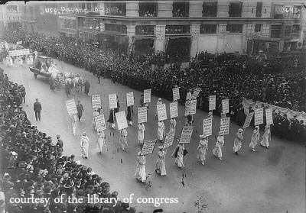
$400 Question from H4
This image best reflects movements during the 19th and 20th Centuries.

Slide 39
$400 Answer from H4
Women fighting for an expansion of civil rights in the 19th century: Ex: Susan Anthony
Women fighting for equality and voting rights during the 20th Century, Equal Rights Amendment. Ex: Alice Paul

Slide 40
$500 Question from H4
What is the difference between a conservationist and a preservationist?

Slide 41
$500 Answer from H4
Conservationist such as Gifford Pinchot wanted to replant trees that were being cut down during the 1900s
Preservationist such as Rachel Carson during the 1960s sought to protest the forests and the environment from pesticides such as DDT so that the environment would be preserved for the generations to come.

Slide 42
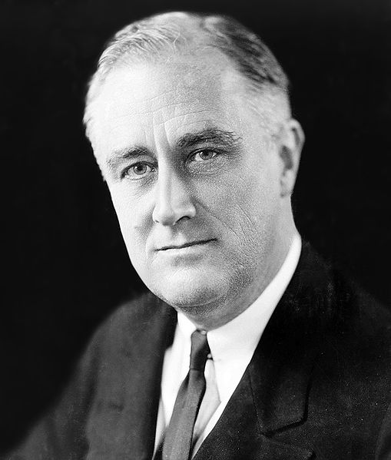
$100 Question from H5
WHO AM I?
4 term President.
New Deal Programs
Established the Social Security Act for elderly and retired peoples
President during most of WWII

Slide 43
$100 Answer from H5
FDR

Slide 44
$200 Question from H5
As a Republican President, I was in office during the suspicion of Communist within our government. I was also influential in enforcing Civil Rights in the South during integration.
Who am I ?

Slide 45
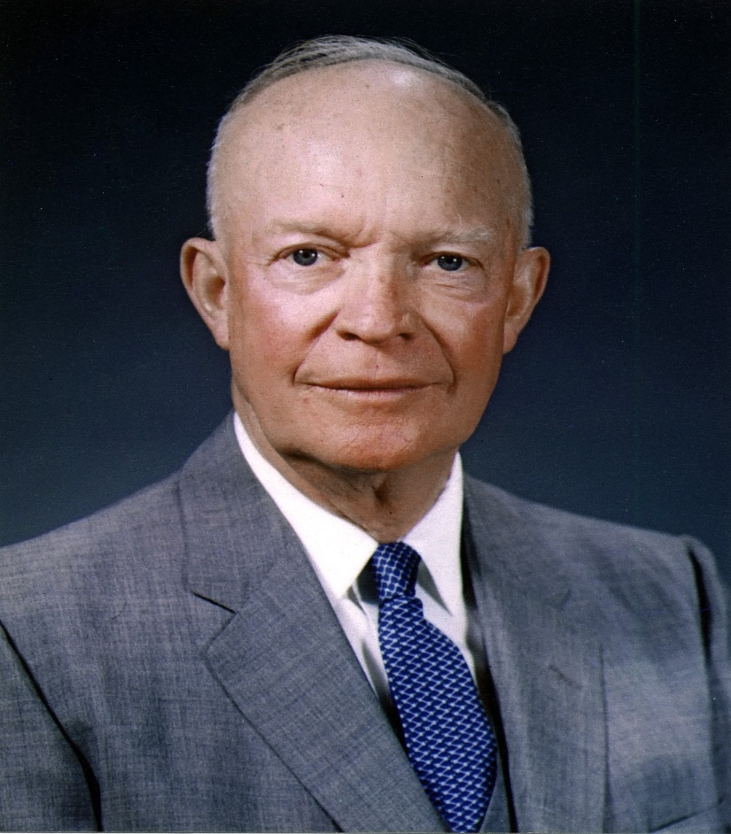
$200 Answer from H5
Dwight D. “Ike” Eisenhower

Slide 46
$300 Question from H5
Took office after William McKinley was assassinated.
Known as a conservationist and a “trustbuster”
“Speak softly, but carry a big stick”
Elected as a Republican; ran again for another term against Taft and Wilson as a Progressivist (Bull Moose)
WHO AM I?

Slide 47
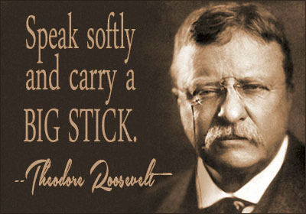
$300 Answer from H5
Teddy Roosevelt

Slide 48
$400 Question from H5
Democrat
Became President after JFK was assassinated
Created the Great Society expanding Medicare and Medicaid
Vietnam War was a blunder for my reelection bid
Signed the Voting Rights Act of the 1965 and the Civil Rights Act of 1968
Who am I?

Slide 49
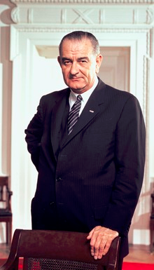
$400 Answer from H5
Lyndon B. Johnson

Slide 50
$500 Question from H5
Born in Virginia: Elected on the wave of Populism
“He kept us out of war”
President during WWI
Wrote the Fourteen Points
Proposed the establishment of the League of Nations although America did not join.
WHO AM I?

Slide 51
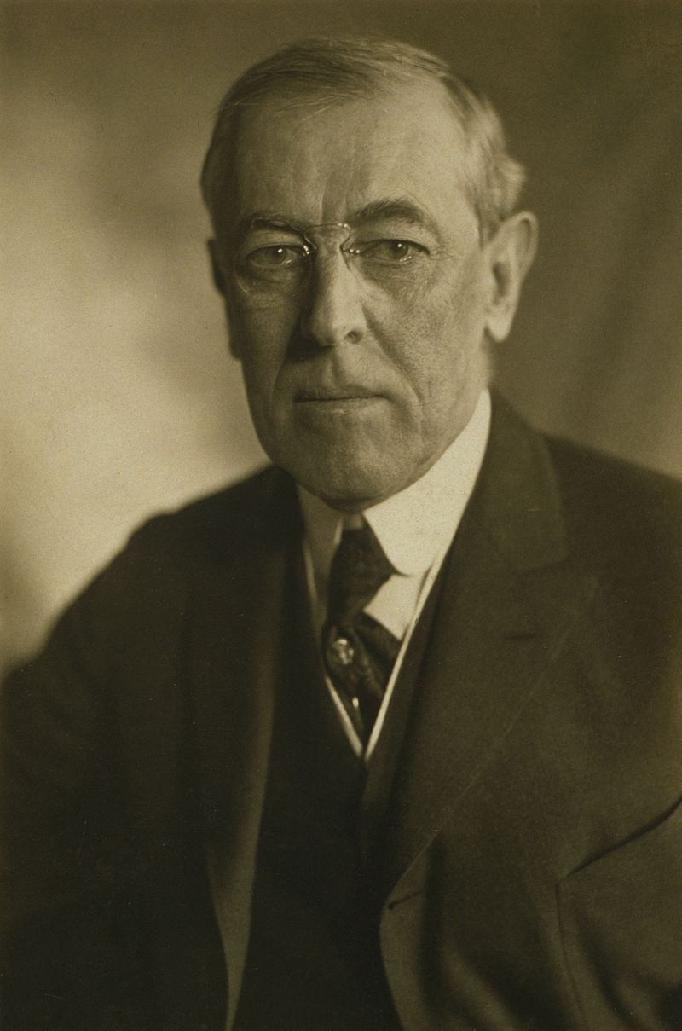
$500 Answer from H5
Woodrow Wilson

Slide 52
Final Jeopardy
20th Century Social Movements
This movement started in L.A California in 1966 as a result to address problems in the black community such as police harassment, poverty, poor education

Slide 53
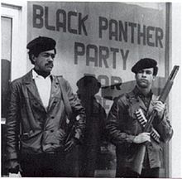
Black Panther Party for Self-Defense

