Slide 1
Jeopardy
Early 19th
Economics
Religion and work
Social Class
Immigration and diversity
Urbanization
Q $100
Q $100
Q $100
Q $100
Q $100
Q $200
Q $200
Q $200
Q $200
Q $200
Q $300
Q $300
Q $300
Q $300
Q $300
Q $400
Q $400
Q $400
Q $400
Q $400
Q $500
Q $500
Q $500
Q $500
Q $500
Final Jeopardy

Slide 2
$100 Question from H1
Which of the following describes the new industrial system that developed in early nineteenth-century America?
It brought workers together under one roof in a factory.
The new system quickly replaced the rural outwork system.
It eliminated any possibility that unions could organize to defend workers’ interests.
The system was bitterly opposed by the many critics of industrial pollution.

Slide 3
$100 Answer from H1
Answer: A) It brought workers together under one roof in a factory.

Slide 4
$200 Question from H1
In the first half of the nineteenth century, American manufacturers’ main advantage over the British mills was that they had access to which of the following?
a. Cheaper shipping c. More natural resources
b. Lower interest rates d. A ready supply of cheap labor

Slide 5
$200 Answer from H1
Answer: C) More Natural Resources
Remember: that an abundance of natural resources made it extremely important for manufactures to make money and produce important products.

Slide 6
$300 Question from H1
The dramatic increase between 1820 and 1850 in the exchange of goods and services in market transactions. It reflected the increased output of farms and factories; the entrepreneurial activities of traders and merchants; and the creation of a transportation network of roads, canals, and railroads.
A) Nativism
B) Market Revolution
C) Industrial Revolution
D) unions

Slide 7
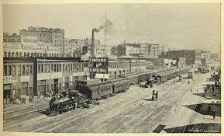
$300 Answer from H1
B) Market Revolution

Slide 8
$400 Question from H1
This country was the 1st to begin the Industrial Revolution

Slide 9
$400 Answer from H1
England (Great Britain)

Slide 10
$500 Question from H1
The belief that human labor produces economic value is called. . .
Labor theory of value
Communism
Self-made man
Moral-free agency

Slide 11
$500 Answer from H1
Answer: A) Labor theory of value

Slide 12
$100 Question from H2
A broad-ranging campaign of moral and institutional reforms inspired by evangelical Christian ideals endorsed by middle class men is called…
Irish Poverty
Unions
Benevolent Empire
nativism

Slide 13
$100 Answer from H2
C) Benevolent Empire

Slide 14
$200 Question from H2
During the 1840s and 1850s, Roman Catholic churches in the United States were known for. . .
A) providing community services and a sense of group identity for most Irish and many German immigrants.
B) loosening many of their ties to the Church in Rome in hopes of gaining more American converts.
C) emphasizing their spiritual functions while neglecting secular matters such as politics and economics.
D) closing their doors to immigrants in order to protect themselves against nativist violence and bad publicity.

Slide 15
$200 Answer from H2
A) providing community services and a sense of group identity for most Irish and many German immigrants.

Slide 16
$300 Question from H2
Which of the following Puritan ideas became a middle-class conviction with a secular twist during industrialization in the early 1800s?
Predestination
The Protestant work ethic
Covenant thinking
Creation of a society based on faith and ideals

Slide 17
$300 Answer from H2
B) The Protestant work ethic

Slide 18
$400 Question from H2
By the 1830s, most laborers in the urban Northeast lived in which type of residences?
A) Barracks provided by factory owners
B) Private slum shanties
C) Church-sponsored charity houses
D) Crowded boardinghouses and tiny apartments

Slide 19
$400 Answer from H2
D) Crowded boardinghouses and tiny apartments

Slide 20
$500 Question from H2
Britions (British immigrants) primarily followed this religion:
Catholicism
Islam
Jehovah’s Witness
Protestantism

Slide 21
$500 Answer from H2
D) Protestantism
Remember: British immigrants did not receive much if not any discrimination compared to those immigrants who were from Ireland, Italy, Germany. (Predominately Catholic Regions)

Slide 22
$100 Question from H3
A nineteenth-century ideal that celebrated men who rose to wealth or social prominence from humble origins through self-discipline, hard work, and temperate habits.

Slide 23
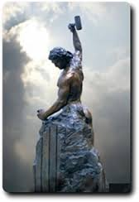
$100 Answer from H3
Self-made Man

Slide 24
$200 Question from H3
An economic group of prosperous farmers, artisans, and traders that emerged in the early nineteenth century. Its rise reflected a dramatic increase in prosperity. This surge in income, along with an abundance of inexpensive mass-produced goods, fostered a distinct urban culture.
Upper Class
Brahmins
Middle Class
Mechanics

Slide 25
$200 Answer from H3
C) Middle Class

Slide 26
$300 Question from H3
An ideology that celebrated small-scale producers, men and women who owned their own shops (or farms). It defined the ideal society as one constituted by, and dedicated to the welfare of, independent workers and citizens.
Division of labor
Unions
Artisan republicanism
Communism

Slide 27
$300 Answer from H3
C) Artisan republicanism

Slide 28
$400 Question from H3
Which of the following was the message of Benjamin Franklin’s Autobiography, published in full in 1818?
His personal belief that men from the lower classes could not raise themselves from poverty
The suggestion that an industrious man could become wealthy
His belief that only the display of wealth through clothing and housing mattered
The lesson that men’s hard work was a waste of effort and accomplished nothing

Slide 29
$400 Answer from H3
B) The suggestion that an industrious man could become wealthy
Remember: Franklin’s words with others of his time is what people during the Industrial Revolution look towards as a end goal.

Slide 30
$500 Question from H3
What led to the growth of the “middle class” in America’s society?
The many deaths during the American Revolution
A dramatic rise in prosperity (wealth)
Religious values and morals from Europe
The ending of the Slave Trade.

Slide 31
$500 Answer from H3
B) A dramatic rise in prosperity (wealth)

Slide 32
$100 Question from H4
Nativist fears were directed mostly at which of the following groups in early and mid-nineteenth-century America?
Women
Irish immigrants
Native Americans
Free blacks

Slide 33
$100 Answer from H4
B) Irish immigrants

Slide 34
$200 Question from H4
What killed thousands of poor immigrants in St. Louis and New York City in the summer of 1849?
Malnutrition
Cholera
Anti-immigrant riots
Fire

Slide 35
$200 Answer from H4
B) Cholera

Slide 36
$300 Question from H4
Which of the following describes German immigrants who settled in the United States during the 1840s and 1850s?
Fewer Germans immigrated to the United States than did Irish and British migrants.
Nearly all Germans were poor and settled in cities because they could not afford more travel.
Germans were the second largest immigrant group and many settled in the Midwestern states.
The Germans led urban riots against the Irish and black populations of cities.

Slide 37
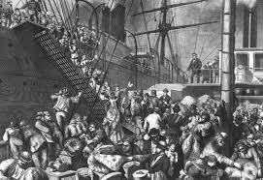
$300 Answer from H4
C) Germans were the second largest immigrant group and many settled in the Midwestern states.

Slide 38
$400 Question from H4
What caused the influx of migration from Ireland to the United States?

Slide 39
$400 Answer from H4
Severe overpopulation and the blight that took out the potato crop

Slide 40
$500 Question from H4
Why were some reasons that Catholics were seen as a threat to American republicanism?

Slide 41
$500 Answer from H4
Accepted answers:
Allegiance to the Pope
Unemployment of Protestants
Seen as uncivilized due to alcoholism (stereotypes of the Irish)

Slide 42
$100 Question from H5
Who was the English immigrant who secretly brought the design of the most advanced British machinery for spinning cotton to America in 1789?
Francis Cabot Lowell
Paul Moody
Samuel Slater
Eli Whitney

Slide 43
$100 Answer from H5
C) Sam Slater

Slide 44
$200 Question from H5
How did Thomas Jefferson respond to the development of American manufacturing by the 1820s?
Jefferson took a theoretical interest in industrial machinery but was indifferent to its practical application.
He continued to warn against the danger of encouraging industrialization at the expense of wholesome rural life.
He praised industrialization and expressed pride in American progress in manufacturing.
Jefferson enthusiastically supported industrialization from the time of his presidency until his death.

Slide 45
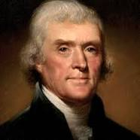
$200 Answer from H5
C) He praised industrialization and expressed pride in American progress in manufacturing.

Slide 46
$300 Question from H5
For which of the following reasons did New York’s state government fund the building of the Erie Canal in 1817?
The state was required to provide publicly funded jobs to the state’s unemployed workers.
New Yorkers sought to link the Hudson River with the Great Lakes.
New York City needed to increase its supply of fresh drinking water.
The governor wanted to display the states’ wealth to the rest of the world.

Slide 47
$300 Answer from H5
B) New Yorkers sought to link the Hudson River with the Great Lakes.

Slide 48
$400 Question from H5
Which of the following factors explained the rapid growth of western cities such as Pittsburgh, Cincinnati, and New Orleans?
Their role in transportation networks
B) Proximity to abundant coal supplies
C) Their location on the fall line
D) Proximity to major American banks

Slide 49
$400 Answer from H5
A) Their role in transportation networks

Slide 50
$500 Question from H5
A system of labor using young women recruited from farm families to work in factories in Lowell, Chicopee, and other sites in Massachusetts and New Hampshire. The women lived in company boardinghouses with strict rules and curfews and were often required to attend church.
Mineral-based economy
The Boston Class System
Waltham-Lowell System
Sabbatarian movement

Slide 51
$500 Answer from H5
C) Waltham-Lowell System

Slide 52
Final Jeopardy
American Geography
Which letter on the map on the next slide depicts the James River Canal?

Slide 53
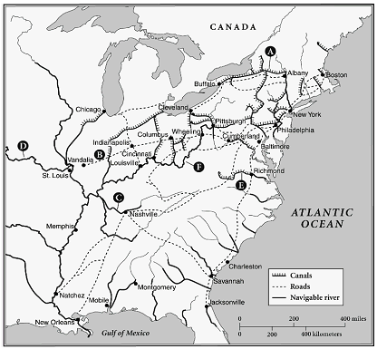
James River Canal

