Slide 1
Missouri Compromise
The Issue of Slavery and the Movement West

Slide 2
Essential Questions
How did the Missouri Compromise of 1820 attempt to settle the debate over the future of slavery in the growing American republic?
How did the Nullification Crisis a decade later demonstrate the widening divide between northern and southern states?

Slide 3
Manifest Destiny
God himself blessed the growth of the American nation
Indian tribes Christianized
Saving souls – 2nd Great Awakening
Economic Motives
Fur trapping
California Gold Rush (1848)

Slide 4
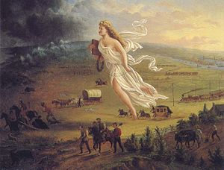
Manifest Destiny
American Progress – John Gast (1872)

Slide 5
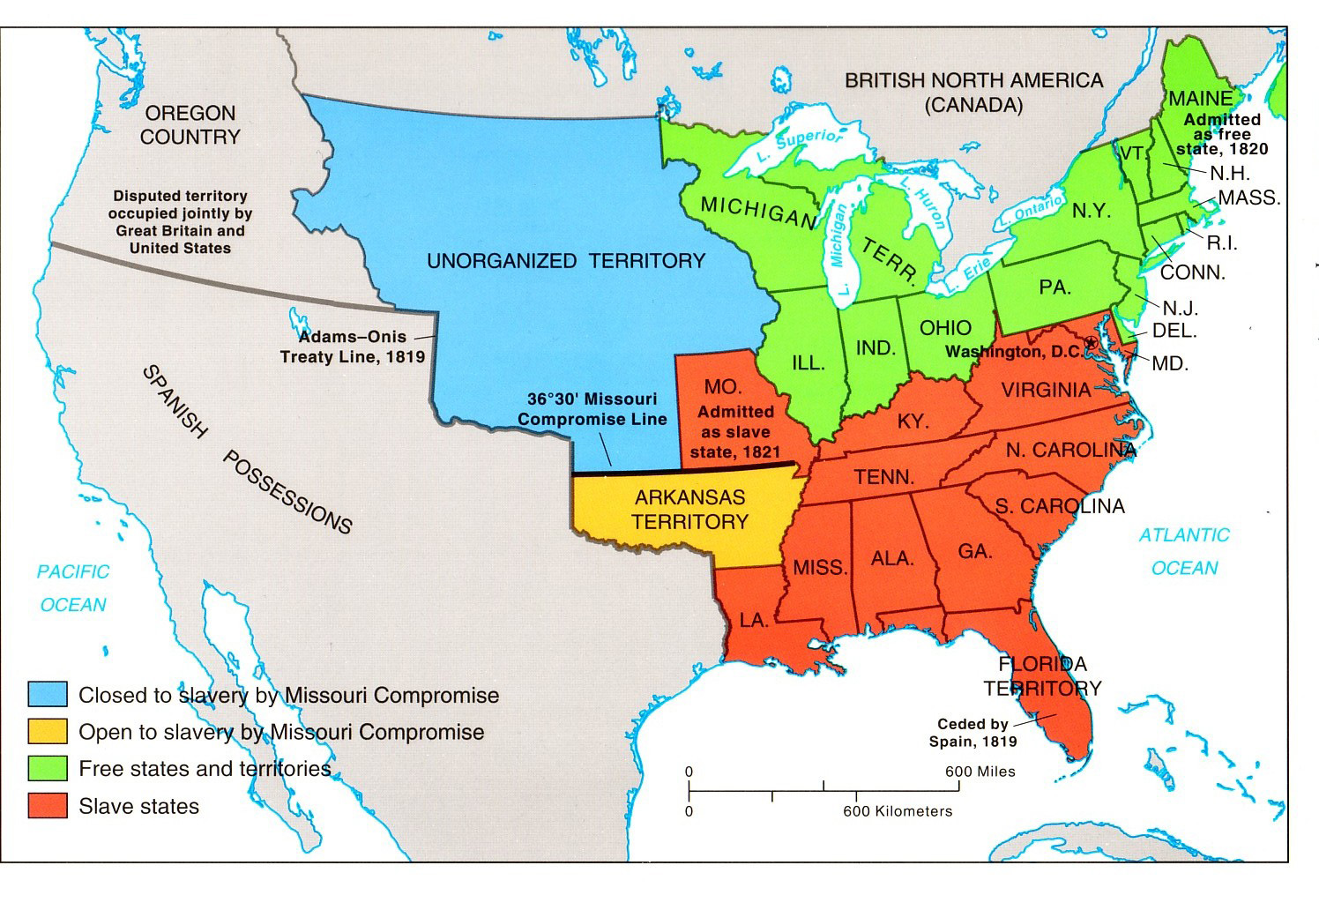

Slide 6
1819
11 free states and 11 slave states
Problem - what to do with new territories?
Senate consist of :
2 representatives from each state
House of Representatives:
based on states population-
slave states had more representatives

Slide 7
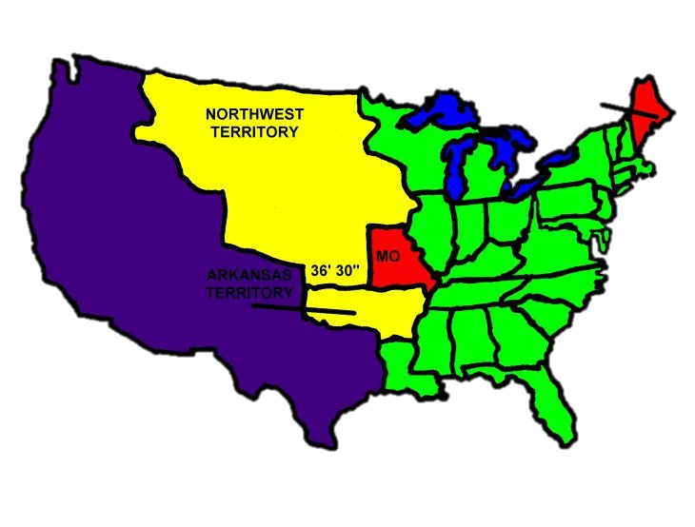
Why is this a Problem?
1820 - 2 territories want to enter
Maine
Missouri (about 2,000 slaves)
What is the dilemma for Congress?

Slide 8
Missouri Compromise
Also known as the Compromise of 1820
Maine enters as a free state
Missouri enters as a slave state
No slavery would be allowed north of the 36’30” line

Slide 10
Interactive map of Missouri Compromise
INTERACTIVE MISSOURI COMPROMISE MAP

Slide 11
The Quick Fix
The Missouri Compromise was a temporary solution to the questions of slavery and territorial rights.

Slide 12
Southern Response
South realized that this compromise threatened the balance between free and slave states
WHY?
South felt the US would need territories from Mexico’s territory in which to expand slavery the only area left was in Arkansas

Slide 14
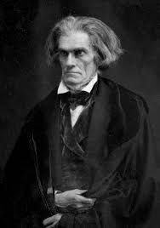
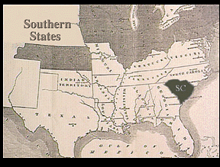
Nullification of South Carolina
SC argued that a state has the right to void within its borders, a law passed by Congress.
Tariff of Abominations (Tariff of 1828)
Attacked Southern Planters
Endangered the institution of slavery
John C. Calhoun and other South Carolinians wanted “States’ rights)
S.C. Threated to secede from the Union

Slide 15
Critical Thinking Questions
Why was the Missouri Compromise called a "compromise"?
What did each section of the country, North and South, gain and what did each give up?
What is the role of compromise in a self-governing society, considering that many convictions are deeply held but not shared by everyone in the community? Further, is some level of compromise necessary to the survival of a democratic republic?

