Slide 1
Jeopardy
Powers and Branches
Judicial & Legislative powers
Structure of Government
Amendments
Voting & Elections
Q $100
Q $100
Q $100
Q $100
Q $100
Q $200
Q $200
Q $200
Q $200
Q $200
Q $300
Q $300
Q $300
Q $300
Q $300
Q $400
Q $400
Q $400
Q $400
Q $400
Q $500
Q $500
Q $500
Q $500
Q $500
Final Jeopardy

Slide 2
$100 Question from H1
America has this type of government with shared powers between the national and state government

Slide 3
$100 Answer from H1
Answer: Federalism

Slide 4
$200 Question from H1
Should the President and Vice President die in office at the same time, who becomes President?
Senate Majority Leader
Secretary of State
Speaker of the House
Secretary of Agriculture

Slide 5
$200 Answer from H1
Answer: Speaker of the House

Slide 6
$300 Question from H1
Which of the following best describes a public prison?
Long term facilities owned by state or federal governments
Facilities run by private corporations who services and beds are contracted out by state or federal governments
Local facilities that host inmates with sentences under a year
Facilities where member of persecuted minorities are deliberately imprisoned to provide force labor or to await mass executions

Slide 7
$300 Answer from H1
Answer: Long term facilities owned by state or federal governments

Slide 8
$400 Question from H1
These are the two major parties in American Government

Slide 9
$400 Answer from H1
Answer: Democrats and Republicans

Slide 10
$500 Question from H1
The United States has this type of economic system which allows for private ownership of businesses with some government regulations.

Slide 11
$500 Answer from H1
Answer: Mixed Economy

Slide 12
$100 Question from H2
Which of these is NOT a First Amendment right?
Speech
Privacy
Religion
Assembly

Slide 13
$100 Answer from H2
Answer: Privacy

Slide 14
$200 Question from H2
What are the first ten amendments of the constitution referred to as?
Magna Carta
The Dream Act
Bill of Rights
Federalist Papers

Slide 15
$200 Answer from H2
Answer: Bill of Rights

Slide 16
$300 Question from H2
Which of these amendments to the Constitution allows for 18 year olds to vote?
26th
19th
15th
22nd

Slide 17
$300 Answer from H2
26th Amendment

Slide 18
$400 Question from H2
The 19th Amendment allowed for which group in the Untied States the right to vote?
African American Males
All Women
All white males
Latin Americans and Asians

Slide 19
$400 Answer from H2
Answer: All women

Slide 20
$500 Question from H2
This document, known as the Supreme Law of the Land, outlines the freedoms that are guaranteed to all Americans and protected by all branches of the U.S. government.
Freedom Charter
Constitution
Articles of Confederation
Declaration of Independence

Slide 21
$500 Answer from H2
Answer: Constitution

Slide 22
$100 Question from H3
Which of the following positions is NOT subjected to an election?
Congressmen
President
Major of Waynesboro
Supreme Court Justice

Slide 23
$100 Answer from H3
Answer: Supreme Court Justices

Slide 24
$200 Question from H3
What body formally elects the President?
U.S Senate
Electoral College
U.S Citizens
Federal Elections Commission

Slide 25
$200 Answer from H3
Answer: Electoral College

Slide 26
$300 Question from H3
Who is currently Virginia’s Governor?
Ralph Northam
Mark Warner
Tim Kaine
Douglas Wilder

Slide 27
$300 Answer from H3
Answer: Ralph Northam

Slide 28
$400 Question from H3
These were given to minorities especially in the South as a barrier to stop them from voting in elections:
Pledge of Allegiance
Literacy Tests
Constitutional Oaths
Codes of Conduct

Slide 29
$400 Answer from H3
Answer: Literacy Tests

Slide 30
$500 Question from H3
The elected five member group that is in charge of the daily decisions and operations of the city of Waynesboro is called:
School board
Board of trustees
City Council
League of Mayors

Slide 31
$500 Answer from H3
Answer: City Council

Slide 32
$100 Question from H4
Which of the following is NOT a constitutional power of the President?
Pardon Criminals
Make treaties
Declare war
Appoint Judges

Slide 33
$100 Answer from H4
Answer: Declare War

Slide 34
$200 Question from H4
Who is in charge of the Executive Branch of the U.S?
Congress
Secretary of State
President
Chief Justice

Slide 35
$200 Answer from H4
Answer: President

Slide 36
$300 Question from H4
What is the title of the person who is second in command of the Executive Branch of Virginia’s State government?
Czar
Attorney General
Lieutenant Governor
State Treasurer

Slide 37
$300 Answer from H4
Answer: Lieutenant Governor

Slide 38
$400 Question from H4
What is the purpose of the Presidential Cabinet?
Create laws
Create the national budget
Help the President make policies
Determine Constitutionality of Laws

Slide 39
$400 Answer from H4
Answer: Helps the President make policies

Slide 40
$500 Question from H4
What is the main purpose of the legislative branch?
Enforce laws
Review laws
Create laws
Appoint judges

Slide 41
$500 Answer from H4
Answer: Make laws

Slide 42
$100 Question from H5
How many justices are on the Supreme Court?
6
9
12
15

Slide 43
$100 Answer from H5
Answer: 9

Slide 44
$200 Question from H5
How many members are in Congress?
100
535
435
50

Slide 45
$200 Answer from H5
Answer: 535

Slide 46
$300 Question from H5
The amount of seats a state gets in the House of Representatives is determined by:
Population of the state
Physical size of the state
Seniority of the state
Through an electoral lottery

Slide 47
$300 Answer from H5
Answer: Population of the State

Slide 48
$400 Question from H5
What law forbids gender discrimination in federally funded educational programs such as school sports?
2nd amendment
Title 9
Miranda Rights
Griswold vs. Connecticut

Slide 49
$400 Answer from H5
Answer: Title 9

Slide 50
$500 Question from H5
Which Supreme Court Case established Judicial Review?
Plessy v. Ferguson
Miranda v. Arizona
McCulloch v. Maryland
Marbury v. Madison

Slide 51
$500 Answer from H5
Answer: Marbury v. Madison

Slide 52
Final Jeopardy
Presidents
This President was the first to ever visit a public prison.

Slide 53
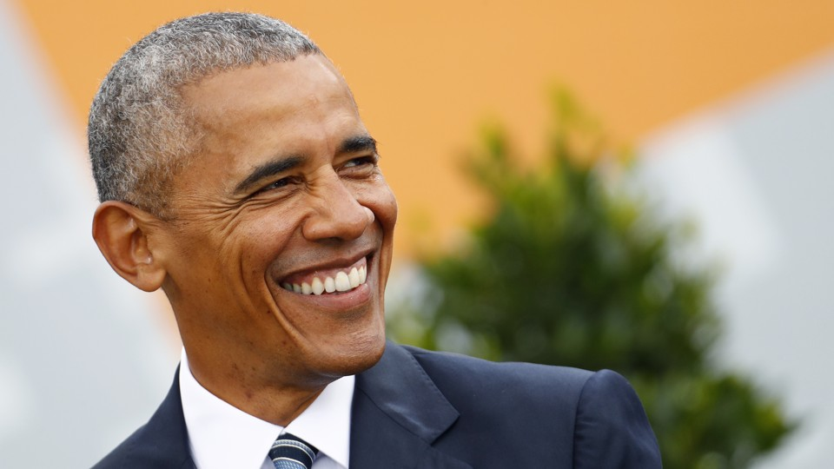
President Barack Obama

