Slide 1
APUSH BELL RINGER 10/31
How did the Constitution lead to more issues in within government? How did the development of political parties reflect the ideals of the founders in terms of the size of government?
Answer in at least three sentences
Turn in chapter 11 Reading Template

Slide 2
JEFFERSONIAN AMERICA

Slide 3
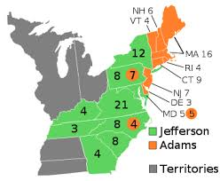
ELECTION OF 1800
– Federalists lost control of both the executive and legislative branches
– Thomas Jefferson becomes the 1st Democratic-Republican president
– 1st peaceful transfer of power between political parties
– “We are all Republicans, we are all Federalists”

Slide 4
FEDERALISTs AND THE JUDICIAL BRANCH
Federalists wanted to maintain some grip on power and passed the Judiciary Act of 1801
– Created new judicial positions
– Called the Midnight Appointments
– Attempt by Adams administration to put
Federalist judges in place before leaving office
One of the midnight judicial appointees (William Marbury) sued Secretary of State James Madison for refusing to deliver his commission
Marbury vs. Madison (1803)

Slide 5
MARBURY VS. MADISON (1803)
Parts of the Judiciary Act of 1789 were ruled unconstitutional
Important because it established the idea of judicial review
– The Supreme Court has the power to declare federal laws unconstitutional
– Massive expansion of judicial power
John Marshall, Chief Justice of Supreme Court from 1801-1835, will dramatically increase power of the federal government

Slide 6
HOW JEFFERSONIAN WAS JEFFERSON?
Jeffersonian Democratic-Republicans:
– Strict interpretation of the Constitution
– Limited federal government
– Advocated agrarian economy: farmers!
• Eliminated excise taxes, lowered national debt
• Did not dismantle all Federalist policies: Kept the Bank of the United States (BUS) & debt plan

Slide 7
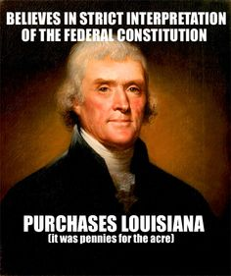
The Historical Audacity of the Louisiana Purchase

Slide 8
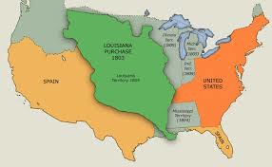
LOUISIANA PURCHASE
Jefferson attempted to buy New Orleans from France
Napoleon offered to sell all of the Louisiana territory for $15 million
• Haitian Revolution
• Fight against England
Although the Constitution does not say the president could purchase foreign land, TJ supported the deal
– In this case, Jefferson used loose interpretation of the Constitution & implied powers to make the deal

Slide 9
Louisiana Purchase--RESULTS
Doubled the size of the U.S.
Supported Jefferson’s vision of a agrarian society of independent farmers
Avoided a potential threat (France) along the nation’s borders
Further weakened the Federalist party
Lewis and Clark led a scientific exploration of the trans-Mississippi West.

Slide 10
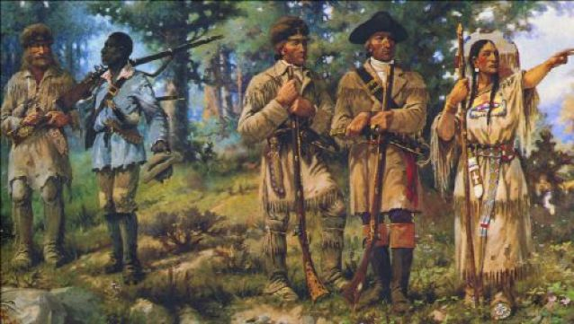
Lewis and Clark Expedition 1804-1806
Meriwether Lewis
William Clark
Corps of Discovery
(33 army volunteers)
Sacagawea
(and husband and baby)
York
To find waterway to Pacific
To establish trade with and U.S. sovereignty over native people
To document plants and animals in new territory
Start of U.S. claims
to the Oregon territory
& Pacific coast

Slide 11
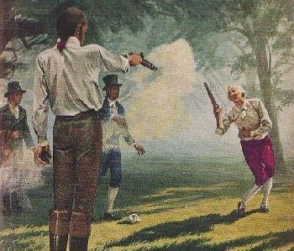
Aaron Burr does some crazy &%$#!
Burr plotted with some radical Federalists to secede New England states from the union
Alexander Hamilton helped defeat Burr in the NY election
Burr killed Hamilton in a duel in 1804
Plotted to take part of Mexico from Spain and potentially unite it with Louisiana territory under his rule
Put on trial for treason but acquitted

Slide 12
Jefferson and the Barbary Pirates
From the Halls of Montezuma To the shores of Tripoli; We fight our country's battles In the air, on land, and sea; First to fight for right and freedom And to keep our honor clean; We are proud to claim the title Of United States Marine.
-Hymn of the Marines

Slide 13
Violation of American Neutrality
War in Europe continued to cause problems for the United States
Violations of U.S. Neutrality
• Impressment: forced enlistment of Americans into the British navy
• France issued the Berlin Decree (1806) that said they would seize ships trading with England
• England issued the Orders in Council (1806) that said ships must stop in England first
SHOWDOWN:
• Chesapeake Leopard Affair (1807): English ship Leopard attacked American ship the Chesapeake

Slide 14
Jefferson’s Response
Embargo Act of 1807
– Banned U.S. trade with ALL foreign nations
Immediate Impact:
The United States economy plummeted
Unintended Consequences:
Helped fuel the industrial revolution in New England

Slide 15
President James Madison
James Madison becomes president in 1809
Non-Intercourse Act (1809): the United States could trade with all nations EXCEPT France & England
Macon’s Bill #2: U.S. would end embargo if the country respected U.S. neutrality and freedom of the sea
Members of Congress in 1811 known as “War Hawks” advocated for war against England
– Stop British harassment – Wipe out Native resistance on the frontier – Take Canada from England

Slide 16
Native Resistance on the Frontier
Shawnee brothers Tecumseh and “the Prophet” organized a confederacy of tribes east of the Mississippi
William Henry Harrison organized an army and attacked native resistance in 1811 at Battle of Tippecanoe
– Huge blow to native resistance and win for American expansion

Slide 17
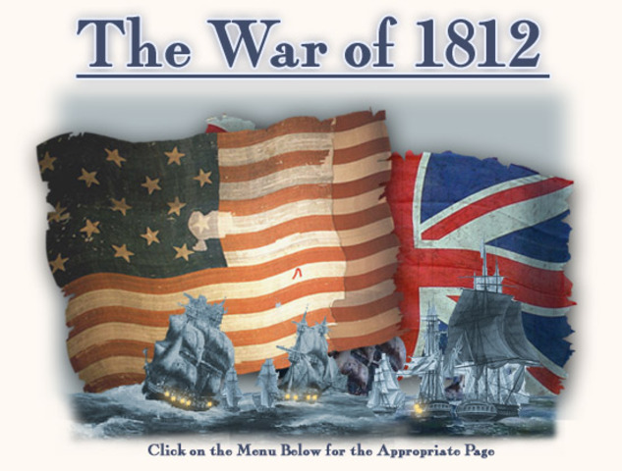
War of 1812 Declared!
England’s arming of Natives on the frontier
England’s continued violations of U.S. neutrality
Pressure from War Hawks in Congress
Desire for more land, protect American honor, etc.)
Democratic- Republicans tended to favor France

Slide 18
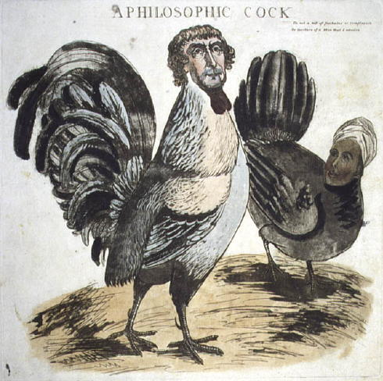
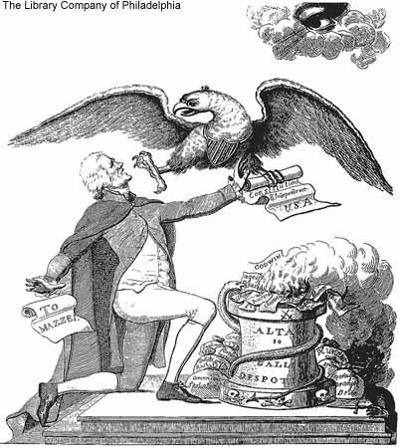
Federalist attack ads

