Slide 1
Jeopardy
Thirteen
O.Cs
Slavery in the Colonies
Colonial Economics
Protestant Reformation in American
Diversity and Enlightenment
Q $100
Q $100
Q $100
Q $100
Q $100
Q $200
Q $200
Q $200
Q $200
Q $200
Q $300
Q $300
Q $300
Q $300
Q $300
Q $400
Q $400
Q $400
Q $400
Q $400
Q $500
Q $500
Q $500
Q $500
Q $500
Final Jeopardy

Slide 2
$100 Question from H1
This was the major cash crop of the Southern Colonies during the early colonial period.

Slide 3
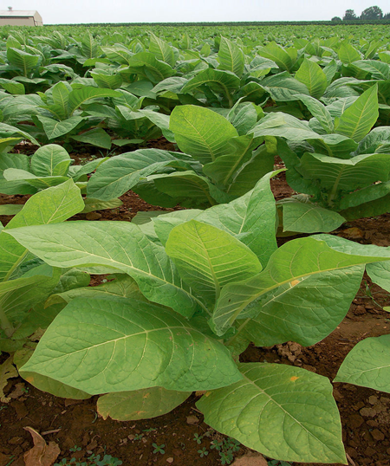
$100 Answer from H1
Answer: What is Tobacco?

Slide 4
$200 Question from H1
This was the reason as to why Jamestown was founded
A. three aristocratic proprietors seeking private gain
B. a joint stock company anxious to return a profit to investors
C. King James I, eager to gain a base for expeditions against Spanish shipping
D. John Smith, desiring to spread Christianity to Native Americans

Slide 5
$200 Answer from H1
Answer: B) a joint stock company anxious to return a profit to investors

Slide 6
$300 Question from H1
Influx of various religious and ethnic groups
Breadbasket of the colonies
Focused around religious tolerance
All of the following describe which colonies?
A) New England
B) Southern
C) Middle
D) Caribbean

Slide 7
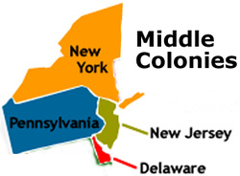
$300 Answer from H1
C) Middle

Slide 8
$400 Question from H1
Which European country settled along the St. Lawrence River
Spain
France
England
Portugal

Slide 9
$400 Answer from H1
B) France

Slide 10
$500 Question from H1
True or False: The economic practices in the English colonies during the late 17th and early 18th century were all agricultural based.

Slide 11
$500 Answer from H1
True: Northern and Southern colonies all focused on agriculture as their economic activity

Slide 12
$100 Question from H2
1619 mark the year of the first slaves arriving to what British colony?

Slide 13
$100 Answer from H2
Virginia (Jamestown)

Slide 14
$200 Question from H2
From 1492 through 1770 most slaves arrived in which part of the western hemisphere?
Hint: Big sugar producing area

Slide 15
$200 Answer from H2
Caribbean

Slide 16
$300 Question from H2
The route across the Atlantic that carried slaves from Africa to the New World is called. . .

Slide 17
$300 Answer from H2
The Middle Passage

Slide 18
$400 Question from H2
What was the Stono Rebellion?

Slide 19
$400 Answer from H2
Slave uprising in 1739 in which a group of slaves armed themselves, plundered six plantations killed more than twenty whites

Slide 20
$500 Question from H2
True or False: Indenture Servitude replaced slavery and allowed for the institution’s demise later in the 18th century.

Slide 21
$500 Answer from H2
FALSE!!! Slavery did not end until the mid 19th Century and the reliance on slavery slowly ended the servitude of European indentures

Slide 22
$100 Question from H3
This is the belief that the colonies should only trade with their mother countries.

Slide 23
$100 Answer from H3
Answer: Mercantilism

Slide 24
$200 Question from H3
Which statement BEST describes an effect of the British policy of salutary neglect?
A) The colonies developed an aptitude for self-governing.
B) Colonial governors became more powerful than assemblies.
C) American colonist stopped sending raw materials to England.
D) Parliament increased its military supervision of the colonies.

Slide 25
$200 Answer from H3
Answer A) The colonies developed an aptitude for self-governing

Slide 26
$300 Question from H3
What was the result of the Molasses Act of 1733?
Hint: John Hancock this this!

Slide 27
$300 Answer from H3
Answer: Smuggling

Slide 28
$400 Question from H3
The cities of New York, Baltimore, and Philadelphia began to become wealthy in the llate-1600s because of what economic activity?
Trading
Slavery
Smuggling
Tobacco farming

Slide 29
$400 Answer from H3
Answer A): Trading
Remember: These areas collectively post and ports for trading goods. (Lumber, grains, fish are some of the few things that were traded)

Slide 30
$500 Question from H3
Name two acts that had a negative affect on the economic affairs of the colonies ?

Slide 31
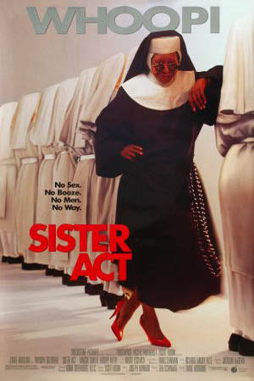
$500 Answer from H3
Accepted Answers:
Stamp Act
Tea Act
Quartering Act
Intolerable Acts
Navigation Acts
Sugar Acts
Answer Not Accepted ☺ ->

Slide 32
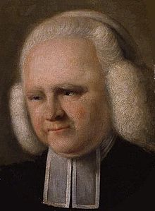
$100 Question from H4
This man was a great Methodist New Light minister who spread his message through revivals from the middle colonies all the way down to the Southern colonies

Slide 33
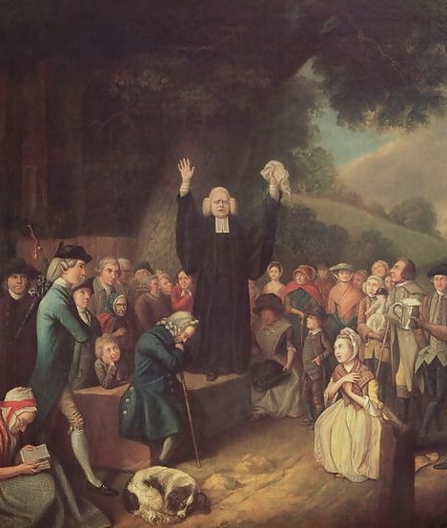
$100 Answer from H4
George Whitefield

Slide 34
$200 Question from H4
What best describes the different between Old Light and New Light ministers?
Old Light ministers promoted the acceptance of slaves within their churches.
B) New Light ministers emphasized the importance of spiritual rebirth and a haven for slaves to worship.
C) Old Light ministers believed that women should be allowed to be spiritual leaders in the churches.
D) New Lights continued the Conservative practices of faith seen in Calvinist Puritan churches in Massachusetts.

Slide 35
$200 Answer from H4
B) New Light ministers emphasized the importance of spiritual rebirth and a haven for slaves to worship.
Remember: These New Lights, especially Baptist believed that adult spirits especially could be reborn through Baptism

Slide 36
$300 Question from H4
Why did the House of Burgesses impose heavy fines on Baptists who preached to African American slaves?
Southern slaveholders feared that the Baptist religion would disrupt the social and economic structure centered around slavery.
B) The government feared that the religion would influence slaves to help Native Americans overthrow the Virginian government.
C) The government feared that the Baptist would allow slaves to run to Spanish and French colonies in America .
D) They feared that the Baptist would also try to promote women’s rights in the South.

Slide 37
$300 Answer from H4
Southern slaveholders feared that the Baptist religion would disrupt the social and economic structure centered around slavery.

Slide 38
$400 Question from H4
An outburst of religious enthusiasm, often prompted by the preaching of a New Light minister is called. . .

Slide 39
$400 Answer from H4
Revival

Slide 40
$500 Question from H4
Which of the following BEST describes William Penn?
He was a Baptist minister that spread his religion throughout the Southern Colonies
He established a colony based on the Quaker religion and allowed for religious tolerance within his community.
C) He led a slave revolt in South Carolina
D) He established a community based on the Conservative Old Light religious theology

Slide 41
$500 Answer from H4
He established a colony based on the Quaker religion and allowed for religious tolerance within his community.

Slide 42
$100 Question from H5
True or False: Germans willing assimilated into colonial cultural setting aside the cultural practices of their homeland

Slide 43
$100 Answer from H5
False!
Remember: The Germans were able to hold onto their beliefs and customs and fought to have legal rights as well!

Slide 44
$200 Question from H5
This colony was established to protect the religious freedoms of Catholics migrating from Britain.

Slide 45
$200 Answer from H5
Maryland:
Remember the Maryland Toleration Act was geared to protect Catholics

Slide 46
$300 Question from H5
Which ethnic group migrated in 1720 to the Pennslvania and VA Shenandoah regions and followed the Presbyterian faith?
Cajuns
Scots-Irish
Algonquian
Russians

Slide 47
$300 Answer from H5
Answer B): Scots-Irish

Slide 48
$400 Question from H5
Locke, Montesquieu, and Rousseau all were
Advocates of American independence
In disagreement with the establishment of British colonies in the New World
Proponents of a constitutional monarchy in France
Influences on the ideals that shaped American govern

Slide 49
$400 Answer from H5
D) Influences on the ideals that shaped American govern

Slide 50
$500 Question from H5
The Enlightenment influenced belief that the Christian God created the universe and then left it to run according to natural laws is called. . .
Satanism
Presbyterianism
Pietism
Deism

Slide 51
$500 Answer from H5
Deism

Slide 52
Final Jeopardy
Rebellions
Clue:
This rebellion was started by a group of farmers who felt that Native Americans had threaten their peace

Slide 53
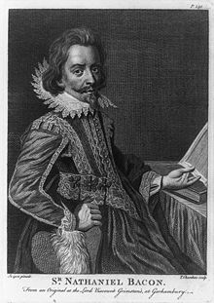
Final Jeopardy Answer
Bacon’s Rebellion

