Slide 1
Jeopardy
Jacksonian
Democracy
To the Left!
(Western Expansion)
Early 19th Century Presidents
Social Movements
‘Merica 1854
Q $100
Q $100
Q $100
Q $100
Q $100
Q $200
Q $200
Q $200
Q $200
Q $200
Q $300
Q $300
Q $300
Q $300
Q $300
Q $400
Q $400
Q $400
Q $400
Q $400
Q $500
Q $500
Q $500
Q $500
Q $500
Final Jeopardy

Slide 2
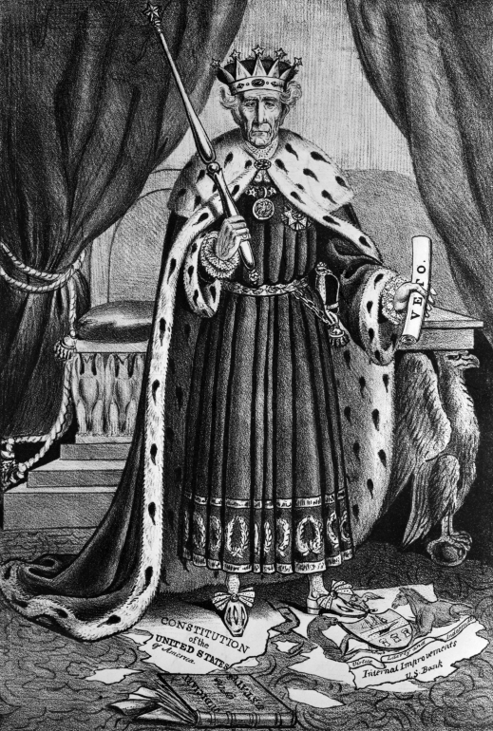
$100 Question from H1
All of the following groups would have been likely to agree with the image’s depiction of Andrew Jackson EXCEPT
South Carolinians who opposed federal tariffs
B. American Indians such as Cherokees
C. western farmers who opposed the national bank
D. advocates of federally funded internal improvement projects

Slide 3
$100 Answer from H1
Answer C: Western farmers who opposed the national bank

Slide 4
$200 Question from H1
The May 1838 forced expulsion of the Cherokee Indians from Georgia to the new Indian Territory is remembered by what name?

Slide 5
$200 Answer from H1
The Indian Removal Act
“Trail of Tears”

Slide 6
$300 Question from H1
What was the “Corrupt Bargain”?

Slide 7
$300 Answer from H1
Corrupt Bargain- Refers to Henry Clay giving his electoral votes to J.Q Adams in the Election of 1824 allowing him to be elected over Andrew Jackson

Slide 8
$400 Question from H1
True or False: Andrew Jackson supported Pet Banks.

Slide 9
$400 Answer from H1
True!
Remember: Pet Banks are federally funded state banks. Part of the Bank War; Jackson was very anti-National Bank!!!!!

Slide 10
$500 Question from H1
This was the term given to the defiance of the South Carolinian legislator in terms of laws enacted by the federal government.
Hint: Foreshadowed South Carolinian succession

Slide 11
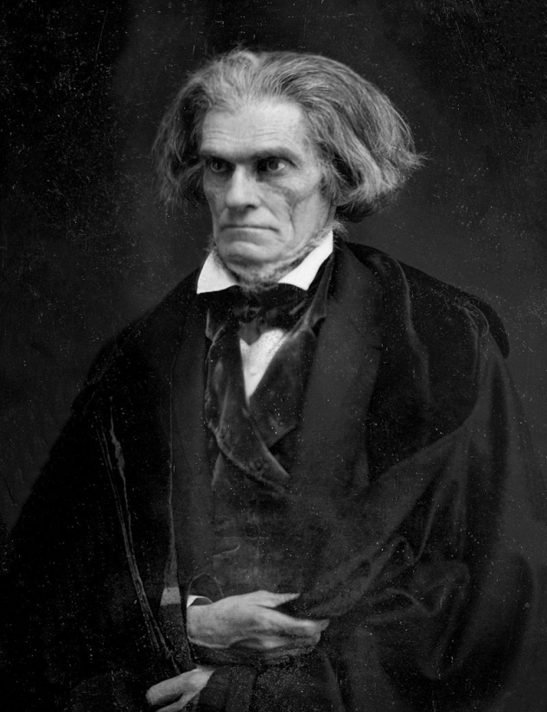
$500 Answer from H1
Nullification Crisis
Remember the Nullification Crisis was about federal tariffs that favored Northern manufacturers and hurt Southern planters!
Sen. John C. Calhoun

Slide 12
$100 Question from H2
What connection did John L. O'Sullivan's term “manifest destiny” have to American expansion of the mid-nineteenth century?
It was based on a vision of the equality of all peoples
The phrase embodied the dreams of American expansionists
It was the motivation behind the Kansas-Nebraska Act
It was the desire to united Native America with White Americans in western territories.

Slide 13
$100 Answer from H2
B) The phrase embodied the dreams of American expansionists

Slide 14
$200 Question from H2
These were the group of violent individuals from Missouri who illegally voted in Kansas elections for a proslavery government.

Slide 15
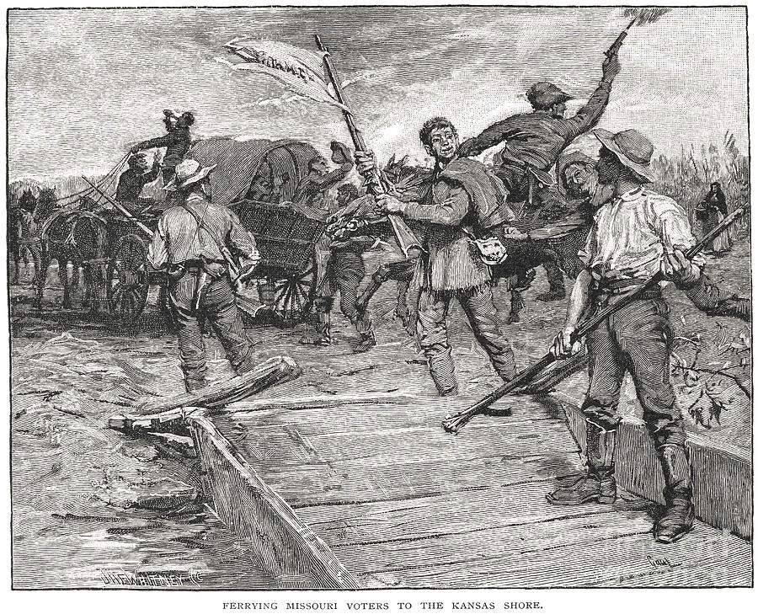
$200 Answer from H2
Border Ruffians

Slide 16
$300 Question from H2
Why did President James K. Polk retreat from his demand for “fifty-four forty or fight”?
He had used the slogan only for election purposes
Britain had threatened a full-scale war against the United States.
Russia had threatened to go to war against the United States over the land
The Mexican-American war had begun and wanted to avoid a war with Britain over Oregon

Slide 17
$300 Answer from H2
D) The Mexican-American war had begun and wanted to avoid a war with Britain over Oregon

Slide 18
$400 Question from H2
What was the Fugitive Slave Act?

Slide 19
$400 Answer from H2
A law in which denied slaves basic human rights and a path of fair treatment in the judicial system

Slide 20
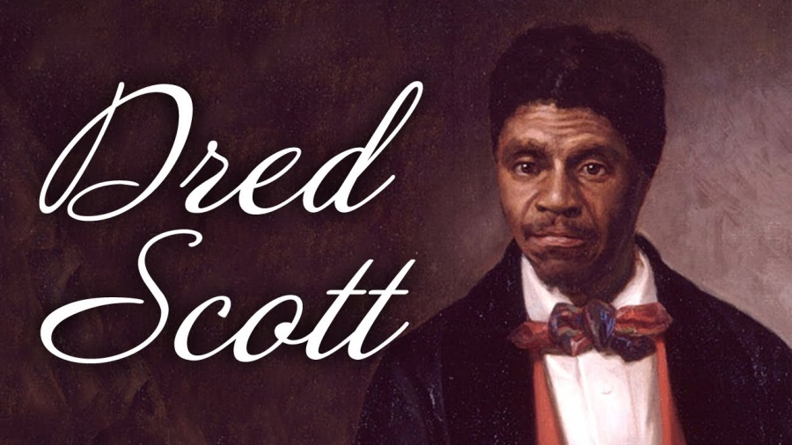
$500 Question from H2
In the Dred Scott decision, Chief Justice Taney ruled that this compromise was unconstitutional

Slide 21
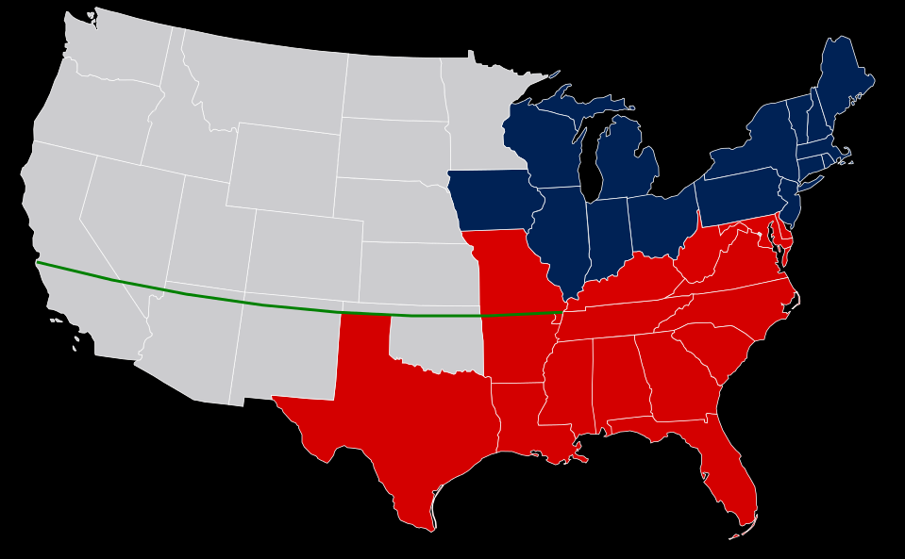
$500 Answer from H2
Missouri Compromise Line of 1820
Remember: Southerners loved this! Northerners hated it.

Slide 22
$100 Question from H3
I was against things like political parties and foreign entanglements because I believe that it would hurt America in the world.

Slide 23
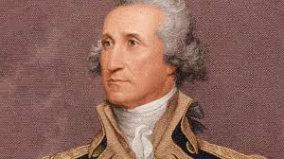
$100 Answer from H3
George Washington

Slide 24
$200 Question from H3
I was the 5th President of the United States; I wanted to protect America from foreign invasions and colonization as well as the rest of the Western Hemisphere. My presidency was considered the “Era of Good Feelings” Who am I?

Slide 25
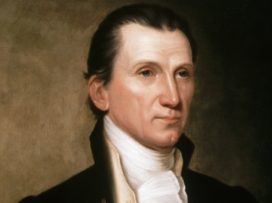
$200 Answer from H3
James Monroe
Remember: Monroe Doctrine

Slide 26
$300 Question from H3
The War of 1812 started when I was President. I belonged to the Democratic-Republican Party.

Slide 27
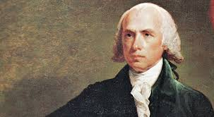
$300 Answer from H3
JAMES MADISON!!!!!!!!!!!!!!!!!!!!!!!!!!!!!!!!!!!!!!!!!!!!!!!!!!!!!!!!!!!!!!!!!!!!!!!!!!!!!!!!!!!!!!!!!!!!!!!!!!!!

Slide 28
$400 Question from H3
Henry Clay was my political bro and I carried on the legacy of the Monroe Doctrine. I was a Democratic-Republican but I supported the National Bank.

Slide 29
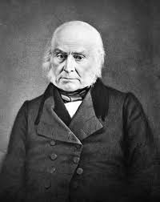
$400 Answer from H3
J.Q Adams

Slide 30
$500 Question from H3
I am a Virginian and I was the VP of William Henry Harrison, until he died 30 days into his Presidency from pneumonia. (“I was like bruh?”) Anyways, I was in the Whig Party but my strong support for states’ rights made me a hated man in that party. Who am I?

Slide 31
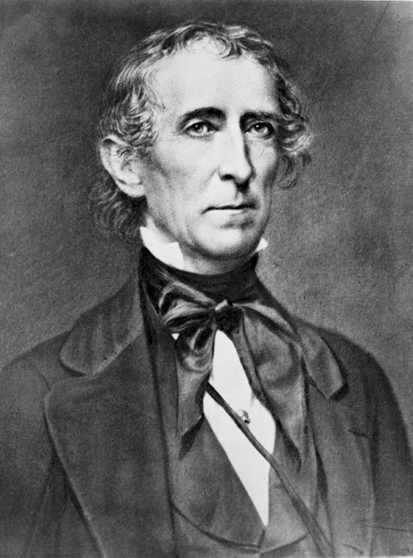
$500 Answer from H3
John Tyler
Remember: He was a strong supporter of Texas Independence
Ran unsuccessful reelection as a Democrat

Slide 32
$100 Question from H4
This man led a violent slave rebellion in Virginia during 1830s which led to strict slave codes in society.

Slide 33
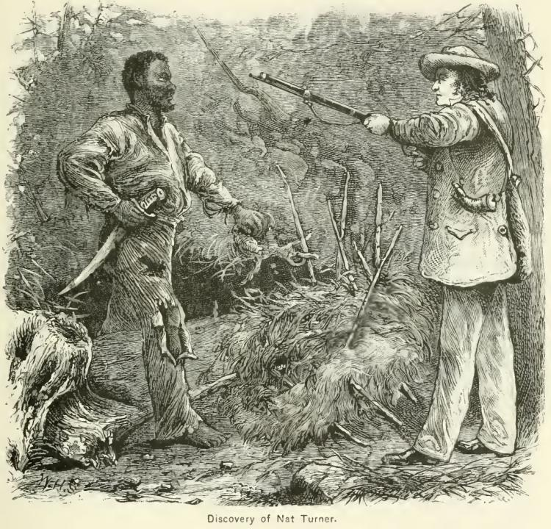
$100 Answer from H4
Nat Turner

Slide 34
$200 Question from H4
What aspect of transcendentalism is seen in Henry David Thoreau’s statement, “If a man does not keep pace with his companions, perhaps it is because he hears a different drummer”?
Individualism B. communion with nature
C. spirituality D. civil disobedience

Slide 35
$200 Answer from H4
A) Individualism

Slide 36
$300 Question from H4
This movement was sponsored and supported by evangelical Christian leaders to end consumption of alcoholic beverages

Slide 37
$300 Answer from H4
The Temperance Movement

Slide 38
$400 Question from H4
Seneca Falls had to do with what social movement?
Hint: Declaration of Sentiments was drafted

Slide 39
$400 Answer from H4
Women’s Rights Movement

Slide 40
$500 Question from H4
Which of the following was not a abolitionist?
A) John Brown
B) Frederick Douglass
C) William Lloyd Garrison
D) Dorothea Dix

Slide 41
$500 Answer from H4
Dorothea Dix
Remember: Dix is responsible for prison reform.

Slide 42
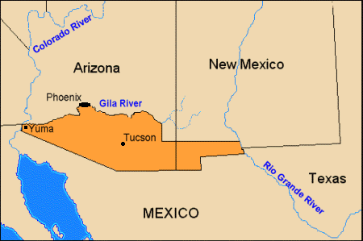
$100 Question from H5
This highlighted territory is land gained from which purchase?

Slide 43
$100 Answer from H5
Gadsden Purchase

Slide 44
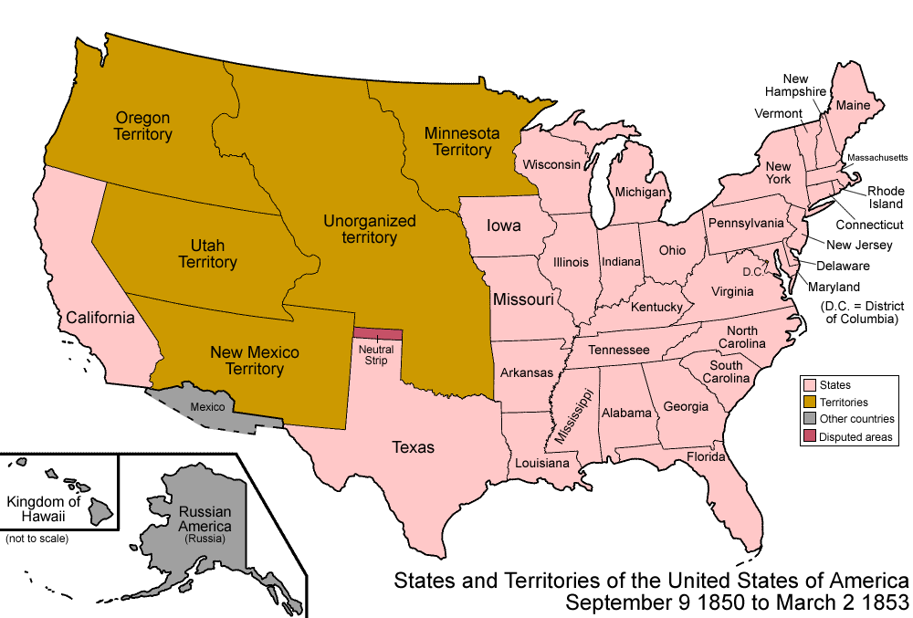
$200 Question from H5
Which letter represents the Utah Territory?
B
A
C
D

Slide 45
$200 Answer from H5
Letter C: Utah Territory

Slide 46
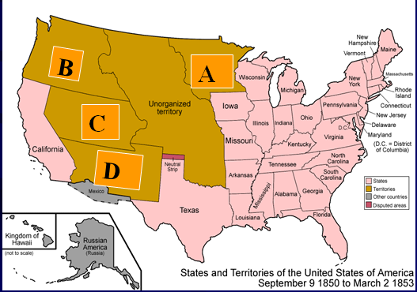
$300 Question from H5
Which letter represents the Oregon Territory?

Slide 47
$300 Answer from H5
Letter B) Oregon Territory

Slide 48
$400 Question from H5
Which letter represents the New Mexico Territory?

Slide 49
$400 Answer from H5
Letter D) New Mexico Territory

Slide 50
$500 Question from H5
The Unorganized Territory on this map is also known as what territory?
Hint: Think of two important states during this time period.

Slide 51
$500 Answer from H5
Kansas and Nebraska Territories

Slide 52
Final Jeopardy
Transcendentalism
Which of the following is properly paired?
James Fenimore Cooper-The Deerslayer
Nathaniel Hawthorne-The American Scholar
Harriet Beecher Stowe--The Legend of Sleepy Hollow
Walt Whitman--Walden

Slide 53
Answer A) James Fenimore Cooper-The Deerslayer

