Slide 1
Presidents
Source: www.whitehouse.gov

Slide 2
George Washington 1789-97

Slide 3
John Adams 1797-1801

Slide 4
Thomas Jefferson 1801-09

Slide 5
James Madison 1809-17

Slide 6
James Monroe 1817-25

Slide 7
John Quincy Adams 1825-29

Slide 8
Andrew Jackson 1829-37

Slide 9
Martin Van Buren 1837-41

Slide 10
William Henry Harrison 1841

Slide 11
John Tyler 1841-45

Slide 12
James K. Polk 1845-49

Slide 13
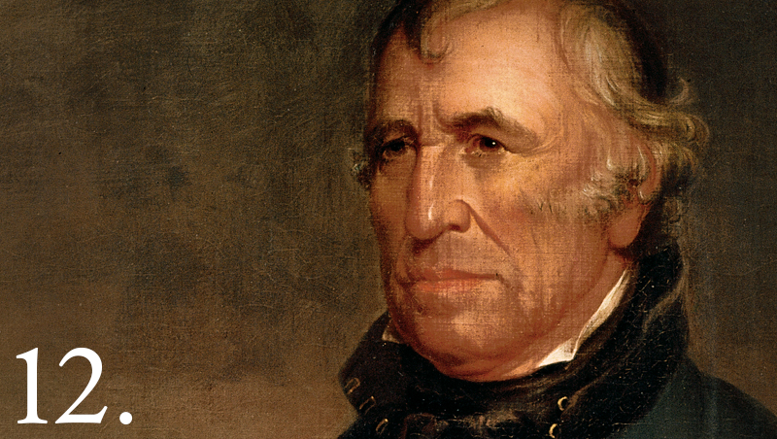
Zachary Taylor 1849-1850
Whig
Won fame as general in Mexican-American War, “Old Rough and Ready”
Declared he was willing to go to war to prevent Southern secession rather than compromise

Slide 14
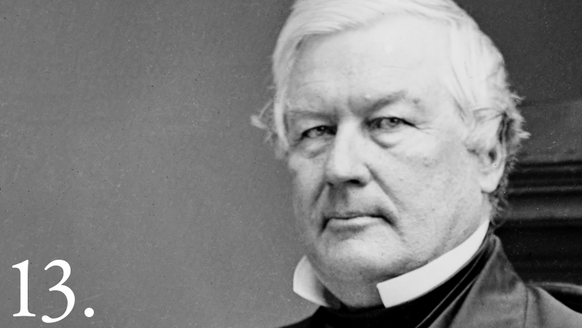
Millard Fillmore 1850-1853
Last President from the Whig party.
Approved the Compromise of 1850, which included the Fugitive Slave Act.
Later, he joined the Know-Nothing Party.

Slide 15
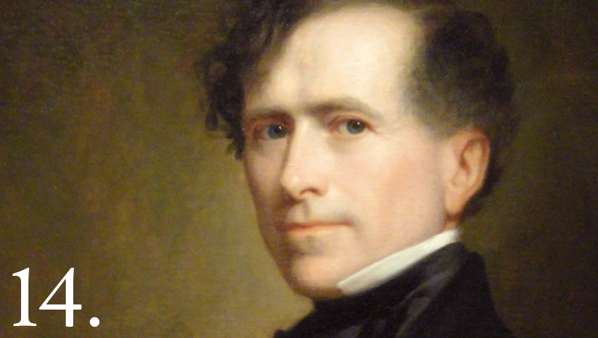
Franklin Pierce 1853-1857
Democrat
Advocated western expansion, upsetting Northerners.
Supported the Kansas-Nebraska Act
“Bleeding Kansas” soon followed during his administration
Treaty of Kanagawa opening trade with Japan

Slide 16
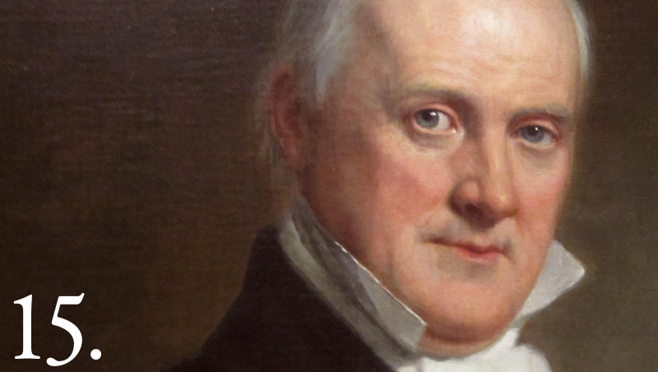
James Buchanan 1857-1861
Democrat
Only President never to marry
Though he thought he could maintain compromise between sectional interests, he failed to prevent the South from seceding
Dred Scott decision issued days after his inauguration.

Slide 17
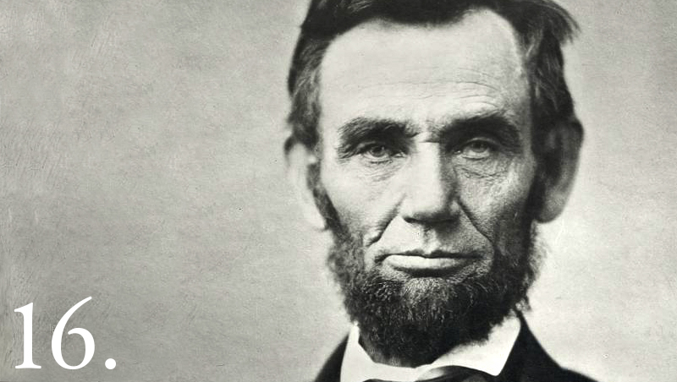
Abraham Lincoln 1861-1865
Republican
Believed secession was illegal and was willing to use force to prevent it.
Led nation through Civil War.
With his Emancipation Proclamation, the Civil War became clearly a war about slavery.

Slide 18
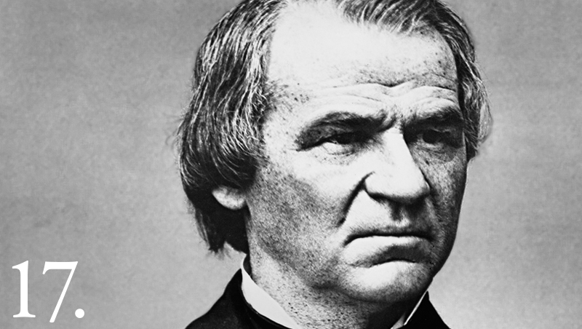
Andrew Johnson 1865-1869
National Union Party
War Democrat from Tennessee.
Oversaw Reconstruction, but was overpowered by Radical Republicans in Congress who had a different vision for Reconstruction.
14th Amendment, Civil Rights Act of 1866, Black Codes
Impeached, charged with violating the Tenure in Office Act, but was acquitted.

Slide 19
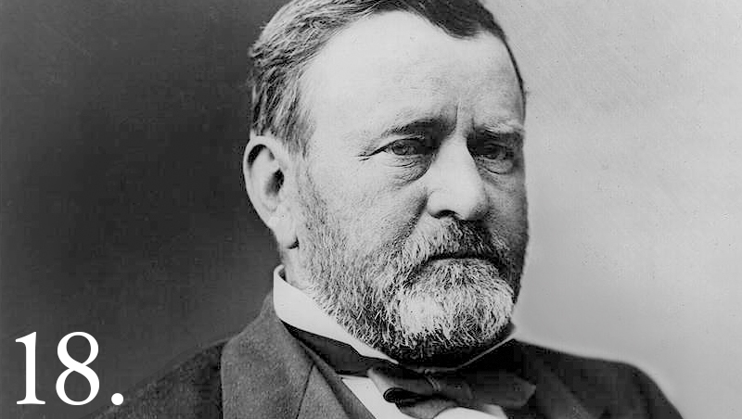
Ulysses S. Grant 1869-1877
Republican
Hero of the Union army.
Supported Radical Reconstruction.
Reduced frontier violence but Great Sioux War of 1876
Supported gold standard
Panic of 1873 (failure)
Unable to annex Dominican Republic

Slide 20
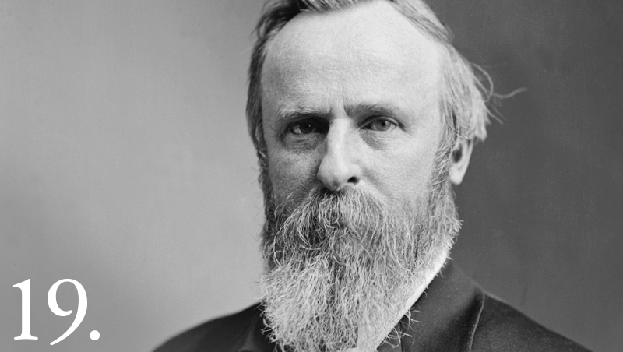
Rutherford B. Hayes 1877-1881
Republican
Defeated Samuel J. Tilden in the disputed election of 1876.
Electoral victory was secured with the promise of ending Reconstruction by withdrawing federal troops from the south.
Contrary to expectations, he avoided rewarding his supporters according to spoils system.

Slide 21
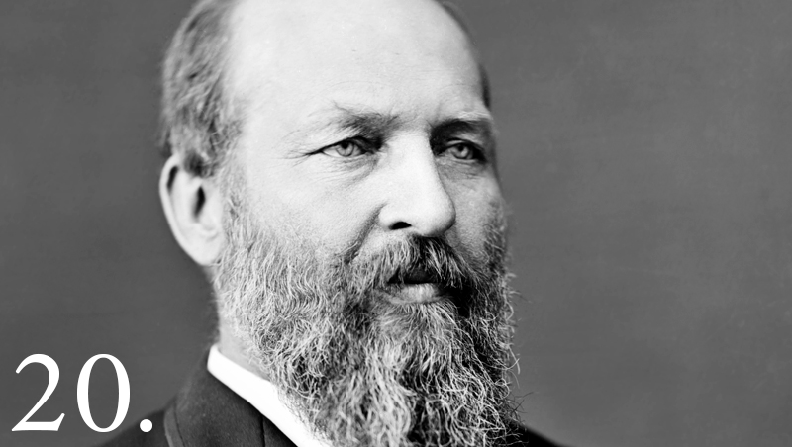
James A. Garfield 1881
Republican
Battled Roscoe Conkling and Stalwart Republicans
Energized naval power
Tried to reform the spoils system (ended corruption in Post Office)
Assassinated

Slide 22
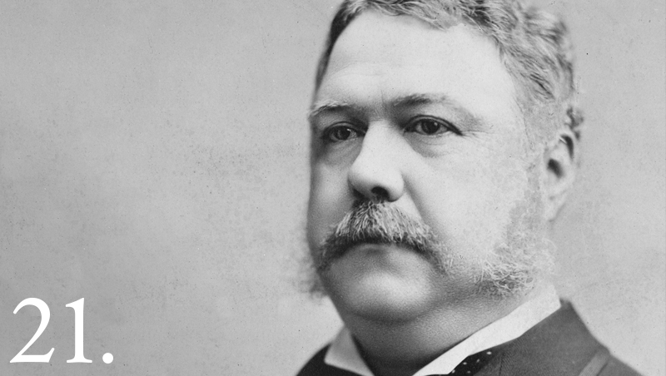
Chester A. Arthur 1881-1885
Republican
Initially supported spoils system, but as president established Civil Service (Pendleton Act)
Tried to lower tariff rates when government was earning surpluses, but signed Tariff Act of 1883
First federal immigration law

Slide 23
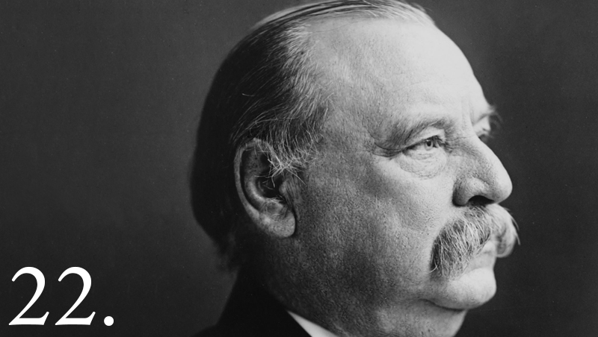
Grover Cleveland 1885-1889, 1893-1897
Democrat
Only President to serve non-consecutive terms
Careful never to grant favors to special interest groups—including seed to drought-stricken farmers or pensions to Civil War veterans based on disabilities not caused by the war
Supported gold standard
Economic depression in second term—policies dealing with it were unpopular
Sent federal troops to break railroad strike
24.

Slide 24
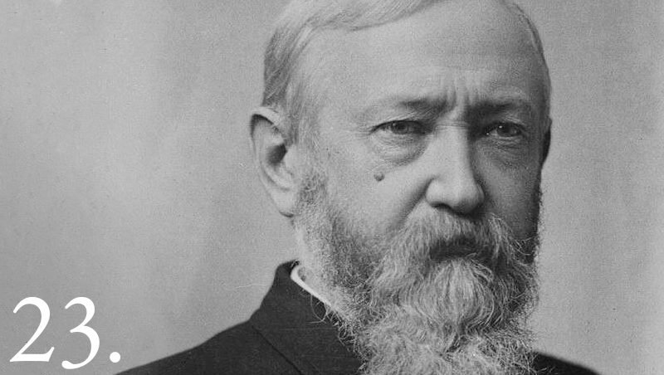
Benjamin Harrison 1889-1893
Republican
Lost popular vote but won electoral vote
Advocated for voting rights for African-Americans
Opposed by western Republicans
Signed Sherman Anti-Trust Act
President during first “Billion-Dollar Congress”

Slide 25
William McKinley (1897-1901)
Republican
Oversaw victory in Spanish-American War
Raised protective tariffs
Open Door Policy
Increasing involvement in world affairs
Assassinated

Slide 26
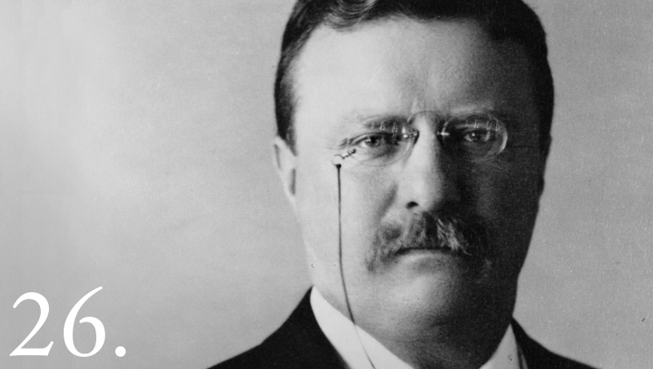
Theodore Roosevelt (1901-1909)
Republican
Fought in Spanish-American War (led Rough Riders)
Square Deal, “trust-buster”
Conservationist--issued executive orders to create wildlife refuges and national parks
Negotiated peace treaty following Russo-Japanese War

Slide 27
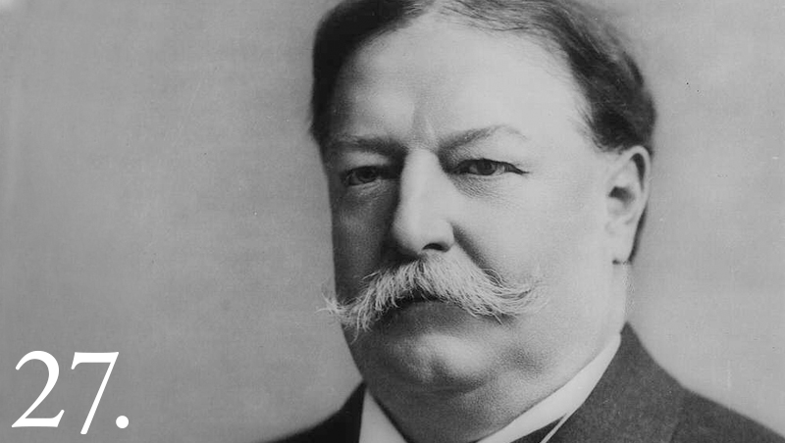
William Howard Taft (1909-1913)
Republican
Avoided press in contrast to T. Roosevelt
Continued Roosevelt’s trust-busting

Slide 28
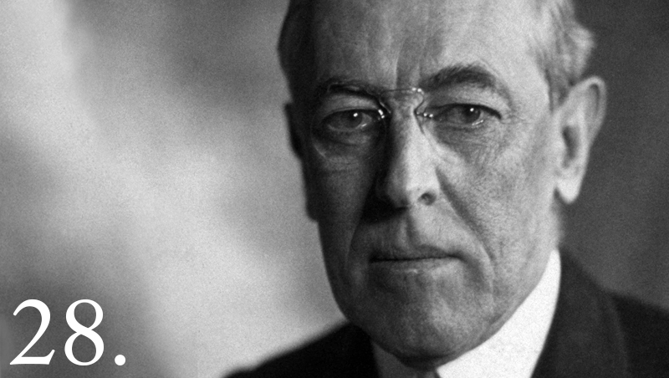
Woodrow Wilson (1913-21)
Democrat
New Freedom
WWI
Neutrality initially
“Make the World Safe for Democracy”
Fourteen Points
League of Nations

Slide 29
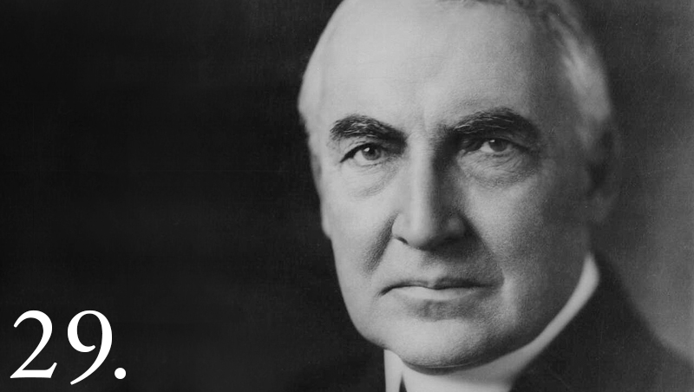
Warren G. Harding (1921-23)
Republican
Teapot Dome Scandal
Sensitive to plights of women, minorities

Slide 30
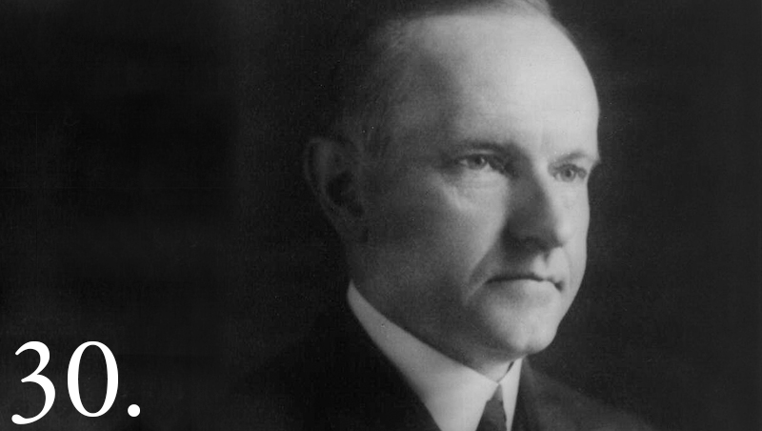
Calvin Coolidge (1923-29)
Republican
“Silent Cal”
Called for isolationism in foreign policy, tax cuts, frugality
Roaring Twenties

Slide 31
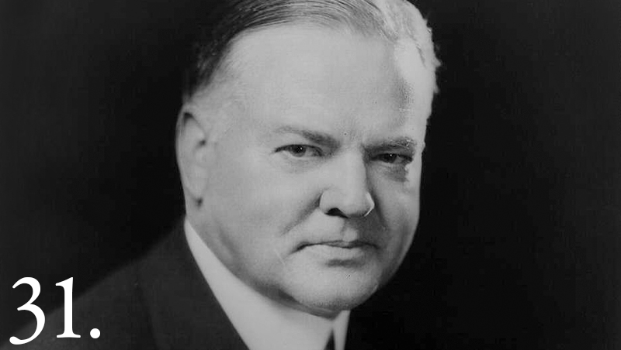
Herbert Hoover (1929-33)
Republican
“Great Humanitarian” who fed Europe during WWI as head of Food Administration
Stock Market Crash, Great Depression
Responded with tax cuts, called for public works programs
Felt aid should be from local volunteers, not gov’t

Slide 32
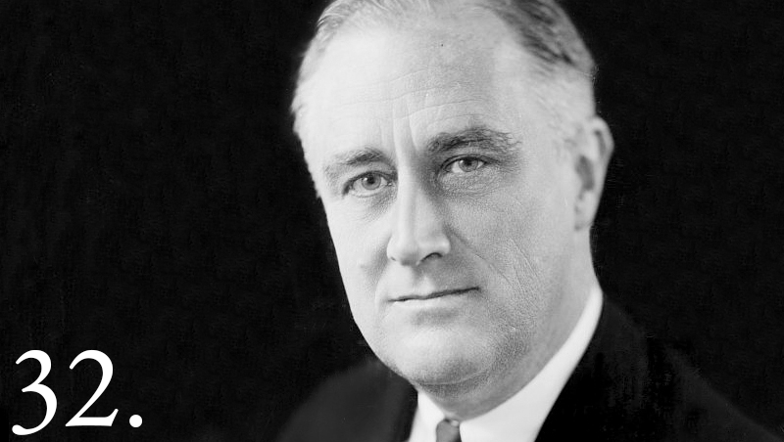
Franklin D. Roosevelt (1933-45)
Democrat (elected 4x)
New Deal to address Great Depression
Alphabet Soup legislation
Fireside Chats
Supreme Court Packing
WWII
Atlantic Charter
Tehran, Yalta Conferences
Manhattan Project

Slide 33
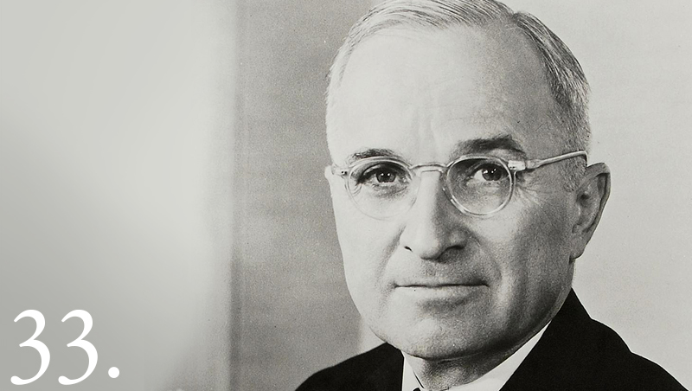
Harry S Truman (1945-53)
Democrat
Atomic bombing of Japan
United Nations
Cold War
Containment
Truman Doctrine
Marshall Plan
NATO
Korean War
Fair Deal--Expanded social security, fair employment, public housing,

Slide 34
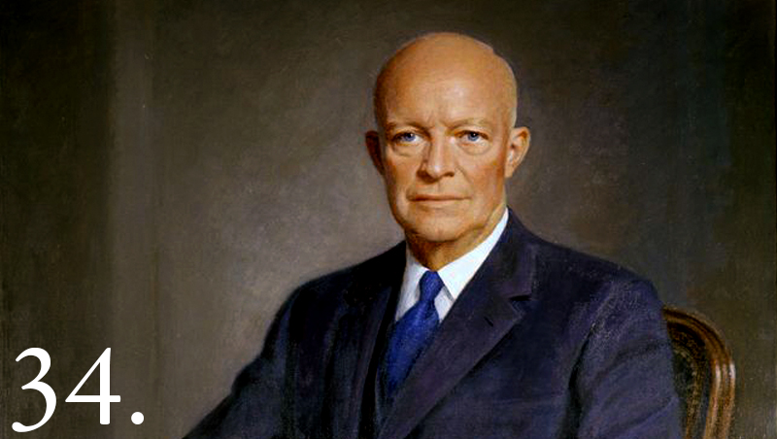
Dwight D Eisenhower (1953-61)
Republican (“I Like Ike”)
Former SCAP-Europe
Korean War
Negotiated truce
Cold War
McCarthyism
Space Race
Civil Rights
Desegregation

Slide 35
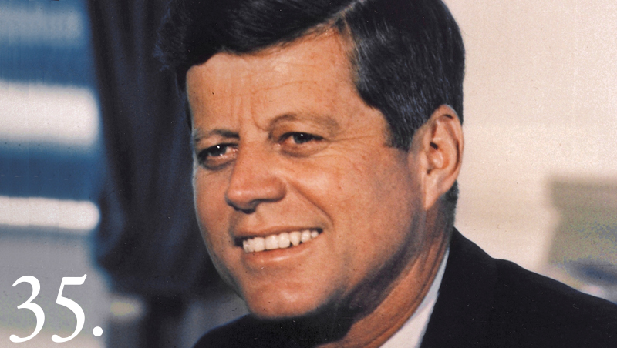
John F. Kennedy (1961-63)
Democrat
New Frontier
“Camelot”
Cold War
Berlin Wall
Bay of Pigs, Cuban Missile Crisis
Civil Rights
Space Program
Peace Corps

Slide 36
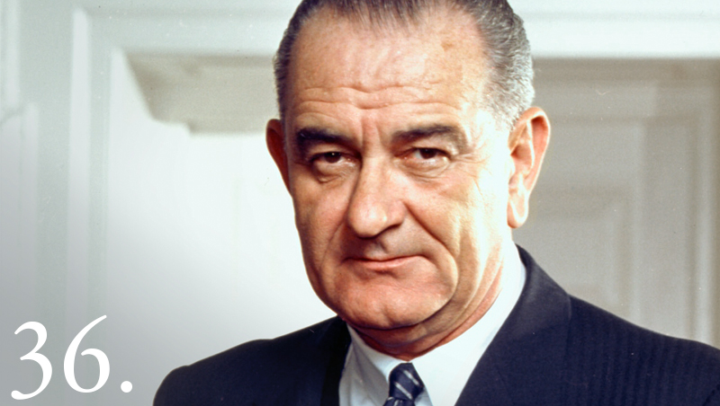
Lyndon B. Johnson 1963-69
Democrat
“Great Society”
War on Poverty
Medicare
Vietnam War
Civil Rights
Civil Rights Act, Voting Rights Act

Slide 37
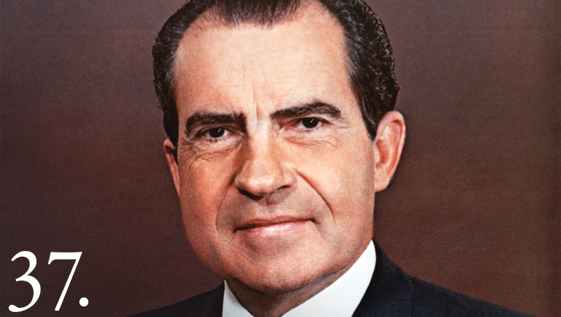
Richard M. Nixon (1969-74)
Republican
“Silent Majority” (vs. Counterculture)
Vietnam War
Vietnamization
Escalation—Cambodia
Diplomacy with China
Détente (SALT I)
Middle East—Yom Kippur War
Watergate--resignation

Slide 38
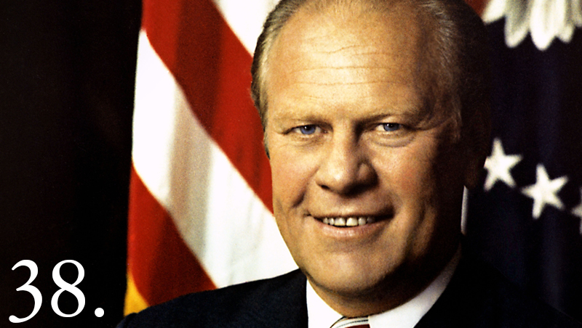
Gerald R. Ford (1974-77)
Republican
Pardoned Nixon
Issues included inflation, recession
International issues: collapse of S. Vietnam, Cambodia; Middle East crisis continued

Slide 39
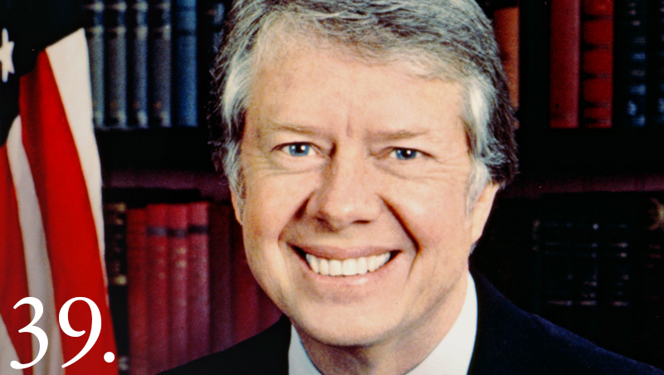
Jimmy Carter (1977-81)
Democrat
Combatted inflation and unemployment
Advocate for human rights
Camp David Accords (Israel and Egypt)
Soviet invasion of Afghanistan
Iran Hostage Crisis

Slide 40
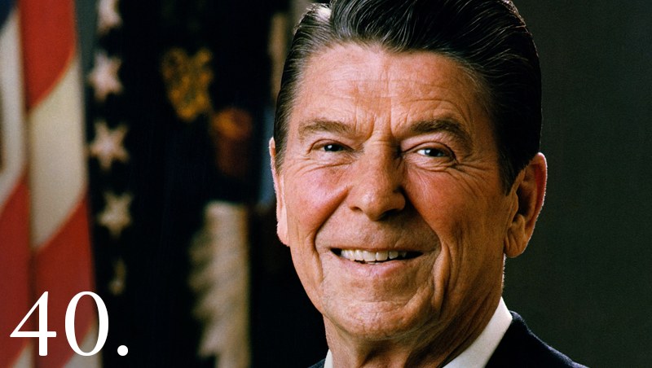
Ronald Reagan (1981-89)
Republican
“Morning again in America”--prosperity
“Mr. Gorbachev, tear down this wall!”
New Conservatism/ Reagan Revolution
Increased defense spending—end of detente
Strategic Defense Initiative--“Star Wars”
Supported “Contras” in Nicaragua—Iran-Contra Scandal

Slide 41
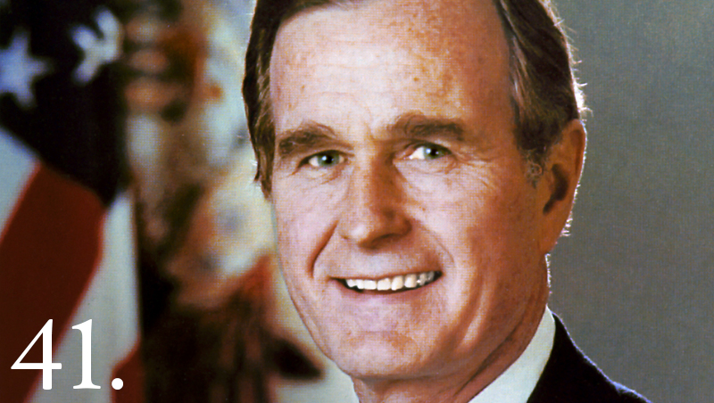
George H.W. Bush (1989-93)
Republican
“A kinder, gentler nation”
“No New Taxes”—faltering economy
Collapse of Soviet Union
Persian Gulf War

Slide 42
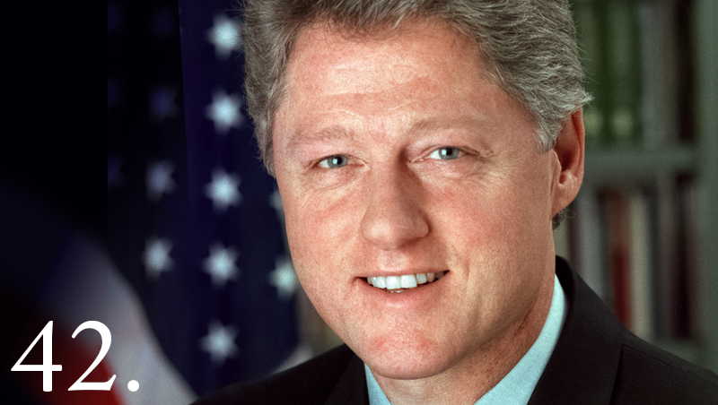
Bill Clinton (1993-2001)
Democrat
Proposed universal health care (failed)
Reduced welfare rolls, reduced crime rates
NAFTA
With NATO, sent troops to Bosnia
Did not send troops to Rwanda
Impeached
(Monica Lewinsky)
Found not guilty in Senate trial

Slide 43
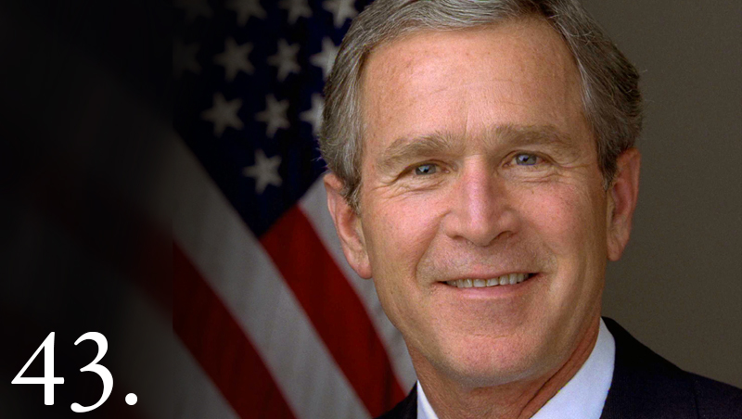
George W. Bush 2001-09
Republican
9/11 attacks
War in Afghanistan
War in Iraq
Patriot Act
War on Terror
“Compassionate Conservatism”
No Child Left Behind
Volunteerism

Slide 44
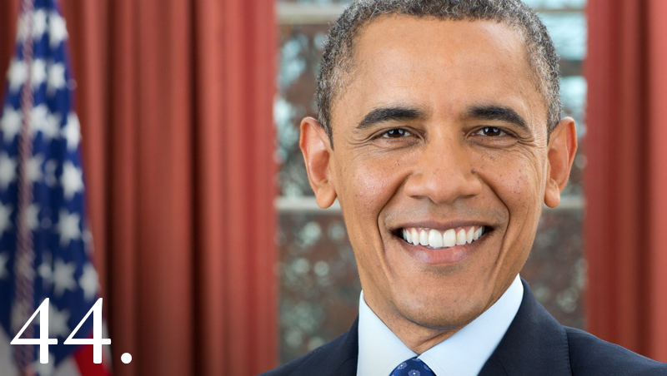
Barack Obama (2009- )
Democrat
Affordable Care Act (Obamacare)
Great Recession
Immigration—Dream Act
Race
First African-American president
Police violence/Black Lives Matter
End of wars in Afghanistan and Iraq?
Attempts to close Guantanamo Bay
Rise of ISIS

