Slide 1
BELL RINGER
List as many things that you know about the Articles of Confederation and the Constitution in their respective spots on the white boards.

Slide 2
Revolution to New Nation

Slide 3
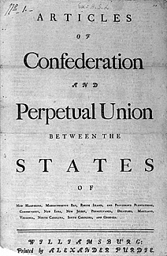
Articles of Confederation
Committee appointed to draft this “constitution” before the Declaration of Independence
Adopted by Congress 1777
Finally ratified by all 13 states in 1781
Conflict between “land-rich” and “land-hungry” states
Agreement to turn western lands to “common cause”; provision to create new “republican states,” NOT colonies

Slide 4
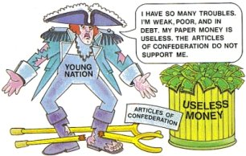
Articles of Confederation--Weaknesses
No executive branch
Judicial branch in state governments
only
Each state had equal votes in Congress,
regardless of population
Amendment by unanimous vote only
Congress could not regulate commerce; states had conflicting laws and were printing their own money
No means of enforcing tax collection (or many other things)

Slide 5
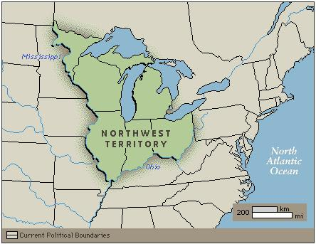
Articles of Confederation--Strengths
Congress could make and enforce treaties
Congress could establish a postal service
Effectively held states together from Continental Congress to Constitution
Land Ordinance of 1785, Northwest Ordinance of 1787 provided a process for admitting new states

Slide 6
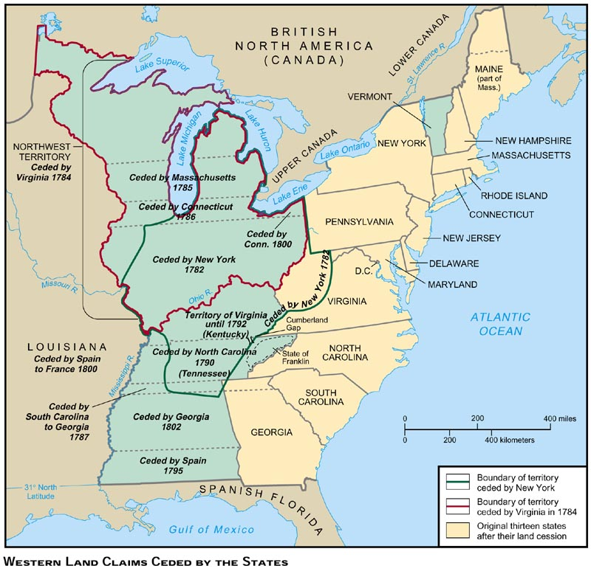

Slide 7
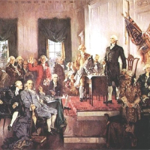
Constitution
Constitutional Convention: May-September 1787
Secret proceedings
55 delegates, 12 states (not Rhode Island)
Conservative, wealthy, educated
Goal: Preserve and strengthen new nation; ensure security (foreign and domestic)
Articles of Confederation required unanimous ratification to be amended. Therefore, framers stipulated creation of new document, not amendment. When 9 states ratified, Constitution became supreme law in those states.

Slide 8
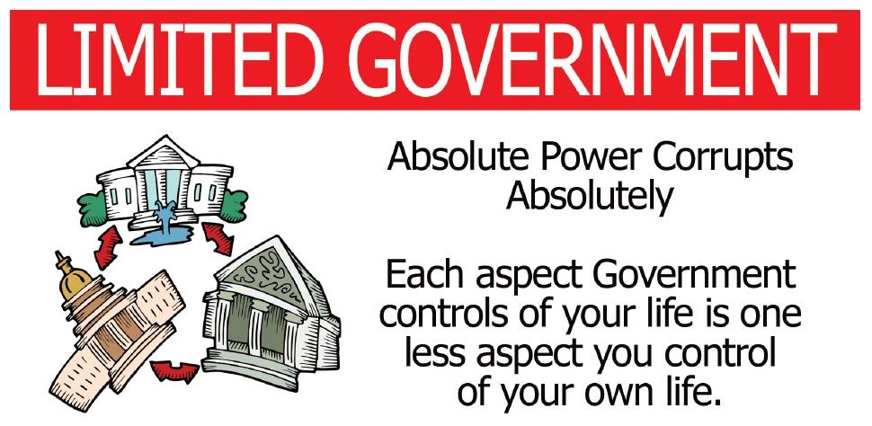
Constitution--Agreement
Stronger government than that provided by Articles
Three branches, checks and balances
Opposition to universal manhood suffrage
Popular sovereignty
Limited government

Slide 9
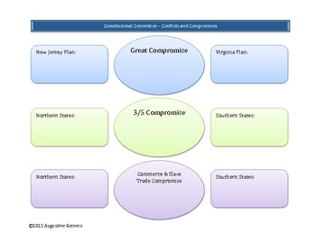
Constitution--Controversies
Virginia Plan vs. New Jersey Plan
Great Compromise
Direct election of President
Electoral College; if tie decision by House of Representatives
Should slaves be counted in population?
3/5 Compromise
Abolition of slave trade
Postponed to 1807

Slide 10
Constitution--Ratification
Debate between federalists (Washington, Franklin, Madison, Hamilton—wealthy, educated, organized) vs. anti-federalists (Samuel Adams, R.H. Lee, Patrick Henry—poorer classes, debtors)
Federalist Papers (see # 10): “Extensive Republic”

Slide 11
Ratification--Antifederalists
Opposed ratification (Patrick Henry, Thomas Jefferson)
Gov’t will be too big—
Population too large for everyone’s interests to be represented
Too diverse--U.S. has different climates, economic interests
Republics should be composed of people with similar interests, beliefs
●When republics expand, they become tyrannical
● Impossible to protect the “public good” if the community is too large

Slide 12
Ratification: Federalists
Favored Ratification (Hamilton, Madison, John Jay)
Federalist Papers
Factions—political group; small or large group of citizens who share ideas, “adverse to the rights of other citizens” or to the interests of the community
Republic vs. Democracy—Democracy requires smaller, more exclusive group in order to function. Republic allows representation of everyone
Extensive Republic—larger population allows broader range of ideas

Slide 13
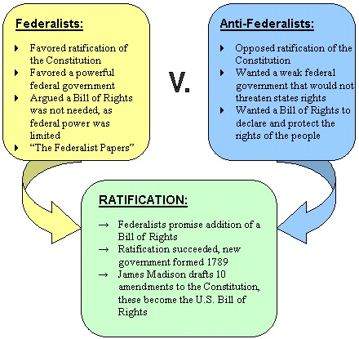
Summary
Antifederalists—It is better to have 13 small republics; the US is too big to function as one republic; the government will become tyrannical
Federalists—Only a strong central government can prevent the development of factions and protect the interest of the community as a whole
Bill of Rights=compromise: it protected individuals from tyranny by the government

Slide 14
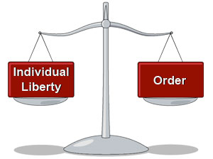
Constitution--Ratification
Bill of Rights—demanded by antifederalists; promised by federalists
Four states (VA, NY, NC, RI)—realized they could not stand alone outside the new United States
Liberty vs. Order OR Liberty plus Order

Slide 15
America 1750

Slide 16
Maps 1754-1763

Slide 17
U.S. 1800

Slide 18
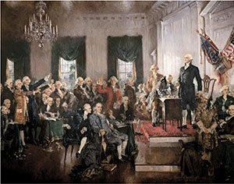
Scene at the Signing of the Constitution

