Slide 1
Unit 4: 1800-1848
Politics
Economics
Society

Slide 2
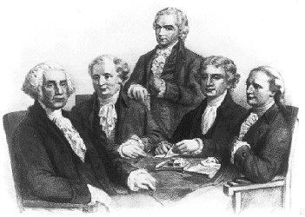
George Washington 1789-1797 Federalist
Established Cabinet of close advisers
French Revolution
Neutrality Proclamation
Organized troops against Whiskey Rebellion
BIG PICTURE IMPACT: Promoted unity; warned against factions and foreign entanglements

Slide 3
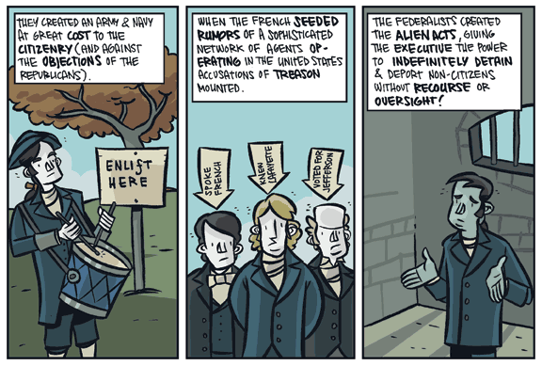
John Adams 1797-1801 Federalist
War in Europe
Alien and Sedition Acts
Library of Congress
BIG PICTURE IMPACT: Last Federalist president;

Slide 4
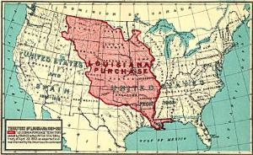
Thomas Jefferson 1801-09 Democratic-Republican
Tripolitan War
Louisiana Purchase
Lewis and Clark
Embargo Act
BIG PICTURE IMPACT: Doubled the size of the nation; inadvertently promoted manufacturing

Slide 5
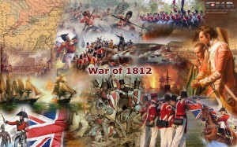
James Madison 1809-17 Democratic-Republican
Macons Bill # 2
To reopen international trade
War of 1812
Invasion of Canada
Treaty of Ghent
Status Quo Ante Bellum
Battle of New Orleans
BIG PICTURE IMPACT: Didn’t lose to Britain in War of 1812; defeated Indians; growth of manufacturing

Slide 6
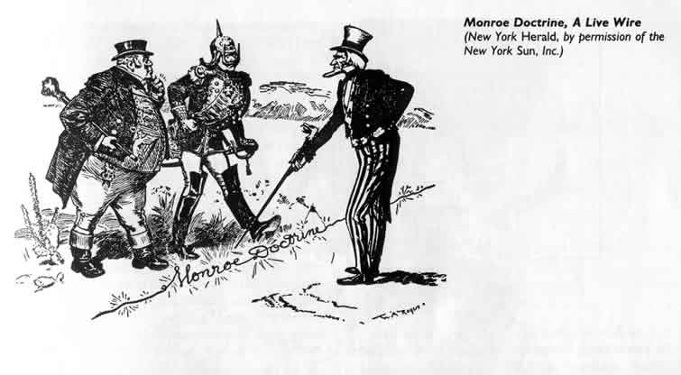
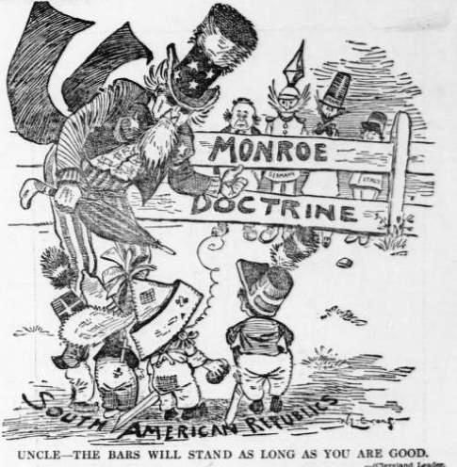
James Monroe 1817-1825 Democratic-Republican
Era of Good Feelings
Panic of 1819
Acquisition of Florida
Monroe Doctrine
BIG PICTURE IMPACT: National unity; beginnings of isolationism; economic struggle

Slide 7
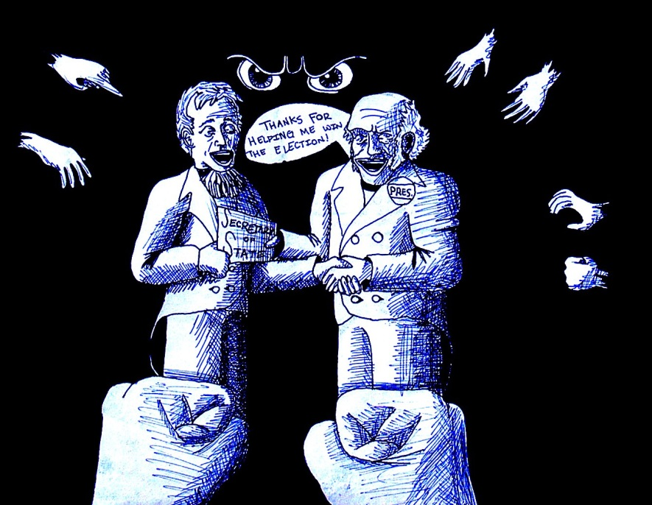
John Quincy Adams 1825-29 Democratic-Republican (later National Republican)
Supported Monroe Doctrine as Secretary of State
“Corrupt Bargain”
BIG PICTURE IMPACT: Nationalist in a time that leaned toward sectionalism and states’ rights;

Slide 8
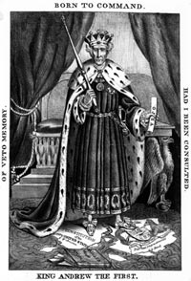
Andrew Jackson 1829-37 Democrat
Spoils System
Indian Removal Act
Bank War
Tariff of 1828/nullification crisis
Independence of Texas from Mexico
BIG PICTURE IMPACT: Jacksonian Democracy; sectionalism; western expansion; increased power of the executive branch

Slide 9
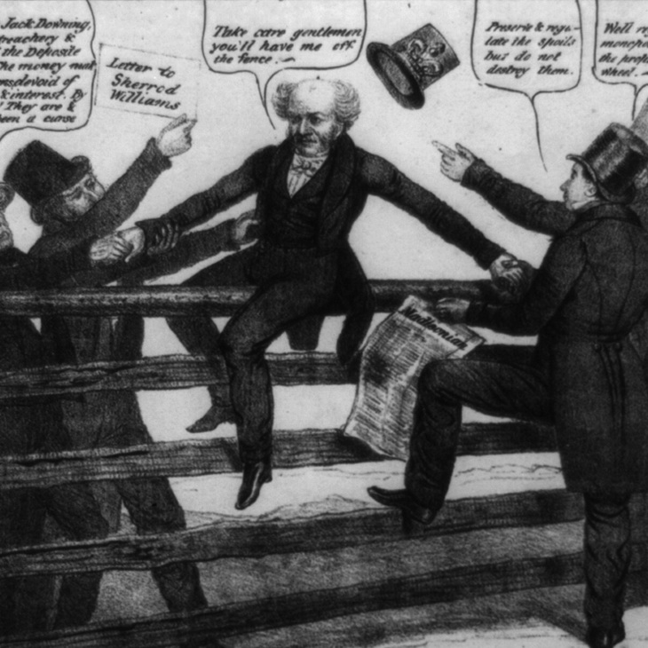
Martin Van Buren 1837-41 Democrat
First President born as an American citizen
Panic of 1837
Independent Treasury

Slide 10
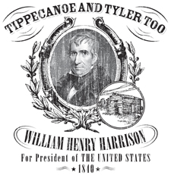
William H. Harrison 1841 Whig
Previously successful military hero—Battle of Tippecanoe (vs. Indians) and Battle of the Thames (vs. British and Indians)
Died in office after 30 days
BIG PICTURE IMPACT: triumph of populist democratic style (log cabin/hard cider)

Slide 11
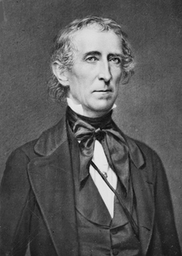
John Tyler 1841-45 Whig
Entire Cabinet resigned after unpopular vetoes of protective tariff and bank bill; expelled from Whig Party
Strict Constructionist of Constitution; supporter of States’ Rights
Supported Manifest Destiny—worked to annex Texas
Opened trade with China
BIG PICTURE IMPACT: Unpopular in his own party

Slide 12
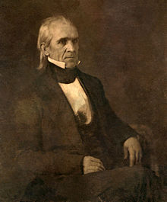
James K. Polk 1845-49 Democrat
Lowered tariff to satisfy South
Restored independent treasury
Mexican-American War to secure annexation of Texas
Acquired California; settled Oregon dispute
BIG PICTURE IMPACT: Foreign policy success; worked to satisfy North and South politically, socially, and economically

Slide 13
Democracy evolves
The United States developed the world’s first
modern mass democracy and celebrated a new national culture, while Americans sought to define the nation’s democratic ideals and to reform its institutions to match them.

Slide 14
Federal Power
Federal Government vs. States
Three Branches—Checks and Balances
Rights and Responsibilities of Individuals

Slide 15
Political Parties
1790s: Federalists vs. Democratic-Republicans
1800-1820: Democratic-Republicans without significant opposition
1828-48s: Democrats vs. Whigs

Slide 16
Supreme Court Decisions
Asserts federal power over state laws
Asserts strength of judicial branch to interpret Constitution
Marbury v. Madison
Fletcher v. Peck
Dartmouth College v. Woodward
McCulloch v. Maryland
Cohens v. Virginia
Gibbons v. Ogden

Slide 17
Regional Conflicts
Economic Conflicts
Embargo Act
Tariffs
National Bank
Slavery
Internal Improvements

Slide 18
Society and Culture
Second Great Awakening
Liberalism
Romanticism
Abolitionist Movement (Slave Trade Abolished, American Colonization Society, Frederick Douglass)
Women’s Rights (Seneca Falls)
Utopian Communities
Reaction (xenophobia, pro-slavery, anti-Indian)

Slide 19
American Identity--Arts
European + Regional/Local Culture
James Fenimore Cooper
Washington Irving
Hudson River School
John James Audubon
Women, Native American, Urban Culture
African American
Richard Allen
David Walker
Slave Music

Slide 20
Work, Technology, and Trade
Developments in technology, agriculture, and
commerce precipitated profound changes in U.S. settlement patterns, regional identities, gender and family relations, political power, and distribution of consumer goods.

Slide 21
Industrial Revolution in America
Global market and communications revolution, influencing and influenced by technological innovations, led to dramatic shifts in the nature of agriculture and manufacturing.
Mechanical Reaper
Steam Engine
Interchangeable Parts
Canals and Railroads
Telegraph

Slide 22
Shift to Manufacturing and Finance
Women in factories and low-skilled male workers produced goods for distant markets
Urban entrepreneurs went into finance rather than manufacturing
Lowell System
Baldwin Locomotive Works
Coal Mining

Slide 23
Regional Economic Specialization
Cotton farming in south (dependent on slave labor) provided raw material for northeastern manufacturing
National economy—foreign trade (cotton); American System
North and Midwest most closely linked via market system
Demand for natural resources
Free and forced migration of Native Americans
Labor
Geographic Boundaries

Slide 24
Peopling of America
Native-born whites moved west
Community replaced family
European immigrants settled in east and midwest
Strong ties between northeast and Old Northwest
South remained distinct from other regions

Slide 25
Economics and Society
Widening gap between rich and poor
Emerging middle and working classes
Increasing separation between home and workplace
Changes in gender and family roles
Cult of Domesticity
Lydia Marie Childs
Early Labor Unions

Slide 26
America in the World
U.S. interest in increasing foreign trade, expanding its national borders, and isolating itself from European conflicts shaped the nation’s foreign policy and spurred government and private initiatives.

Slide 27
Expanding geographically; trading internationally
Louisiana Purchase
Oregon border negotiation
Annexation of Texas
Trade with China

Slide 28
Dominance of North America
Diplomatic, Military, Judicial methods
Monroe Doctrine
Webster-Ashburton Treaty

Slide 29
Conflicts over expansion
Slave vs Non-slave areas
Missouri Compromise
Defining Native American territories
War Hawks
Indian Removal Act
Seminole Wars
Worcester v. Georgia
Resistance of federal power from states
Hartford Convention
Nullification Crisis

