Slide 1
The Civil War and Transformation of American Society
Unit 5 Overview

Slide 2
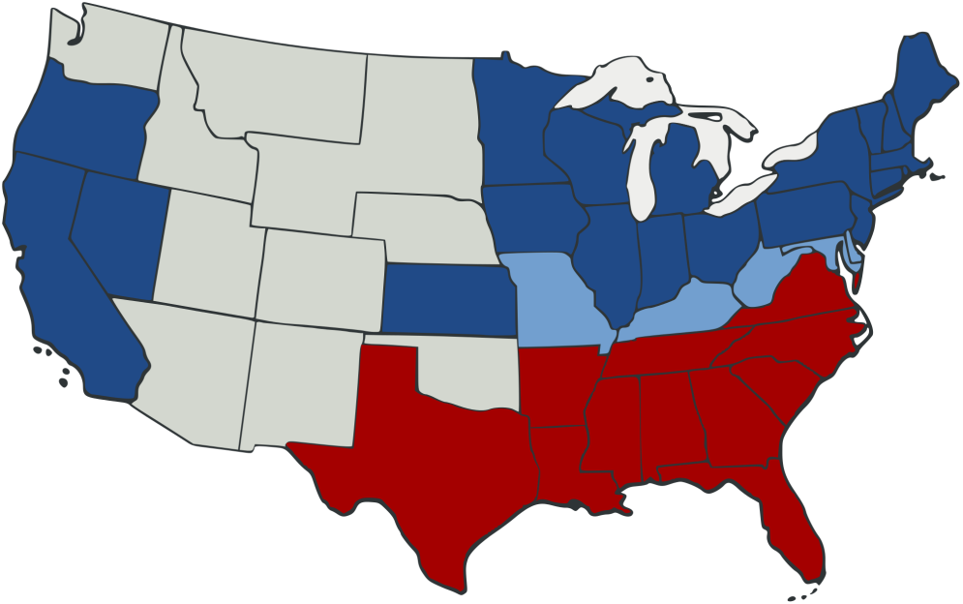
Period 5: 1844-1877
As the nation expanded and its population grew, regional tensions, especially over slavery, led to a civil war — the course and aftermath of which transformed American society.

Slide 3
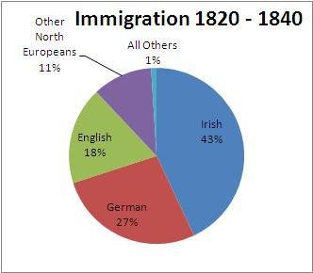
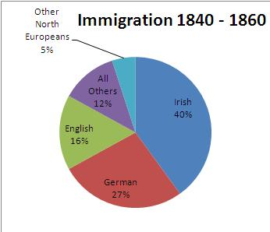
Key Concept 5.1
The United States became more connected with the world as it pursued an expansionist foreign policy in the Western Hemisphere and emerged as the destination for many migrants from other countries.
Germans
Irish

Slide 4
I. Why expansion?
Bolstered by economic and national security interests
Resulted in
Acquisition of new territories
Substantial migration westward
New overseas initiatives

Slide 6
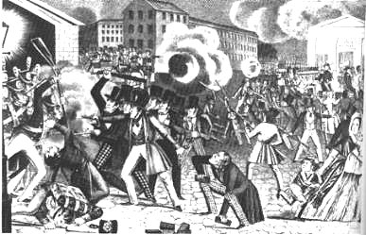
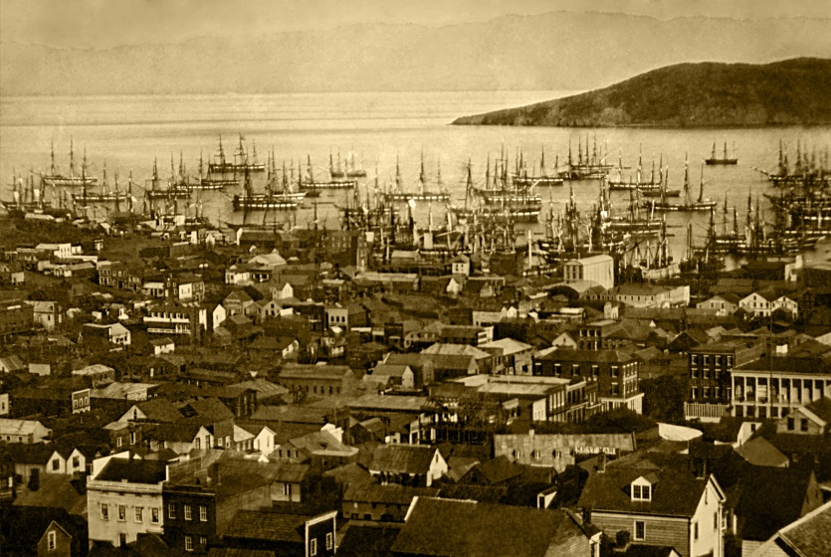
A. Desire for access to natural and mineral resources and the hope of many settlers for economic opportunities or religious refuge led to an increased migration to and settlement in the West. Forty-niners Chinese immigration Pike’s Peak Mormons Comstock Lode Decline of buffalo
Merchant ships fill San Francisco harbor, 1850–51

Slide 7
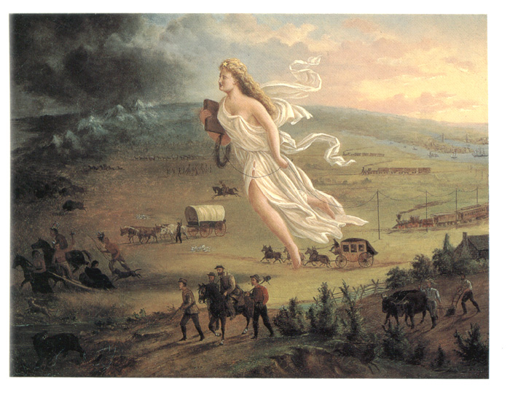
B. Advocates of annexing western lands argued that Manifest Destiny and superiority of American institutions compelled the U.S. to expand its borders to the Pacific Ocean
Manifest Destiny
Election of 1844
Annexation of Texas
Slidell Mission
Bear Flag Revolt
Treaty of Guadalupe Hidalgo
Gadsden Purchase

Slide 8
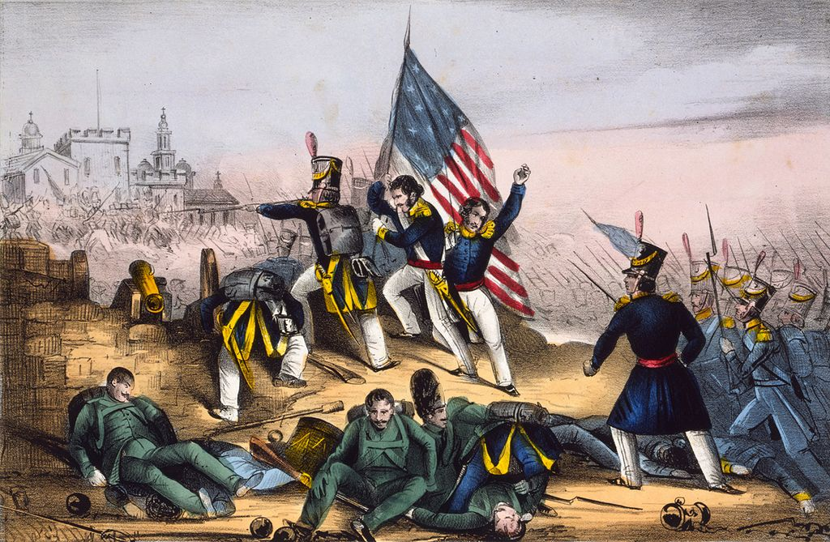
C. U.S. added large territories in the West
Victory in Mexican-American War
Negotiations
Raised questions about status of slavery, American Indians, and Mexicans in newly acquired lands
Wilmot Proviso
Free Soil Party
Civil Disobedience (Thoreau)
Popular sovereignty
Attack on Chapultepec, Sept. 13th 1847--Mexicans routed with great loss

Slide 9
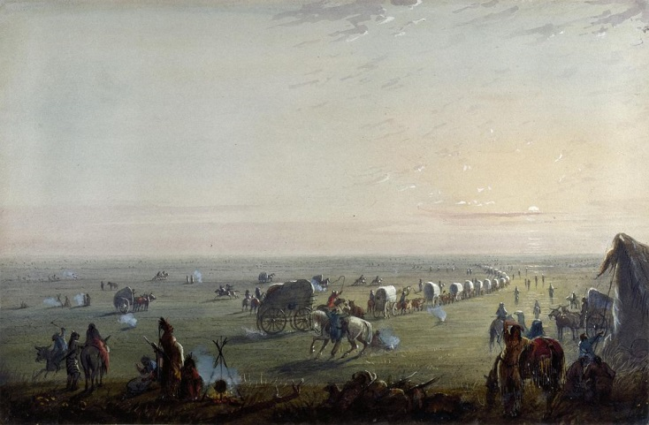
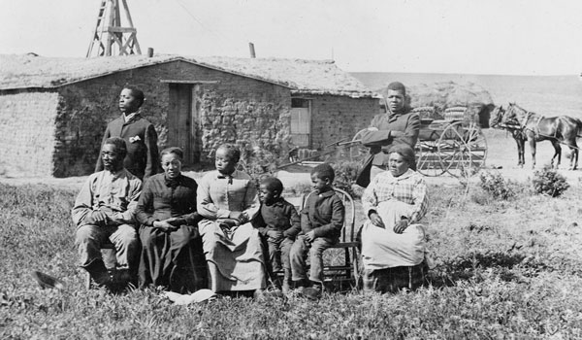
D. Westward migration was boosted during and after the Civil War by the passage of new legislation promoting Western transportation and economic development.
The Oregon Trail: Breaking up Camp at Sunrise, by Alfred Jacob Miller
Gadsden Purchase
Pacific Railway Act
Oregon Donation Land Claim Act Homestead Act
Morrill Land Grant Act

Slide 10
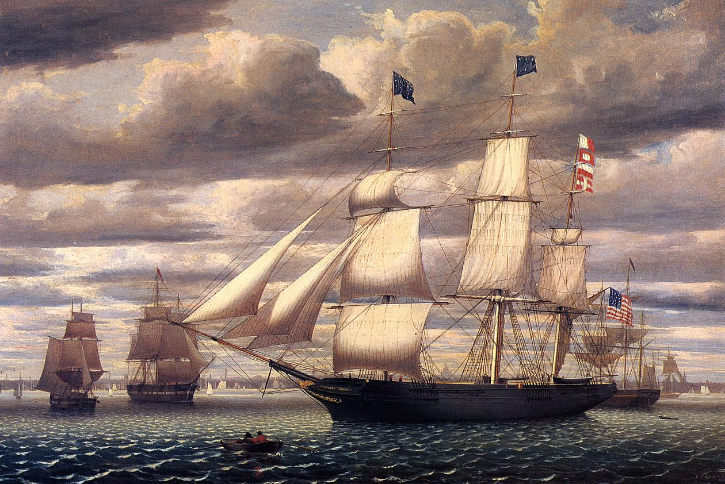
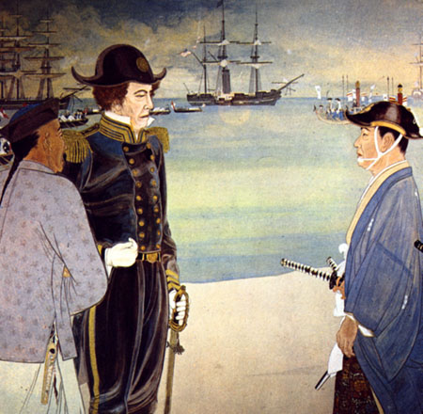
E. U.S. interest in expanding trade
Clipper ship Southern Cross leaving Boston Harbor, 1851, by Fitz Hugh Lane
Led to economic, diplomatic, and cultural initiatives westward to create more ties with Asia
Clipper ships
Treaty of Wanghia
Commodore Matthew Perry’s expedition to Japan
Missionaries
Cmdre. Matthew C. Perry commanded US naval forces in the China seas. He warned Pres. Fillmore that the British would soon control all trade in the area. The US should take "active measures to secure a number of ports of refuge" in Japan.
Perry arrived in Tokyo Harbor in 1853.

Slide 11
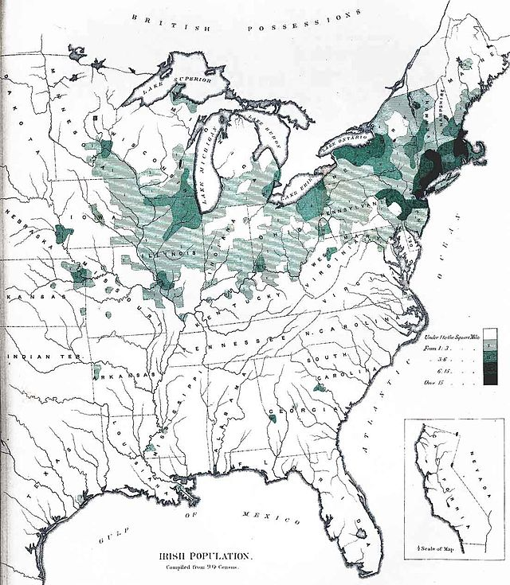
II. Conflicts over rights and citizenship for various groups of U.S. inhabitants (1840s-1850s)
Substantial numbers of international migrants continued to arriver from Europe and Asia, mainly from Ireland and Germany, often settling in ethnic communities where they could preserve elements of their languages and customs
Old Immigration
Irish Potato Famine
Parochial Schools

Slide 12
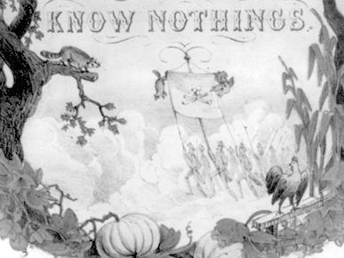
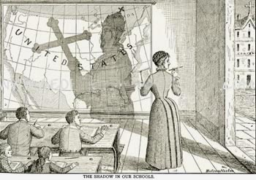
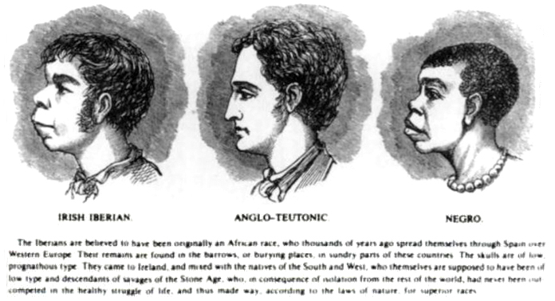
Nativism
B. Gave rise to a major, often violent nativist movement that was strongly anti-Catholic and aimed at limiting immigrants’ political power and cultural influence
Know-Nothing Party (American Party)

Slide 13
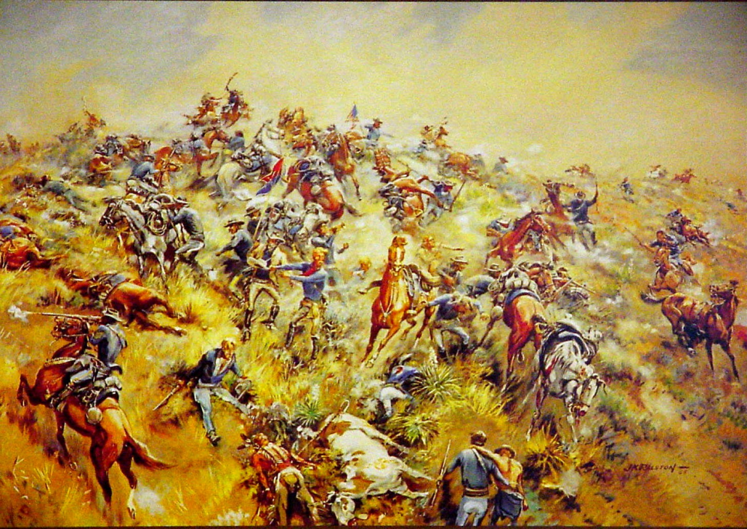
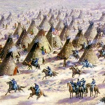
C. Interaction and Conflict
U.S. Government vs. Mexican-Americans and American Indians
Increased in regions newly taken from American Indians and Mexico
Altered these groups’ economic self-sufficiency and cultures
Mariano Vallejo
Californios
Sand Creek Massacre
Little Big Horn

Slide 14
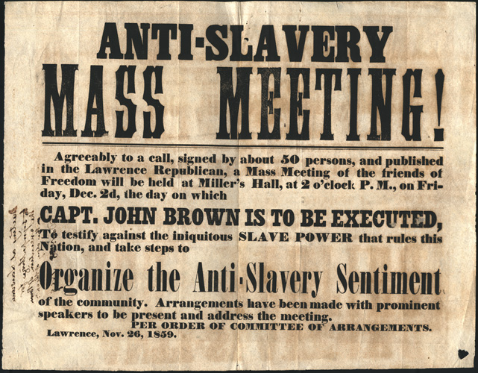
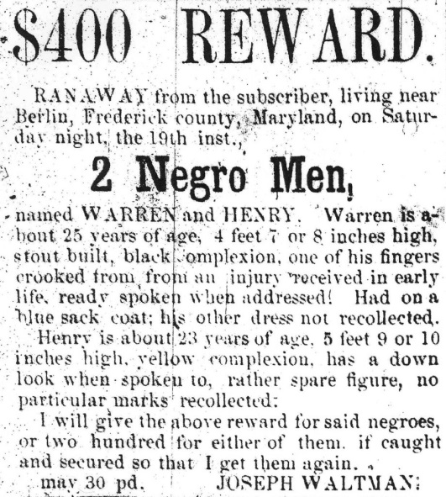
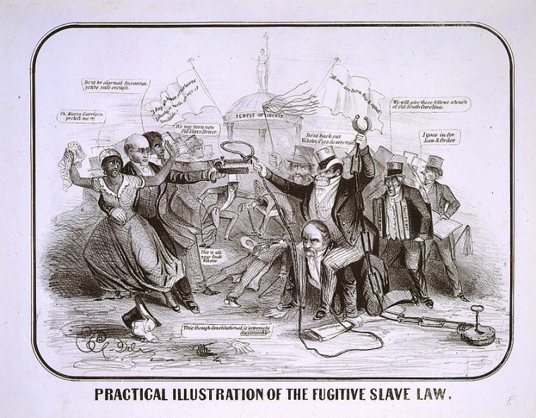
Key Concept 5.2
Intensified by expansion and deepening regional divisions, debates over slavery and other economic, cultural, and political issues led the nation into civil war.

Slide 15
I. Intensifying Sectionalism
Caused by
Ideological differences over slavery
Economic differences over slavery

Slide 16
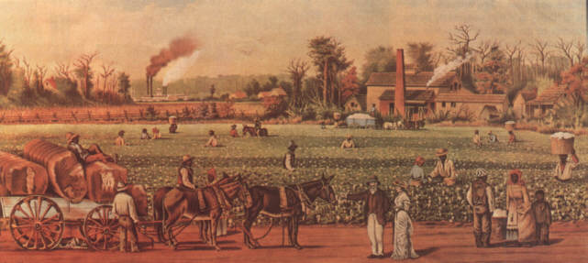
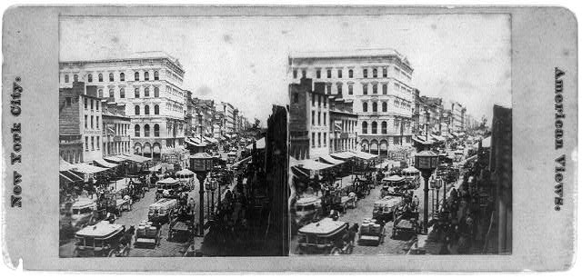
North vs. South
Expanding manufacturing economy
Dependence on free labor
Some northerners
Did not object to slavery on principle
Argued slavery undermined free labor market
Emergence of Free Soil Movement
Slavery is incompatible with free labor
Slow population growth
Slave-based agriculture

Slide 17
II. Debates over slavery dominated political discussion in the 1850s, culminating in the bitter election of 1860 and the secession of the Southern states.
The Mexican cession led to heated controversies over whether to allow slavery in the newly acquired territories

Slide 18
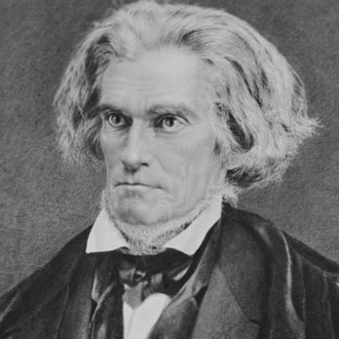
North vs. South
Abolitionists
Minority in North
African-American and White
Waged highly visible campaign against slavery
Moral Arguments—Wm. L. Garrison, F. Douglass
Assistance in Escapes--Underground Railroad
Violence—Nat Turner, John Brown
Defenders of slavery
Defense of slavery as a positive good
Racial doctrines
Constitutional protection of slavery and states’ rights
John C. Calhoun

Slide 19
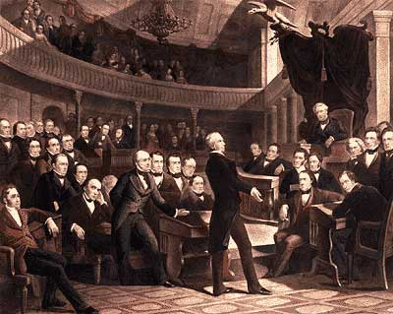
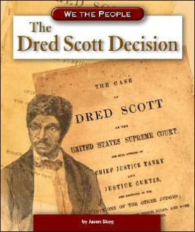
B. Attempts at sectional compromise
Compromise of 1850
Kansas-Nebraska Act
Dred Scott decision
These all ultimately failed to reduce conflict
The "Great Compromiser," Henry Clay, introduces the Compromise of 1850 in the Senate.

Slide 20
C. End of Second Party System
Issues of slavery and anti-immigrant nativism weakened loyalties to the two major parties
Emergence of sectional parties
Republican Party in the North
Free soil doctrine
Lincoln’s “House Divided” speech
Lincoln-Douglas debates
Freeport Doctrine (Stephen Douglas)

Slide 21
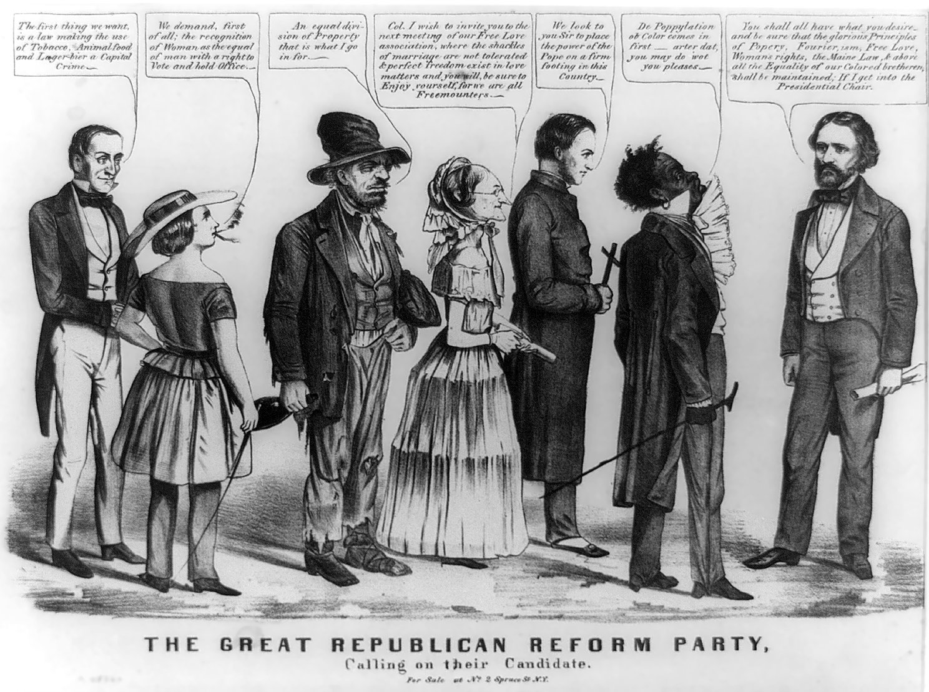
This Democratic editorial cartoon links Republican candidate John Frémont (far right) to other radical movements including temperance,
feminism,
Fourierism, free love, Catholicism, and abolition.

Slide 22
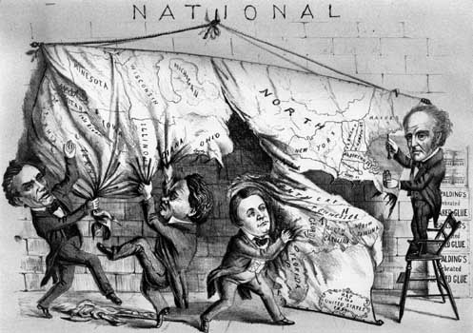
D. Election of 1860
Lincoln’s election on a free soil platform in the election of 1860 accomplished without any Southern electoral votes
Led various Southern leaders to conclude that their states must secede from the Union, precipitating civil war.
Cartoon from the 1860 presidential election showing three of the candidates—(left to right) Republican Abraham Lincoln, Democrat Stephen A. Douglas, and Southern Democrat John C. Breckinridge—tearing the country apart, while the Constitutional Union candidate, John Bell, applies glue from a tiny, useless pot.
Library of Congress, Washington, D.C.

Slide 23
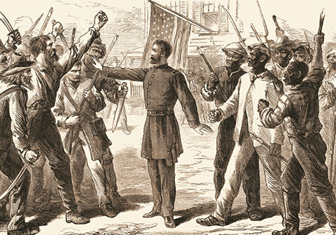
Key Concept 5.3
The Union victory in the Civil War and the contested reconstruction of the South settled the issues of slavery and secession, but left unresolved many questions about the power of the federal government and citizenship rights.
“The tumultuous decade that followed the Civil War failed to enshrine black voting and civil rights, and instead paved the way for more than a century of entrenched racial injustice.” www.washingtonmonthly.com

Slide 24
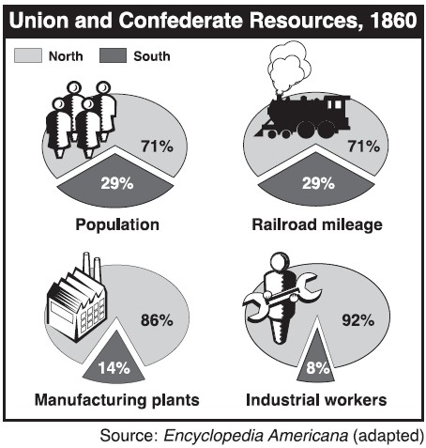
I. Union advantages
The North’s greater manpower and industrial resources, the leadership of Abraham Lincoln and others, and the decision for emancipation eventually led to the Union military victory over the Confederacy in the devastating Civil War.

Slide 25
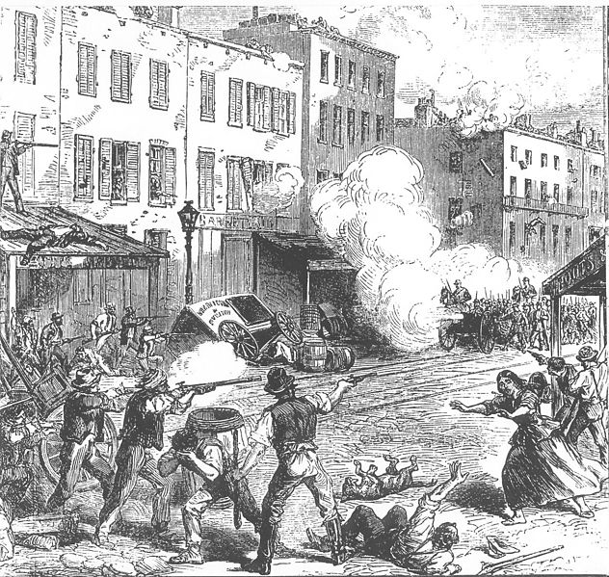
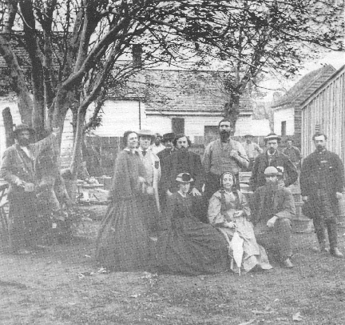
A. Mobilization
New York City Draft Day Riots, 1863
Both the Union and the Confederacy mobilized their economies and their societies to wage the war even while facing considerable homefront opposition
Suspension of Habeas corpus
Morrill Tariff
Conscription acts
Radical Republicans
War Democrats

Slide 26
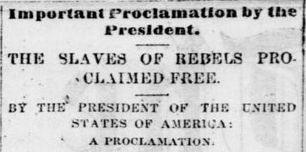
B. Emancipation Proclamation
Lincoln’s decision to issue the Emancipation Proclamation reframed the purpose of the war and helped prevent the Confederacy from gaining full diplomatic support from European powers.
Many African-Americans fled southern plantations and enlisted in the Union army and helping to undermine the Confederacy
Notice of the Emancipation Proclamation from the The Alleghenian, September 25, 1862

Slide 27
C. Gettysburg Address
Lincoln sought to reunify the country and used speeches such as the Gettysburg address to portray the struggle against slavery as the fulfillment of America’s founding democratic ideals.
Battle of Gettysburg
Significance of “Fourscore and seven years ago…”

Slide 28
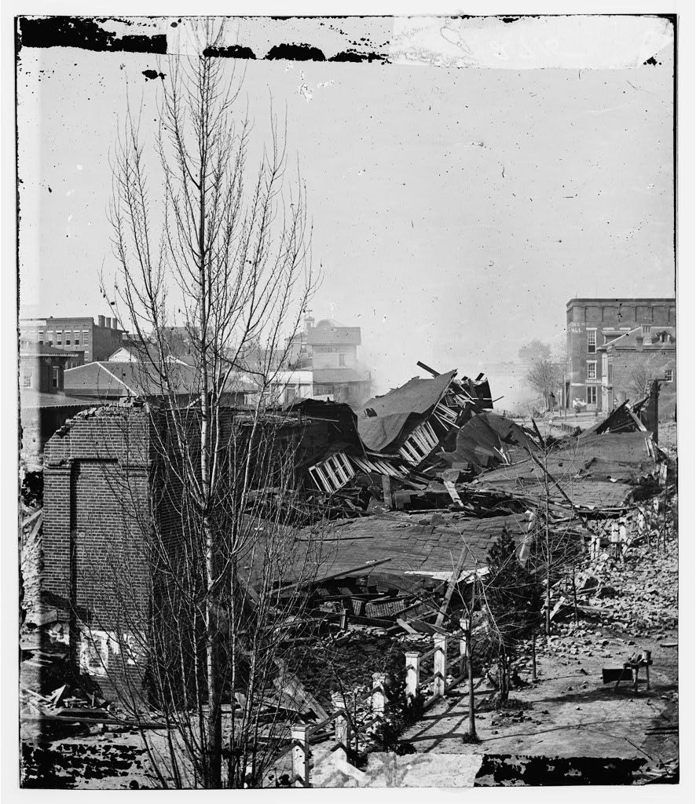
D. Union victory
Although Confederate leadership showed military initiative and daring early in the war, the Union ultimately succeeded due to improvements in leadership and strategy, key victories, greater resources, and the wartime destruction of the South’s infrastructure.
Anaconda Plan
Antietam
Battle of Gettysburg
Vicksburg
Union’s “total war” strategy
Sherman’s March to the Sea
Appomattox Courthouse
Sherman’s army left Atlanta in ruins in November 1864 and marched to Savannah, the famous “March to the Sea.”

Slide 29
II. Outcomes
The Union victory in the Civil War and the contested reconstruction of the South settled the issues of slavery and secession, but left unresolved many questions about the power of the federal government and citizenship rights.

Slide 30
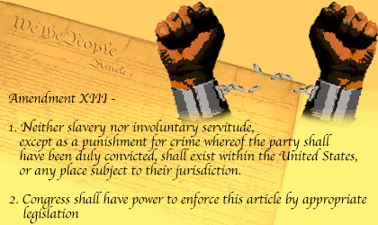
A. Thirteenth Amendment
The 13th Amendment abolished slavery, while the 14th and 15th amendments granted African Americans citizenship, equal protection under the laws, and voting rights.

Slide 31
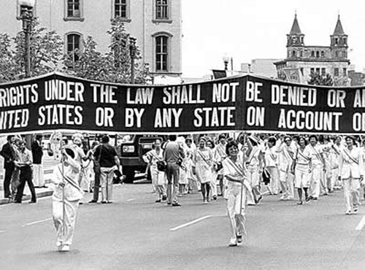
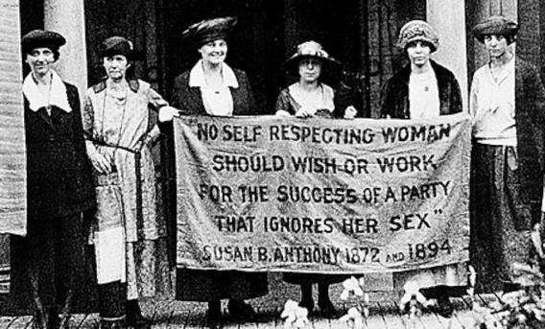
B. Women’s Rights
The women’s rights movement was both emboldened and divided over the 14th and 15th amendments to the Constitution.
NWSA vs. AWSA
Elizabeth Cady Stanton
Susan B. Anthony
Lucy Stone

Slide 32
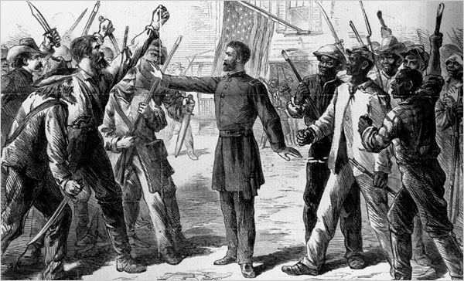
C. Reconstruction
Efforts by radical and moderate Republicans to change the balance of power between Congress and the presidency and to reorder race relations in the defeated South yielded some short-term successes.
Harper’s Weekly
An engraving depicting an agent of the Freedman’s Bureau as a peacemaker between blacks and whites after the Civil War.

Slide 33
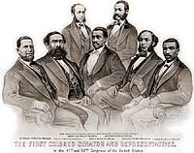
C. Reconstruction
Reconstruction opened up political opportunities and other leadership roles to former slaves, but it ultimately failed, due both to determined Southern resistance and the North’s waning resolve.
Black Codes
KKK
Presidential vs. Radical
Military reconstruction
Carpetbaggers, scalawags
Freedmen’s Bureau
Hiram Revels, Blanche K Bruce, Robert Smalls
Hiram Revels of Mississippi was elected Senator and six other African Americans were elected as Congressmen from other southern states during the Reconstruction era.

Slide 34
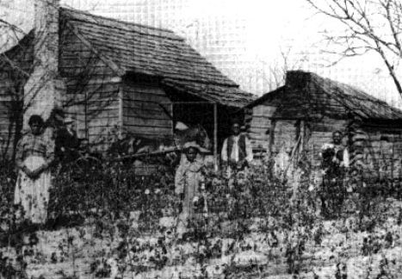
D. Sharecropping System
Southern plantation owners continued to own the majority of the region’s land even after Reconstruction. Former slaves sought land ownership but generally fell short of self-sufficiency, as an exploitative and soil-intensive sharecropping system limited blacks’ and poor whites’ access to land in the south.

Slide 35
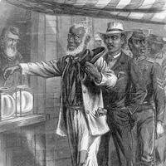
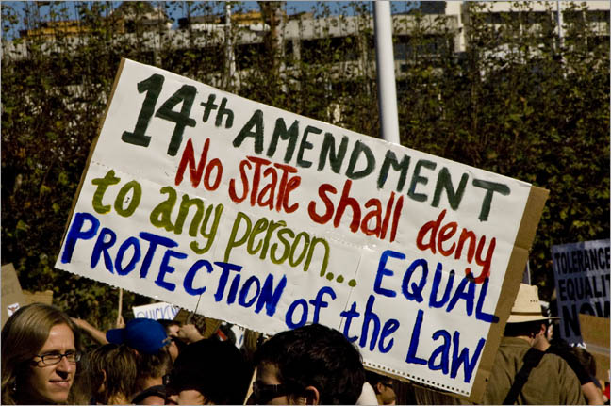
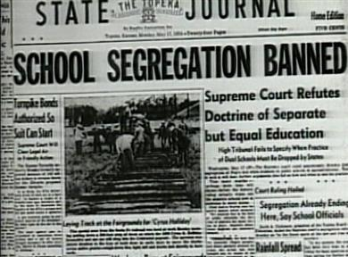
E. Failures & Successes of Reconstruction
Segregation, violence, Supreme Court decisions, and local political tactics progressively stripped away African American rights, but the 14th and 15th amendments eventually became the basis for court decisions upholding civil rights in the 20th century.

